Slide 1
QuerySet API
A QuerySet can be defined as a list containing all those objects we have created using the Django model.
QuerySets allow you to read the data from the database, filter it and order it.
query property – This property is used to get sql query of query set.
Syntax:- queryset.query

Slide 2
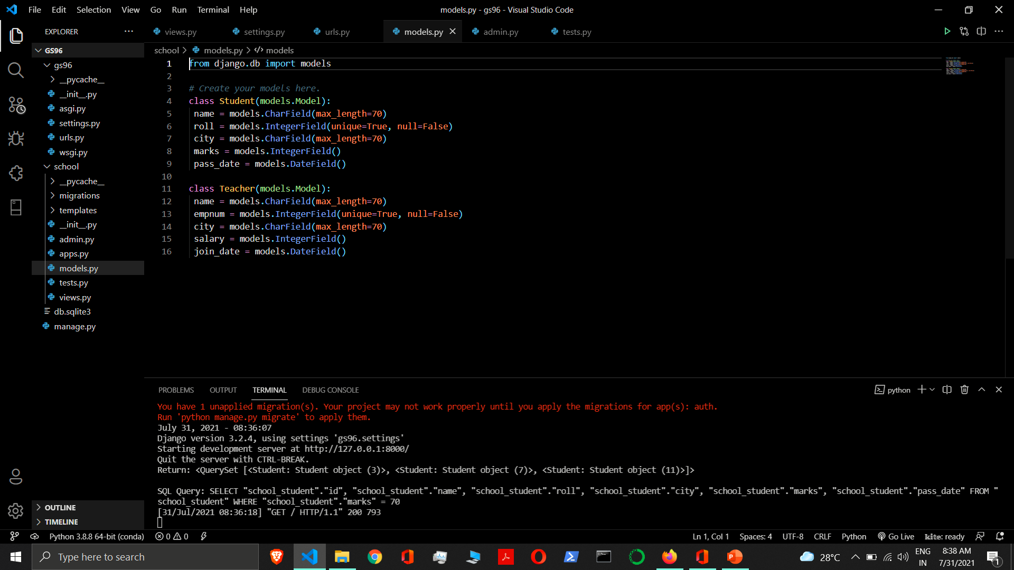

Slide 3
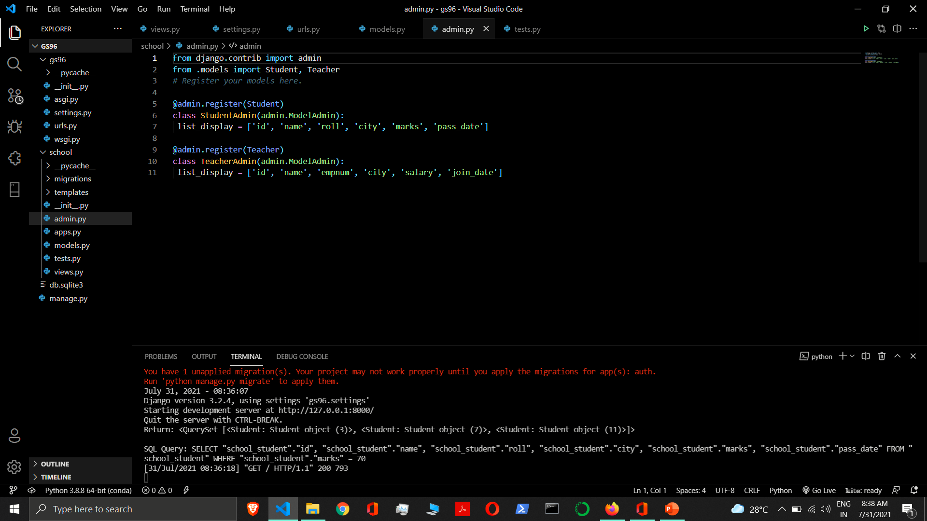

Slide 4
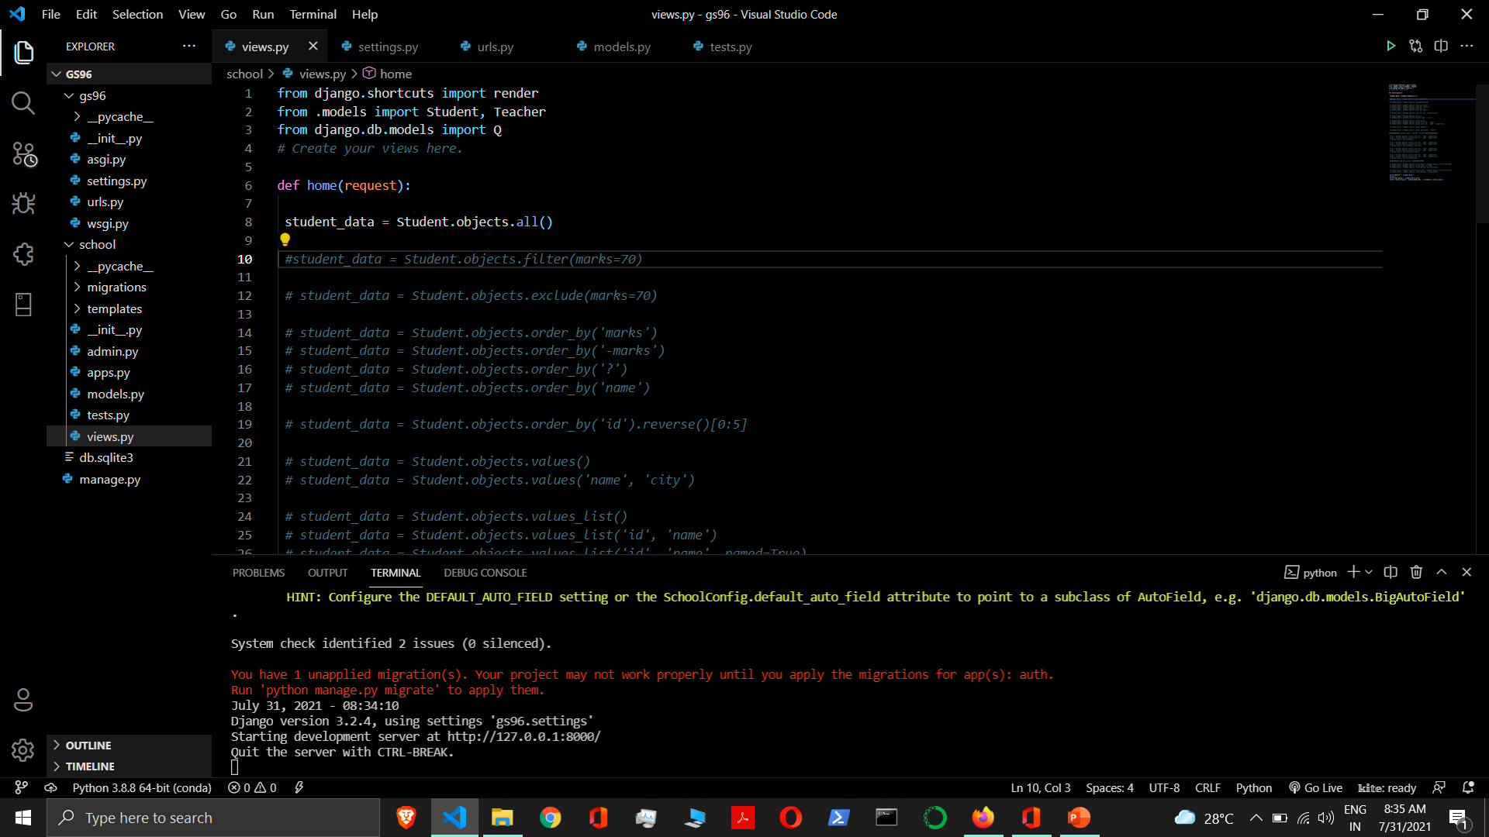
Methods that return new QuerySets
Retrieving all objects
all ( ) - This method is used to retrieve all objects. This returns a copy of current QuerySet.
Example:- Student.objects.all()
Retrieving specific objects
filter (**kwargs) - It returns a new QuerySet containing objects that match the given lookup parameters. filter() will always give you a QuerySet, even if only a single object matches the query.
Example:- Student.objects.filter(marks=70)
exclude(**kwargs) - It returns a new QuerySet containing objects that do not match the given lookup parameters.
Example:- Student.objects.exclude(marks=70)

Slide 5
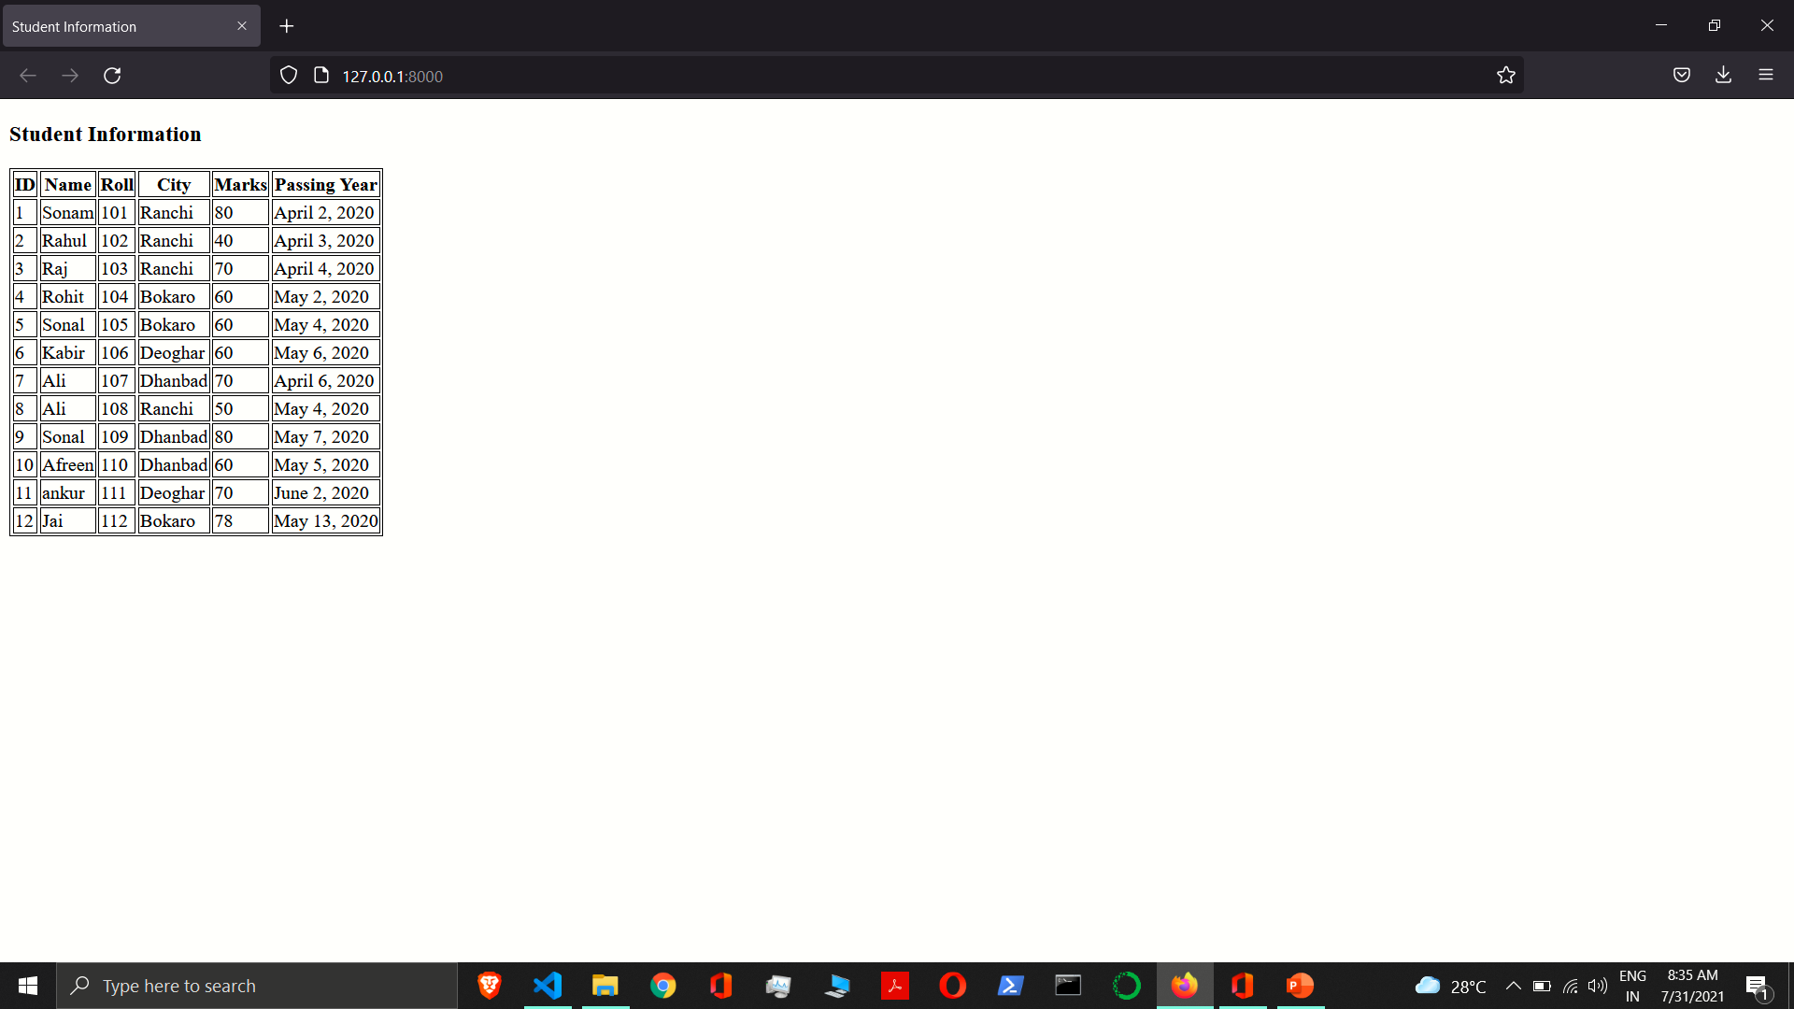

Slide 6
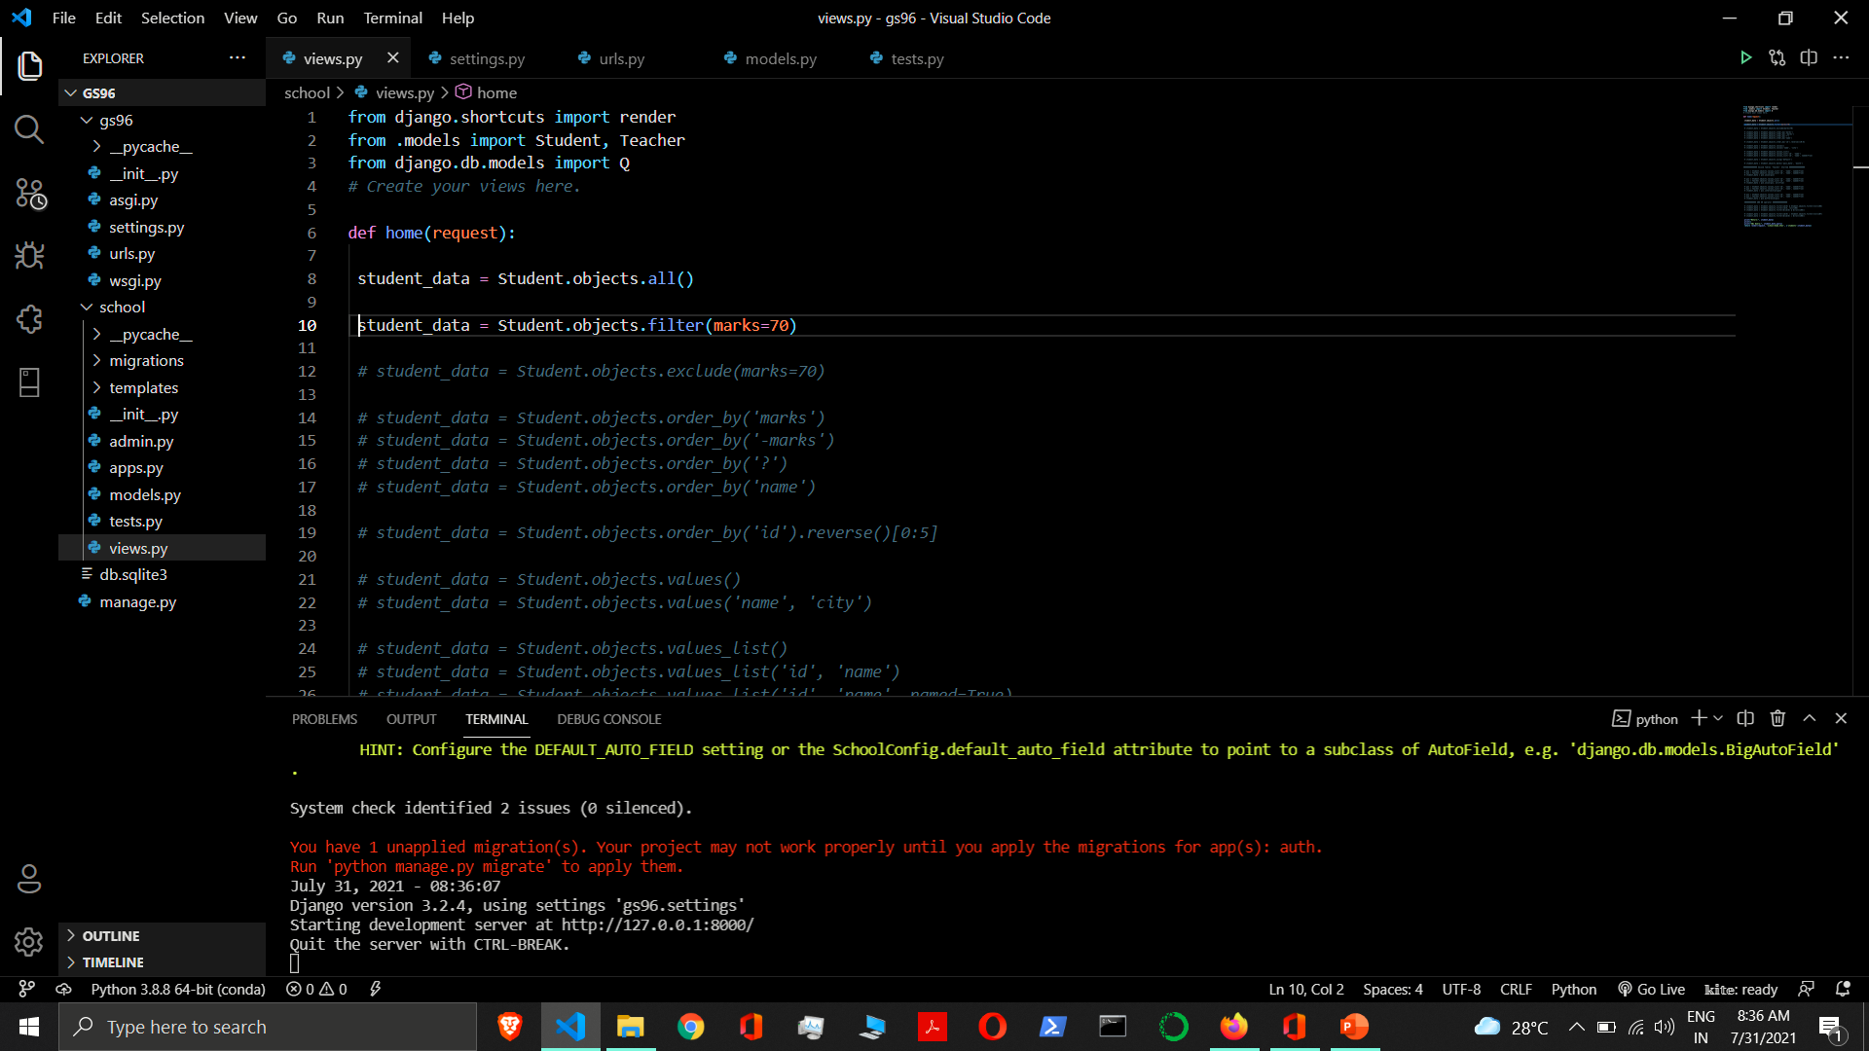

Slide 7
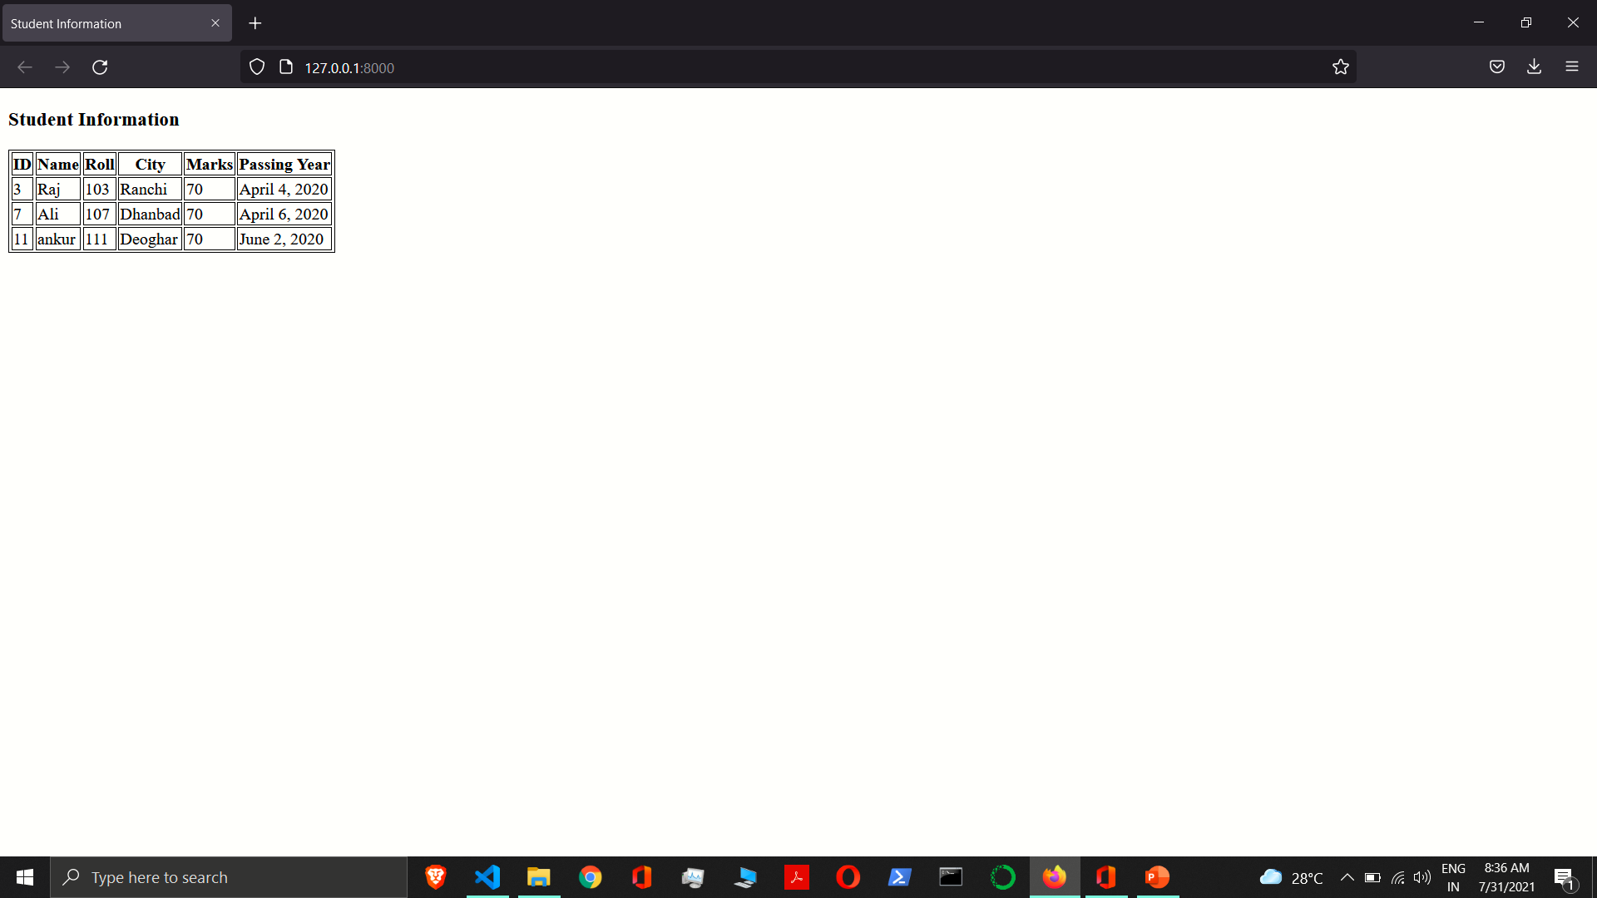

Slide 8
Methods that return new QuerySets
order_by(*fields) – It orders the fields.
‘field’ – Asc order
‘-field’ – Desc Order
‘?’ – Randomly
reverse() – This works only when there is ordering in queryset.
values(*fields, **expressions) - It returns a QuerySet that returns dictionaries, rather than model instances, when used as an iterable. Each of those dictionaries represents an object, with the keys corresponding to the attribute names of model objects.
distinct(*fields) - This eliminates duplicate rows from the query results.

Slide 9
Methods that return new QuerySets
values_list(*fields, flat=False, named=False) - This is similar to values() except that instead of returning dictionaries, it returns tuples when iterated over.
If you don’t pass any values to values_list(), it will return all the fields in the model, in the order they were declared.
If you only pass in a single field, you can also pass in the flat parameter. If True, this will mean the returned results are single values, rather than one-tuples.
You can pass named=True to get results as a namedtuple.
using(alias) - This method is for controlling which database the QuerySet will be evaluated against if you are using more than one database. The only argument this method takes is the alias of a database, as defined in DATABASES.
Example:- student_data = Student.objects.using('default')

Slide 10
Methods that return new QuerySets
dates(field, kind, order='ASC’) - It returns a QuerySet that evaluates to a list of datetime.date objects representing all available dates of a particular kind within the contents of the QuerySet.
Where,
field – It should be the name of a DateField of your model.
kind – It should be either "year", "month", "week", or "day".
"year" returns a list of all distinct year values for the field.
"month" returns a list of all distinct year/month values for the field.
"week" returns a list of all distinct year/week values for the field. All dates will be a Monday.
"day" returns a list of all distinct year/month/day values for the field.
order – It should be either 'ASC' or 'DESC'. This specifies how to order the results. defaults to 'ASC’.
Each datetime.date object in the result list is “truncated” to the given type.

Slide 11
Methods that return new QuerySets
datetimes(field_name, kind, order='ASC', tzinfo=None) – It returns a QuerySet that evaluates to a list of datetime.datetime objects representing all available dates of a particular kind within the contents of the QuerySet.
field_name – It should be the name of a DateTimeField of your model.
Kind - It should be either "year", "month", "week", or "day".
"year" returns a list of all distinct year values for the field.
"month" returns a list of all distinct year/month values for the field.
"week" returns a list of all distinct year/week values for the field. All dates will be a Monday.
"day" returns a list of all distinct year/month/day values for the field.
order – It should be either 'ASC' or 'DESC'. This specifies how to order the results. defaults to 'ASC’.
tzinfo – It defines the time zone to which datetimes are converted prior to truncation. This parameter must be a datetime.tzinfo object. If it’s None, Django uses the current time zone. It has no effect when USE_TZ is False.
Each datetime.datetime object in the result list is “truncated” to the given type.

Slide 12
Methods that return new QuerySets
none() - Calling none() will create a queryset that never returns any objects and no query will be executed when accessing the results. A qs.none() queryset is an instance of EmptyQuerySet.
Example:- student_data = Student.objects.none()
union(*other_qs, all=False) - Uses SQL’s UNION operator to combine the results of two or more QuerySets. The UNION operator selects only distinct values by default. To allow duplicate values, use the all=True argument.
Example:- student_data = qs2.union(qs1, all=True)
intersection(*other_qs) – Uses SQL’s INTERSECT operator to return the shared elements of two or more QuerySets.
Example:- student_data = qs1.intersection(qs2)
difference(*other_qs) - Uses SQL’s EXCEPT operator to keep only elements present in the QuerySet but not in some other QuerySets.
Example:- student_data = qs1.difference(qs2)

Slide 13
Methods that return new QuerySets
select_related(*fields)
defer(*fields)
only(*fields)
prefetch_related(*lookups)
extra(select=None, where=None, params=None, tables=None, order_by=None, select_params=None)
select_for_update(nowait=False, skip_locked=False, of=())
raw(raw_query, params=None, translations=None)
annotate(*args, **kwargs)

Slide 14
Operators that return new QuerySets
AND (&) - Combines two QuerySets using the SQL AND operator.
Example:-
student_data = Student.objects.filter(id=6) & Student.objects.filter(roll=106)
student_data = Student.objects.filter(id=6, roll=106)
student_data = Student.objects.filter(Q(id=6) & Q(roll=106))
OR (|) - Combines two QuerySets using the SQL OR operator.
Example:-
Student.objects.filter(id=11) | Student.objects.filter(roll=106)
Student.objects.filter(Q(id=11) | Q(roll=106))

Slide 15
Methods that do not return new QuerySets
Retrieving a single object
get ( ) - It returns one single object. If There is no result match it will raise DoesNotExist exception. If more than one item matches the get() query. It will raise MultipleObjectsReturned.
Example:- Student.objects.get(pk=1)
first() - It returns the first object matched by the queryset, or None if there is no matching object. If the QuerySet has no ordering defined, then the queryset is automatically ordered by the primary key.
Example:- student_data = Student.objects.first()
student_data = Student.objects.order_by(‘name’).first()
last() - It returns the last object matched by the queryset, or None if there is no matching object. If the QuerySet has no ordering defined, then the queryset is automatically ordered by the primary key.

Slide 16
Methods that do not return new QuerySets
latest(*fields) - It returns the latest object in the table based on the given field(s).
Example:- student_data = Student.objects.latest('pass_date')
earliest(*fields) - It returns the earliest object in the table based on the given field(s).
Example:- student_data = Student.objects.earliest('pass_date’)
exists() - It returns True if the QuerySet contains any results, and False if not. This tries to perform the query in the simplest and fastest way possible, but it does execute nearly the same query as a normal QuerySet query.
Example:-
student_data = Student.objects.all()
print(student_data.exists())

Slide 17
Methods that do not return new QuerySets
create(**kwargs) - A convenience method for creating an object and saving it all in one step.
Example:-
s = Student(name='Sameer', roll=112, city='Bokaro', marks=60, pass_date='2020-5-4')
s.save(force_insert=True)
s = Student.objects.create(name='Sameer', roll=112, city='Bokaro', marks=60, pass_date='2020-5-4’)
get_or_create(defaults=None, **kwargs) - A convenience method for looking up an object with the given kwargs (may be empty if your model has defaults for all fields), creating one if necessary.
It returns a tuple of (object, created), where object is the retrieved or created object and created is a boolean specifying whether a new object was created.
Example:-
student_data, created = Student.objects.get_or_create(name='Sameer', roll=112, city='Bokaro', marks=60, pass_date='2020-5-4')
print(student_data, created)

Slide 18
Methods that do not return new QuerySets
update(**kwargs) - Performs an SQL update query for the specified fields, and returns the number of rows matched (which may not be equal to the number of rows updated if some rows already have the new value).
Example:-
student_data = Student.objects.filter(id=12).update(name='Kabir', marks=80)
# Update student’s city Pass who has marks 60
student_data = Student.objects.filter(marks=60).update(city='Pass’)
student_data = Student.objects.get(id=12).update(name='Kabir', marks=80)

Slide 19
Methods that do not return new QuerySets
update_or_create(defaults=None, **kwargs) – A convenience method for updating an object with the given kwargs, creating a new one if necessary. The defaults is a dictionary of (field, value) pairs used to update the object. The values in defaults can be callables.
It returns a tuple of (object, created), where object is the created or updated object and created is a boolean specifying whether a new object was created.
The update_or_create method tries to fetch an object from database based on the given kwargs. If a match is found, it updates the fields passed in the defaults dictionary.
Example:-
student_data, created = Student.objects.update_or_create(id=14, name='Kohli’, defaults={'name':'Sameer'})

Slide 20
Methods that do not return new QuerySets
bulk_create(objs, batch_size=None, ignore_conflicts=False) – This method inserts the provided list of objects into the database in an efficient manner.
The model’s save() method will not be called, and the pre_save and post_save signals will not be sent.
It does not work with child models in a multi-table inheritance scenario.
If the model’s primary key is an AutoField it does not retrieve and set the primary key attribute, as save() does, unless the database backend supports it (currently PostgreSQL).
It does not work with many-to-many relationships.
It casts objs to a list, which fully evaluates objs if it’s a generator. The cast allows inspecting all objects so that any objects with a manually set primary key can be inserted first.
The batch_size parameter controls how many objects are created in a single query. The default is to create all objects in one batch, except for SQLite where the default is such that at most 999 variables per query are used.
On databases that support it (all but Oracle), setting the ignore_conflicts parameter to True tells the database to ignore failure to insert any rows that fail constraints such as duplicate unique values. Enabling this parameter disables setting the primary key on each model instance.

Slide 21
Methods that do not return new QuerySets
Example:-
objs = [
Student(name='Sonal', roll=120, city='Dhanbad', marks=40, pass_date='2020-5-4'),
Student(name='Kunal', roll=121, city='Dumka', marks=50, pass_date='2020-5-7'),
Student(name='Anisa', roll=122, city='Giridih', marks=70, pass_date='2020-5-9') ]
student_data = Student.objects.bulk_create(objs)

Slide 22
Methods that do not return new QuerySets
bulk_update(objs, fields, batch_size=None) - This method efficiently updates the given fields on the provided model instances, generally with one query. QuerySet.update() is used to save the changes, so this is more efficient than iterating through the list of models and calling save() on each of them.
You cannot update the model’s primary key.
Each model’s save() method isn’t called, and the pre_save and post_save signals aren’t sent.
If updating a large number of columns in a large number of rows, the SQL generated can be very large. Avoid this by specifying a suitable batch_size.
Updating fields defined on multi-table inheritance ancestors will incur an extra query per ancestor.
If objs contains duplicates, only the first one is updated.
The batch_size parameter controls how many objects are saved in a single query. The default is to update all objects in one batch, except for SQLite and Oracle which have restrictions on the number of variables used in a query.
Example:-
all_student_data = Student.objects.all()
for stu in all_student_data:
stu.city = 'Bhel'
student_data = Student.objects.bulk_update(all_student_data, ['city'])

Slide 23
Methods that do not return new QuerySets
in_bulk(id_list=None, field_name='pk’) – It takes a list of field values (id_list) and the field_name for those values, and returns a dictionary mapping each value to an instance of the object with the given field value. If id_list isn’t provided, all objects in the queryset are returned. field_name must be a unique field, and it defaults to the primary key.
Example:-
student_data = Student.objects.in_bulk([1, 2])
print(student_data[1].name)
print()
student_data1 = Student.objects.in_bulk([])
print(student_data1)
print()
student_data2 = Student.objects.in_bulk()
print(student_data2)
print()

Slide 24
Methods that do not return new QuerySets
delete() - The delete method, conveniently, is named delete(). This method immediately deletes the object and returns the number of objects deleted and a dictionary with the number of deletions per object type.
Example:-
Delete One Record
student_data = Student.objects.get(pk=22)
deleted = student_data.delete()
Delete in Bulk
You can also delete objects in bulk. Every QuerySet has a delete() method, which deletes all members of that QuerySet.
Example:- student_data = Student.objects.filter(marks=50).delete()
Delete All Records
Example:- student_data = Student.objects.all().delete()

Slide 25
Methods that do not return new QuerySets
count() - It returns an integer representing the number of objects in the database matching the QuerySet. A count() call performs a SELECT COUNT(*) behind the scenes.
Example:-
student_data = Student.objects.all()
print(student_data.count())
explain(format=None, **options) – It returns a string of the QuerySet’s execution plan, which details how the database would execute the query, including any indexes or joins that would be used. Knowing these details may help you improve the performance of slow queries. explain() is supported by all built-in database backends except Oracle because an implementation there isn’t straightforward. The format parameter changes the output format from the databases’s default, usually text-based. PostgreSQL supports 'TEXT', 'JSON', 'YAML', and 'XML'. MySQL supports 'TEXT' (also called 'TRADITIONAL') and 'JSON'.
Example:- print(Student.objects.all().explain())

Slide 26
Methods that do not return new QuerySets
aggregate(*args, **kwargs)
as_manager()
iterator(chunk_size=2000)

Slide 27
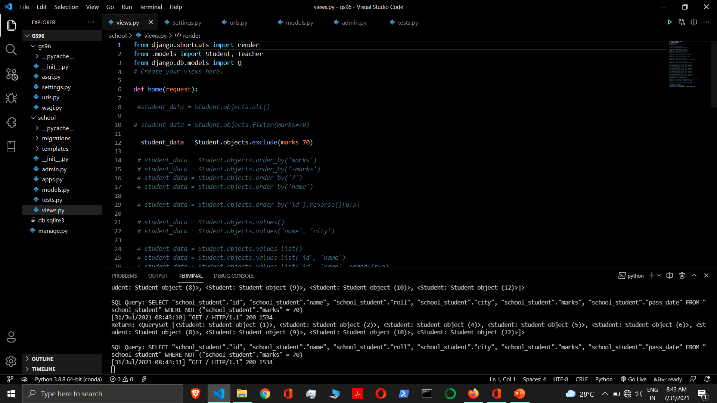

Slide 28
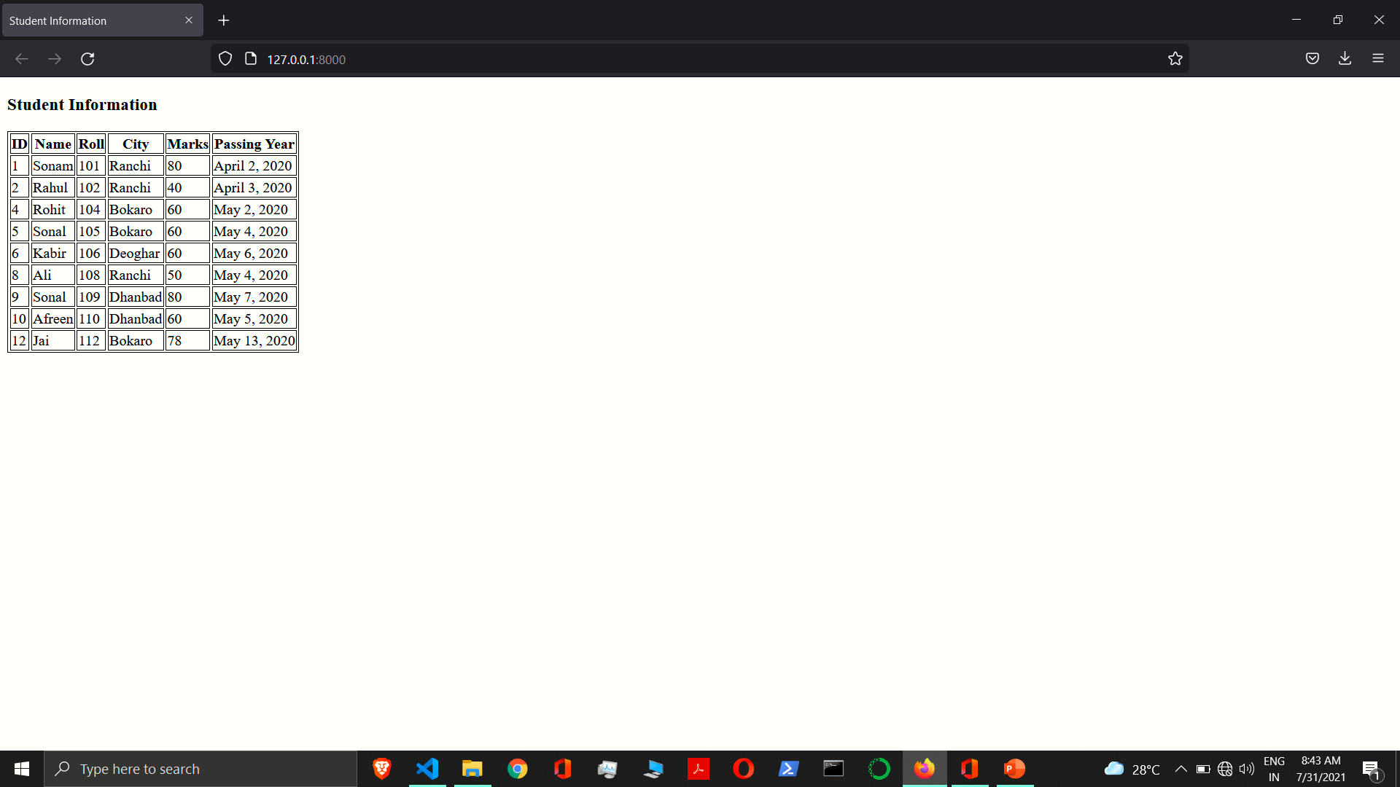

Slide 29
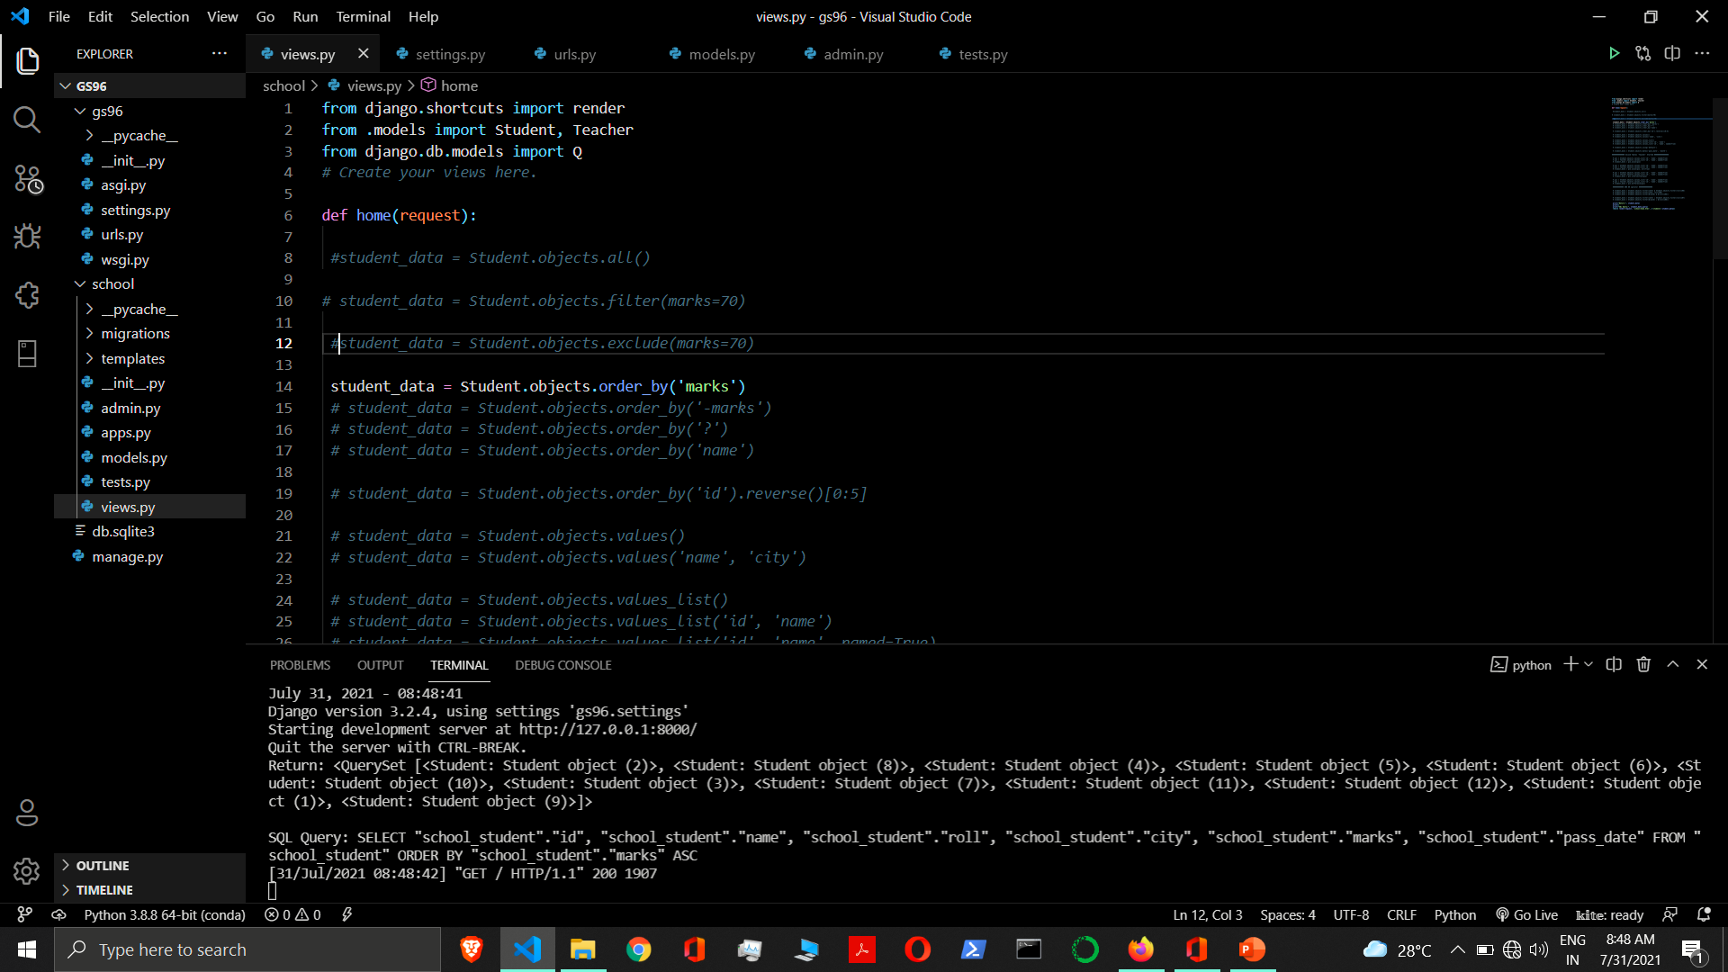

Slide 30
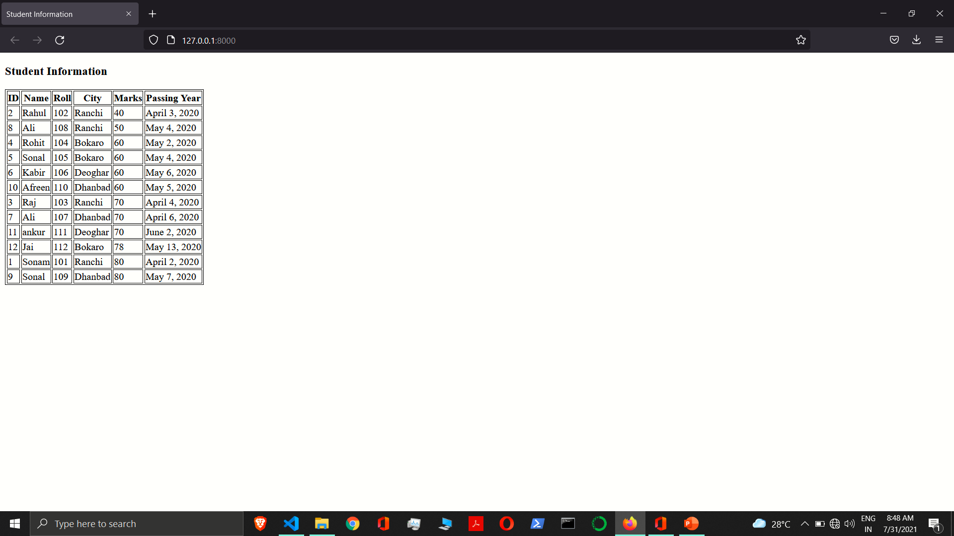

Slide 31


Slide 32


Slide 33
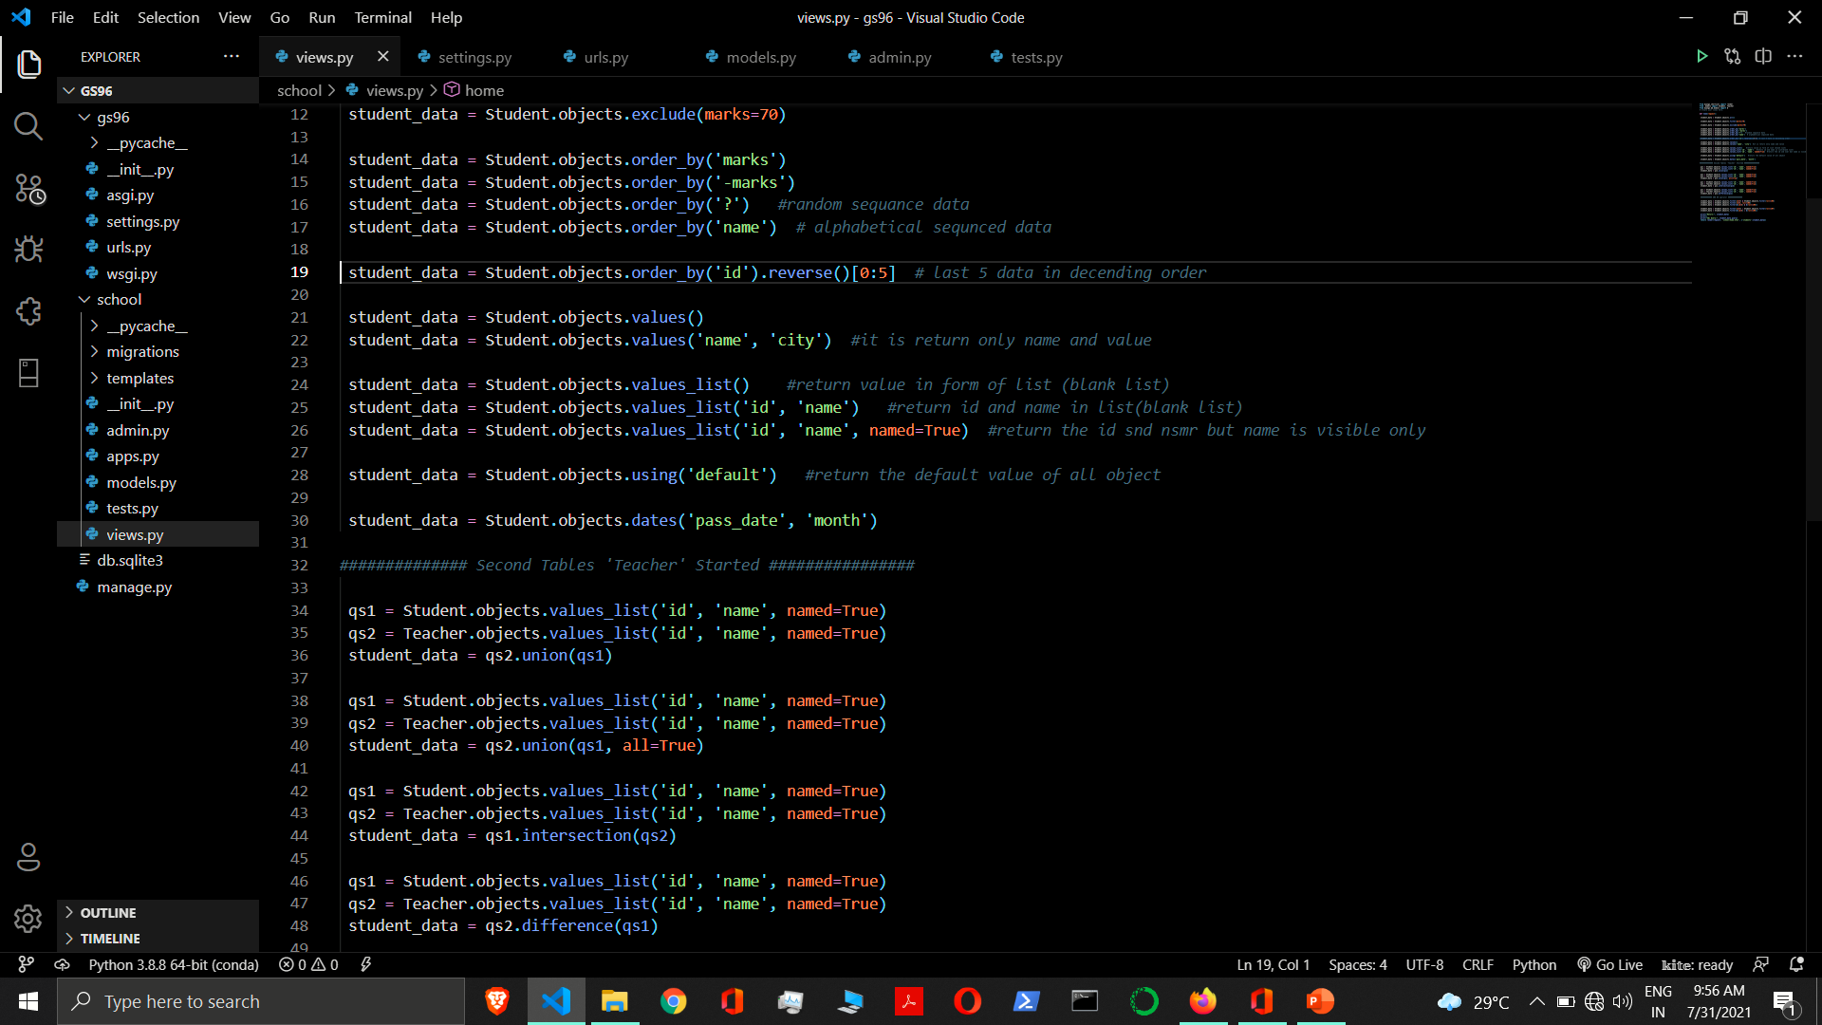

Slide 34
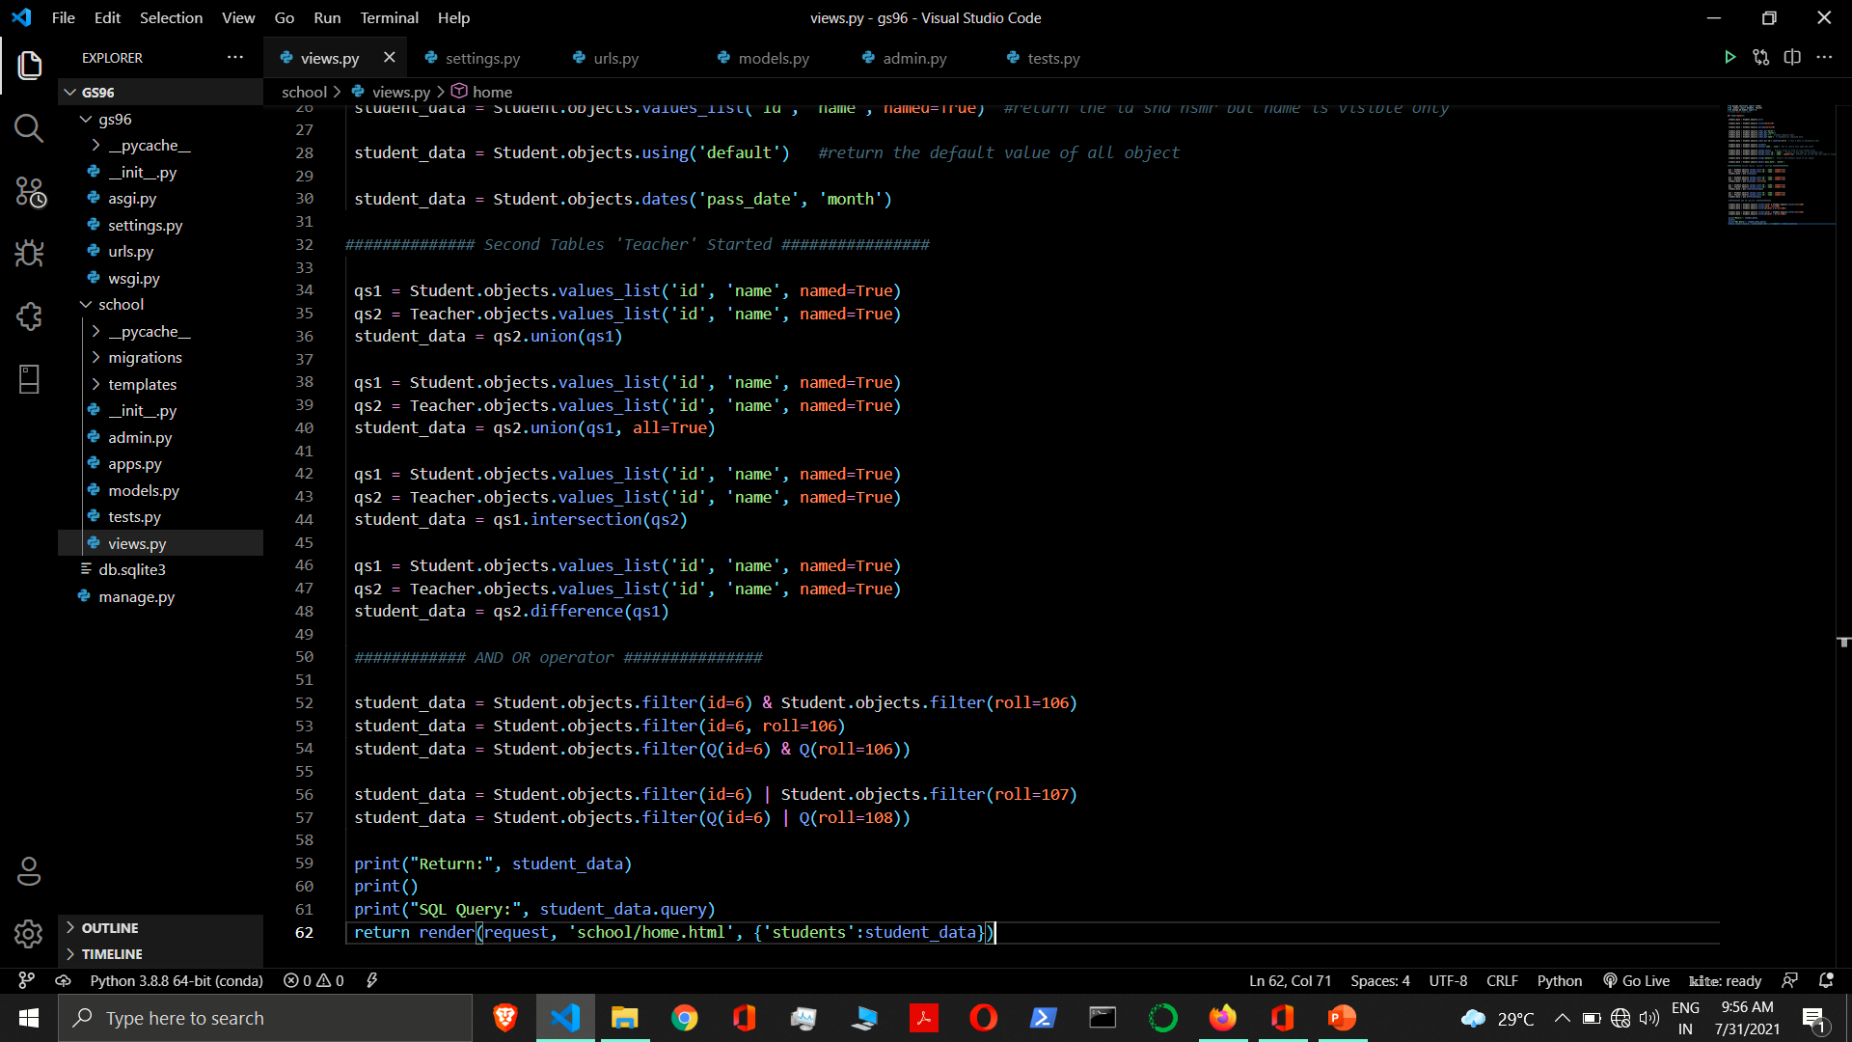

Slide 35
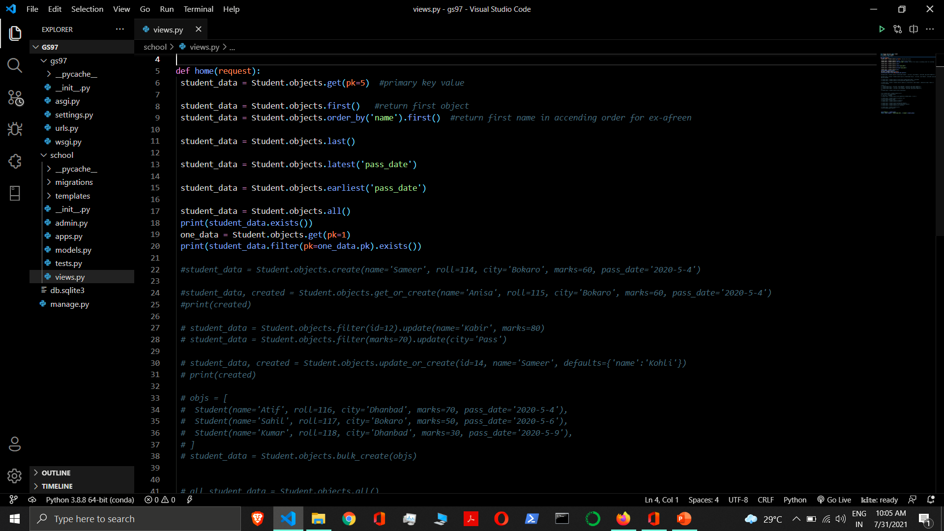

Slide 36
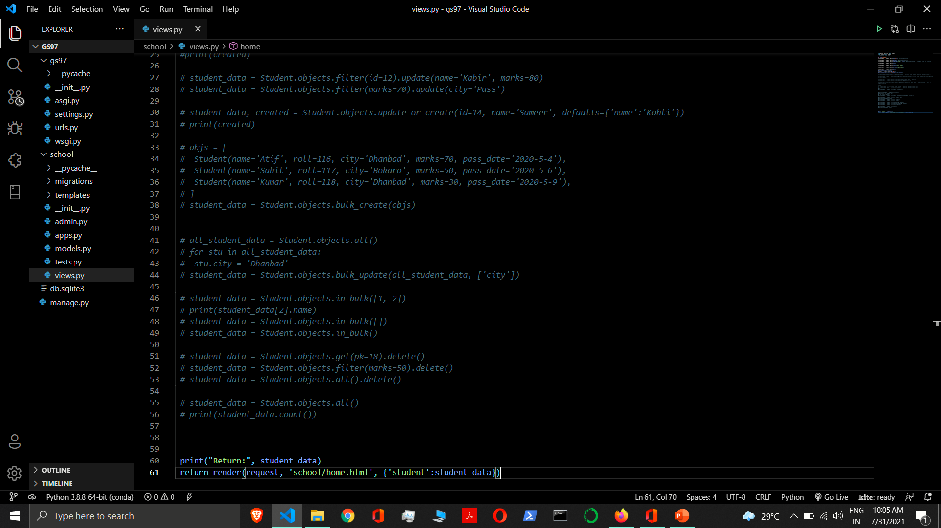

Slide 37
Field Lookups
Field lookups are how you specify the meet of an SQL WHERE clause.
They’re specified as keyword arguments to the QuerySet methods filter(), exclude() and get().
If you pass an invalid keyword argument, a lookup function will raise TypeError.
Syntax:- field__lookuptype=value
Example:- Student.objects.filter(marks__lt=‘50’)
SELECT * FROM myapp_student WHERE marks < ’50’;
The field specified in a lookup has to be the name of a model field.
In case of a ForeignKey you can specify the field name suffixed with _id. In this case, the value parameter is expected to contain the raw value of the foreign model’s primary key.
Example:- Student.objects.filter(stu_id=10)

Slide 38
Field Lookups
exact - Exact match. If the value provided for comparison is None, it will be interpreted as an SQL NULL. This is case sensitive
Example:- Student.objects.get(name__exact='sonam')
iexact - Exact match. If the value provided for comparison is None, it will be interpreted as an SQL NULL. This is case insensitive
Example:- Student.objects.get(name__iexact='sonam')
contains - Case-sensitive containment test.
Example:- Student.objects.get(name__contains='kumar')
icontains - Case-insensitive containment test.
Example:- Student.objects.get(name__icontains='kumar’)
in - In a given iterable; often a list, tuple, or queryset. It’s not a common use case, but strings (being iterables) are accepted.
Example:- Student.objects.filter(id__in=[1, 5, 7])

Slide 39
Field Lookups
gt - Greater than.
Example: - Student.objects.filter(marks__gt=50)
gte - Greater than or equal to.
Example: - Student.objects.filter(marks__gte=50)
lt - Less than.
Example: - Student.objects.filter(marks__lt=50)
lte - Less than or equal to.
Example: - Student.objects.filter(marks__lte=50)

Slide 40
Field Lookups
startswith - Case-sensitive starts-with.
Example: - Student.objects.filter(name__startswith='r')
istartswith - Case-insensitive starts-with.
Example: - Student.objects.filter(name__istartswith='r')
endswith - Case-sensitive ends-with.
Example:- Student.objects.filter(name__endswith='j')
iendswith - Case-insensitive ends-with.
Example:- Student.objects.filter(name__iendswith='j’)

Slide 41
Field Lookups
range - Range test (inclusive).
Example:- Student.objects.filter(passdate__range=('2020-04-01', '2020-05-05'))
SQL: - SELECT ... WHERE admission_date BETWEEN '2020-04-01' and '2020-05-05';
You can use range anywhere you can use BETWEEN in SQL — for dates, numbers and even characters.
date - For datetime fields, casts the value as date. Allows chaining additional field lookups. Takes a date value.
Example:-
Student.objects.filter(admdatetime__date=date(2020, 6, 5))
Student.objects.filter(admdatetime__date__gt=date(2020, 6, 5))
year - For date and datetime fields, an exact year match. Allows chaining additional field lookups. Takes an integer year.
Example:-
Student.objects.filter(passdate__year=2020)
Student.objects.filter(passdate__year__gt=2019)

Slide 42
Field Lookups
month - For date and datetime fields, an exact month match. Allows chaining additional field lookups. Takes an integer 1 (January) through 12 (December).
Example:-
Student.objects.filter(passdate__month=6)
Student.objects.filter(passdate__month__gt=5)
day - For date and datetime fields, an exact day match. Allows chaining additional field lookups. Takes an integer day.
Example:-
Student.objects.filter(passdate__day=5)
Student.objects.filter(passdate__day__gt=3)
This will match any record with a pub_date on the third day of the month, such as January 3, July 3, etc.

Slide 43
Field Lookups
week - For date and datetime fields, return the week number (1-52 or 53) according to ISO-8601, i.e., weeks start on a Monday and the first week contains the year’s first Thursday.
Example:-
Student.objects.filter(passdate__week=23)
Student.objects.filter(passdate__week__gt=22)
week_day - For date and datetime fields, a ‘day of the week’ match. Allows chaining additional field lookups.
Takes an integer value representing the day of week from 1 (Sunday) to 7 (Saturday).
Example:-
Student.objects.filter(passdate__week_day=6)
Student.objects.filter(passdate__week_day__gt=5)
This will match any record with a admission_date that falls on a Monday (day 2 of the week), regardless of the month or year in which it occurs. Week days are indexed with day 1 being Sunday and day 7 being Saturday.

Slide 44
Field Lookups
quarter - For date and datetime fields, a ‘quarter of the year’ match. Allows chaining additional field lookups. Takes an integer value between 1 and 4 representing the quarter of the year.
Example to retrieve entries in the second quarter (April 1 to June 30):
Student.objects.filter(passdate__quarter=2)
time - For datetime fields, casts the value as time. Allows chaining additional field lookups. Takes a datetime.time value.
Example:- Student.objects.filter(admdatetime__time__gt=time(6,00))
hour - For datetime and time fields, an exact hour match. Allows chaining additional field lookups. Takes an integer between 0 and 23.
Example:- Student.objects.filter(admdatetime__hour__gt=5)

Slide 45
Field Lookups
minute - For datetime and time fields, an exact minute match. Allows chaining additional field lookups. Takes an integer between 0 and 59.
Example:- Student.objects.filter(admdatetime__minute__gt=50)
second - For datetime and time fields, an exact second match. Allows chaining additional field lookups. Takes an integer between 0 and 59.
Example:- Student.objects.filter(admdatetime__second__gt=30)
isnull - Takes either True or False, which correspond to SQL queries of IS NULL and IS NOT NULL, respectively.
Example:- Student.objects.filter(roll__isnull=False)
regex
iregex

Slide 46
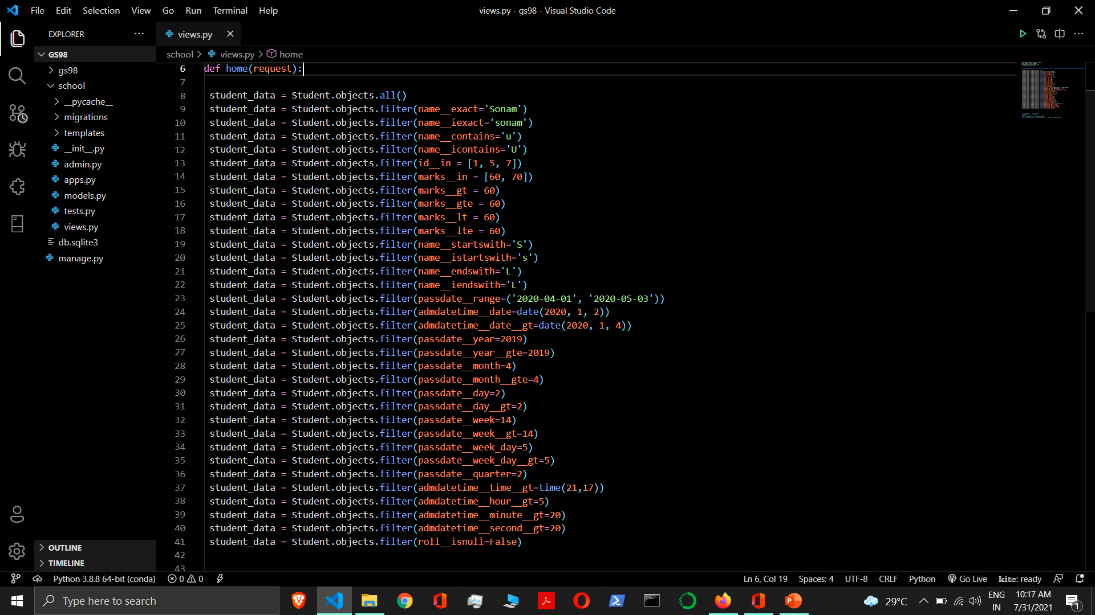

Slide 47
Aggregation
sometimes you will need to retrieve values that are derived by summarizing or aggregating a collection of objects.
aggregate() - It is a terminal clause for a QuerySet that, when invoked, returns a dictionary of name-value pairs. The name is an identifier for the aggregate value; the value is the computed aggregate. The name is automatically generated from the name of the field and the aggregate function.
Syntax:- aggregate(name=agg_function(‘field’), name=agg_function(‘field’),)
field - It describes the aggregate value that we want to compute.
name - If you want to manually specify a name for the aggregate value, you can do so by providing that name when you specify the aggregate clause.
annotate() - Per-object summaries can be generated using the annotate() clause. When an annotate() clause is specified, each object in the QuerySet will be annotated with the specified values. The output of the annotate() clause is a QuerySet; this QuerySet can be modified using any other QuerySet operation, including filter(), order_by(), or even additional calls to annotate().
Syntax:- annotate(name=agg_function(‘field’), name=agg_function(‘field’),)

Slide 48
Aggregation Functions
Django provides the following aggregation functions in the django.db.models module.
Avg(expression, output_field=None, distinct=False, filter=None, **extra) - It returns the mean value of the given expression, which must be numeric unless you specify a different output_field.
Default alias: <field>__avg
Return type: float if input is int, otherwise same as input field, or output_field if supplied
Has one optional argument:
distinct - If distinct=True, Avg returns the mean value of unique values. This is the SQL equivalent of AVG(DISTINCT <field>). The default value is False.
Count(expression, distinct=False, filter=None, **extra) - It returns the number of objects that are related through the provided expression.
Default alias: <field>__count
Return type: int
Has one optional argument:
distinct - If distinct=True, the count will only include unique instances. This is the SQL equivalent of COUNT(DISTINCT <field>). The default value is False.

Slide 49
Aggregation Functions
Max(expression, output_field=None, filter=None, **extra)- It returns the maximum value of the given expression.
Default alias: <field>__max
Return type: same as input field, or output_field if supplied
Min(expression, output_field=None, filter=None, **extra) - It returns the minimum value of the given expression.
Default alias: <field>__min
Return type: same as input field, or output_field if supplied
Sum(expression, output_field=None, distinct=False, filter=None, **extra) - It computes the sum of all values of the given expression.
Default alias: <field>__sum
Return type: same as input field, or output_field if supplied
Has one optional argument:
distinct - If distinct=True, Sum returns the sum of unique values. This is the SQL equivalent of SUM(DISTINCT <field>). The default value is False.

Slide 50
Aggregation Functions
StdDev(expression, output_field=None, sample=False, filter=None, **extra) - It returns the standard deviation of the data in the provided expression.
Default alias: <field>__stddev
Return type: float if input is int, otherwise same as input field, or output_field if supplied
Has one optional argument:
sample - By default, StdDev returns the population standard deviation. However, if sample=True, the return value will be the sample standard deviation.
Variance(expression, output_field=None, sample=False, filter=None, **extra) - It returns the variance of the data in the provided expression.
Default alias: <field>__variance
Return type: float if input is int, otherwise same as input field, or output_field if supplied
Has one optional argument:
sample - By default, Variance returns the population variance. However, if sample=True, the return value will be the sample variance.

Slide 51
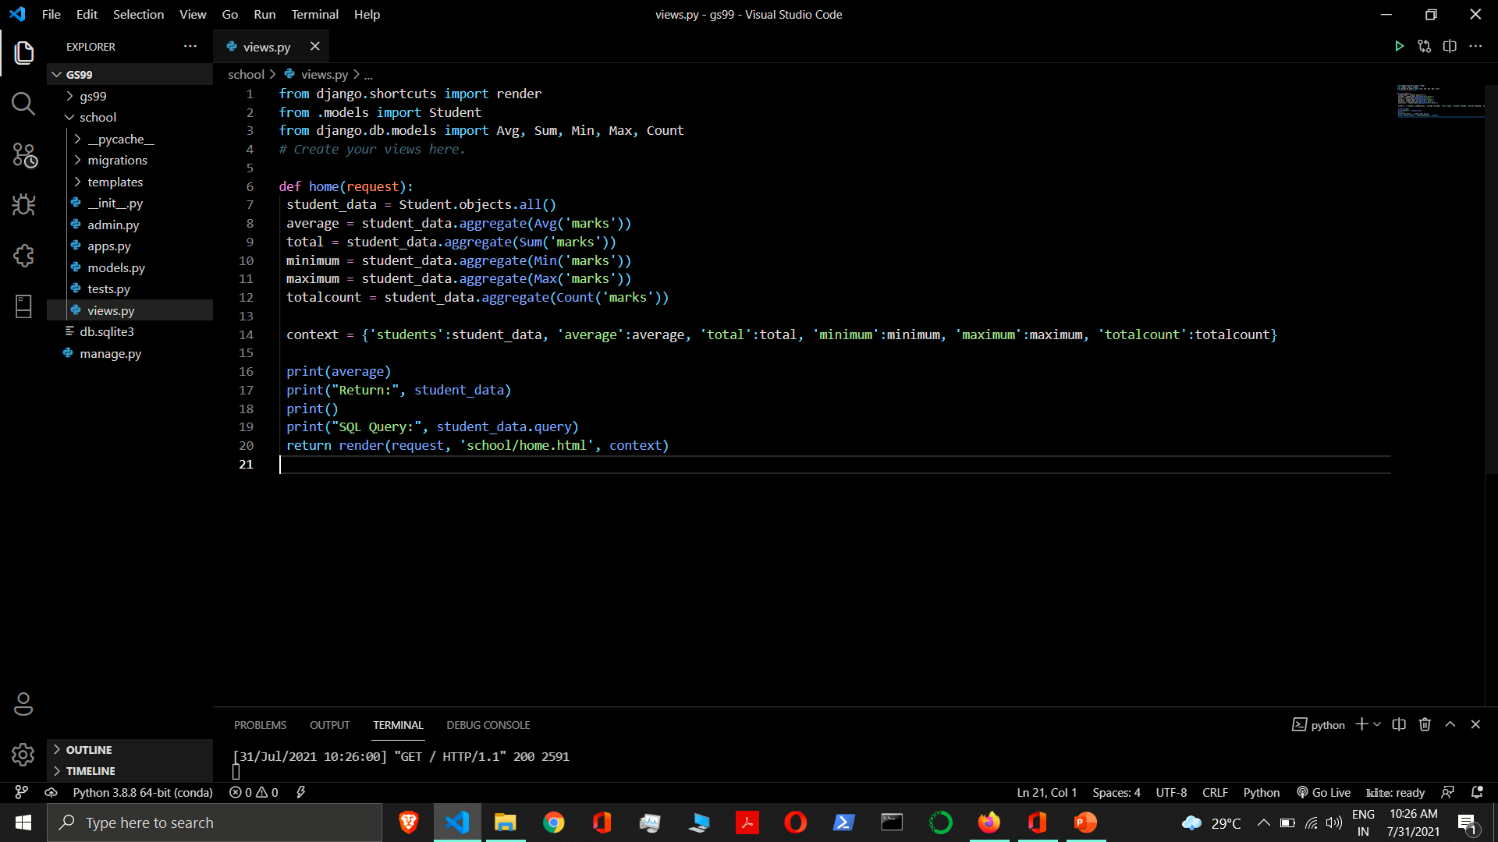

Slide 52
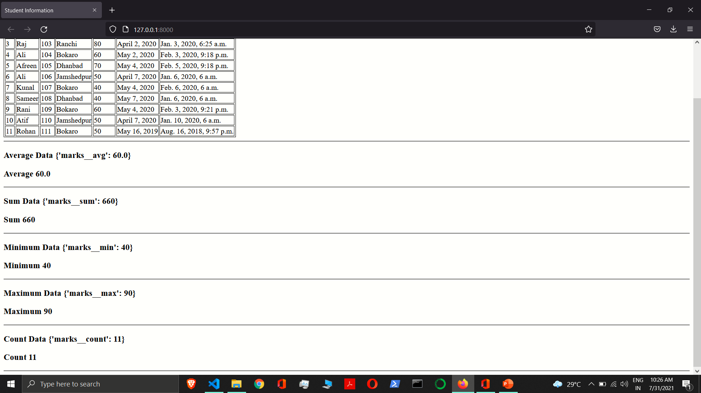

Slide 53
Q Objects
Q object is an object used to encapsulate a collection of keyword arguments. These keyword arguments are specified as in “Field lookups” .
If you need to execute more complex queries, you can use Q objects.
Q objects can be combined using the & and | operators. When an operator is used on two Q objects, it yields a new Q object.
from django.db.models import Q
& (AND) Operator
Example:- Student.objects.filter(Q(id=6) & Q(roll=106))
| (OR) Operator
Example:- Student.objects.filter(Q(id=6) | Q(roll=108))
~ Negation Operator
Example:- Student.objects.filter(~Q(id=6))

Slide 55
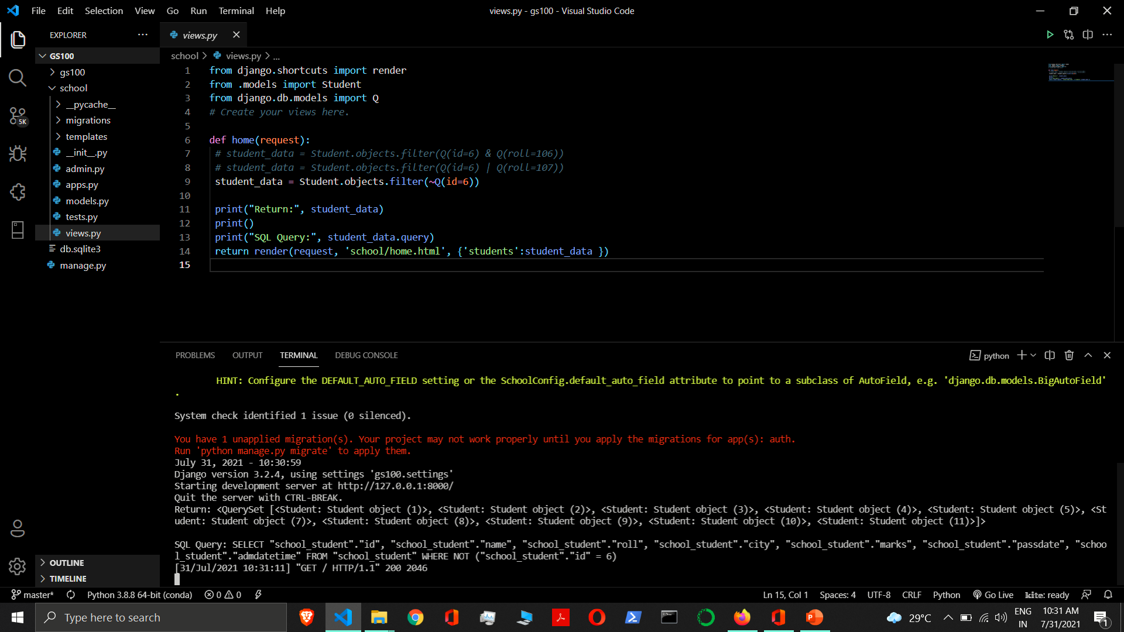

Slide 56
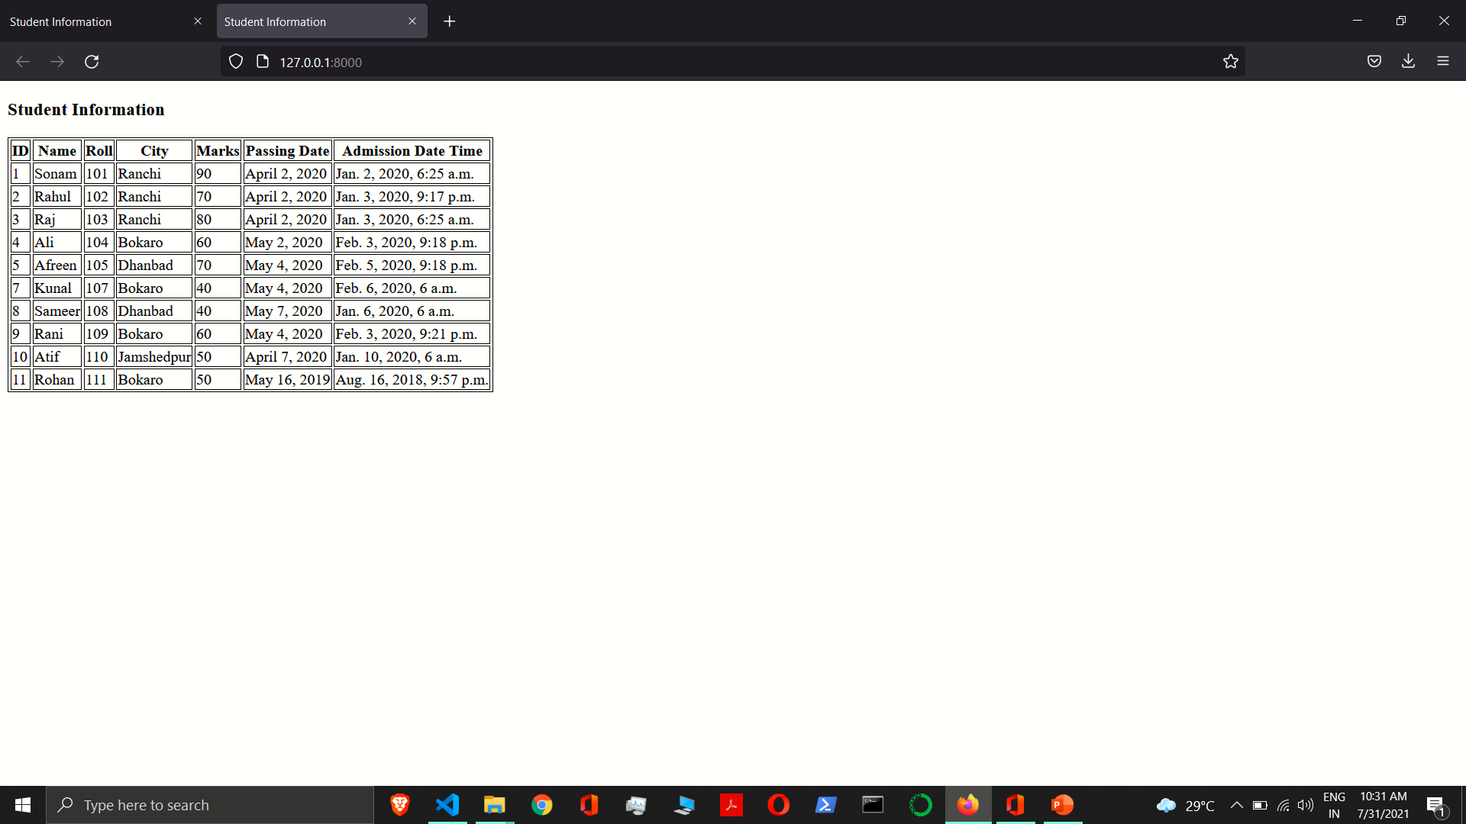

Slide 57
Limiting QuerySets
Use a subset of Python’s array-slicing syntax to limit your QuerySet to a certain number of results. This is the equivalent of SQL’s LIMIT and OFFSET clauses.
Student.objects.all()[:5] - This returns First 5 objects
Student.objects.all()[5:10] - This returns sixth through tenth objects
Student.objects.all()[-1] - This is not valid.
Student.objects.all()[:10:2] - This returns a list of every second object of the first 10.

Slide 58
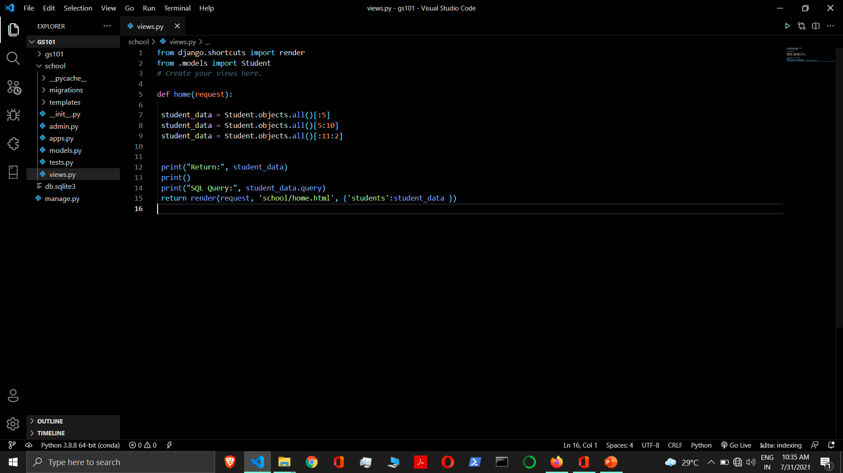

Slide 59
Model Inheritance
Model inheritance in Django works almost identically to the way normal class inheritance works in Python. The base class should subclass django.db.models.Model.
Abstract Base Classes
Multi-table Inheritance
Proxy Models

Slide 60
Abstract Base Classes
Abstract base classes are useful when you want to put some common information into a number of other models.
You write your base class and put abstract=True in the Meta class.
This model will then not be used to create any database table. Instead, when it is used as a base class for other models, its fields will be added to those of the child class.
It does not generate a database table or have a manager, and cannot be instantiated or saved directly.
Fields inherited from abstract base classes can be overridden with another field or value, or be removed with None.

Slide 61
Abstract Base Classes
from django.db import models
class CommonInfo(models.Model):
name = models.CharField(max_length=70)
age = models.IntegerField()
class Meta:
abstract = True
class Student(CommonInfo):
fees = models.IntegerField()
class Teacher(CommonInfo):
salary = models.IntegerField()

Slide 62
Abstract Base Classes
Meta Inheritance - When an abstract base class is created, Django makes any Meta inner class you declared in the base class available as an attribute.
If a child class does not declare its own Meta class, it will inherit the parent’s Meta.
If the child wants to extend the parent’s Meta class, it can subclass it.
Django does make one adjustment to the Meta class of an abstract base class: before installing the Meta attribute, it sets abstract=False.
This means that children of abstract base classes don’t automatically become abstract classes themselves.
You can make an abstract base class that inherits from another abstract base class. You just need to remember to explicitly set abstract=True each time.

Slide 63
Abstract Base Classes
from django.db import models
class CommonInfo(models.Model):
name = models.CharField(max_length=70)
age = models.IntegerField()
class Meta:
abstract = True
class Student(CommonInfo):
fees = models.IntegerField()
class Meta:
abstract = False

Slide 64
Abstract Base Classes
When you are using related_name or related_query_name in an abstract base class (only), part of the value should contain '%(app_label)s' and '%(class)s'.
'%(class)s' is replaced by the lowercased name of the child class that the field is used in.
'%(app_label)s' is replaced by the lowercased name of the app the child class is contained within. Each installed application name must be unique and the model class names within each app must also be unique, therefore the resulting name will end up being different.
from django.db import models
class Base(models.Model):
m2m = models.ManyToManyField(
OtherModel,
related_name="%(app_label)s_%(class)s_related",
related_query_name="%(app_label)s_%(class)ss",
)
class Meta:
abstract = True
class ChildA(Base):
pass
class ChildB(Base):
pass

Slide 65
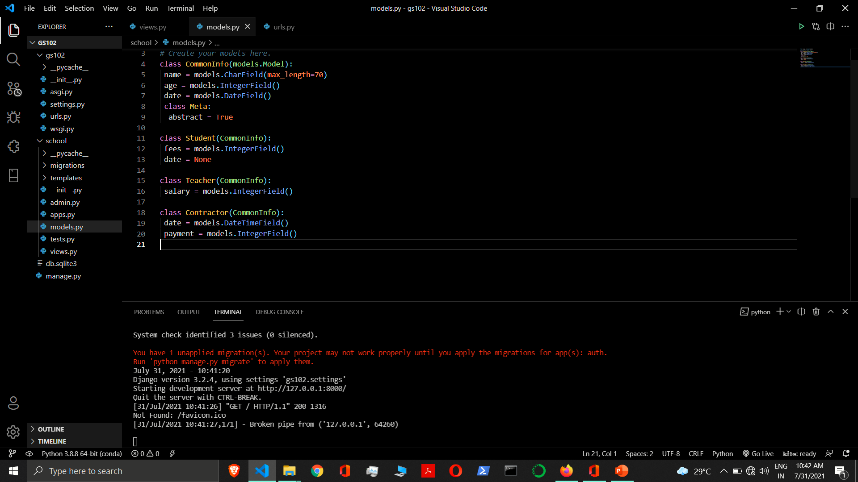

Slide 66
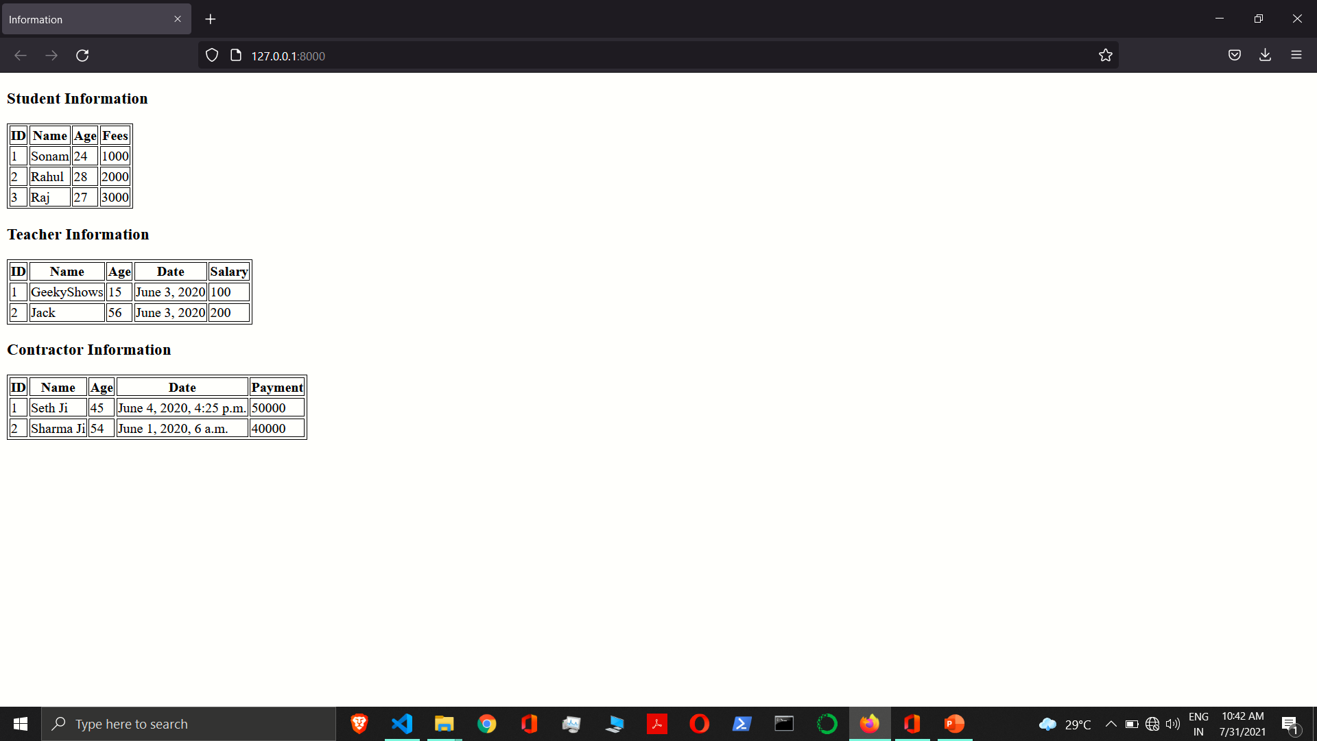

Slide 67
Multi-table Inheritance
In this inheritance each model have their own database table, which means base class and child class will have their own table.
The inheritance relationship introduces links between the child model and each of its parents (via an automatically-created OneToOneField).
from django.db import models
class ExamCenter(models.Model):
cname = models.CharField(max_length=70)
city = models.CharField(max_length=70)
class Student(ExamCenter):
name = models.CharField(max_length=70)
roll = models.IntegerField()
All of the fields of ExamCenter will also be available in Student, although the data will reside in a different database table.

Slide 68
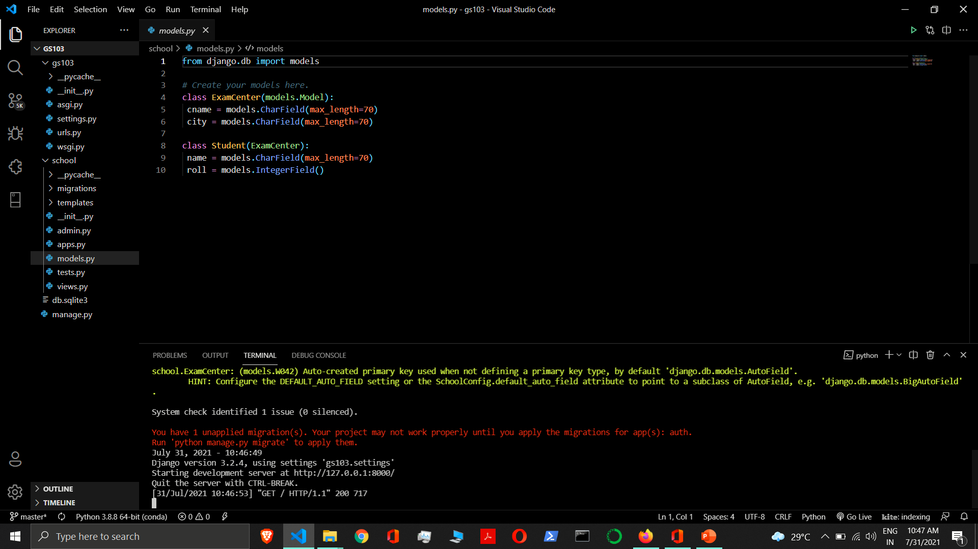

Slide 69
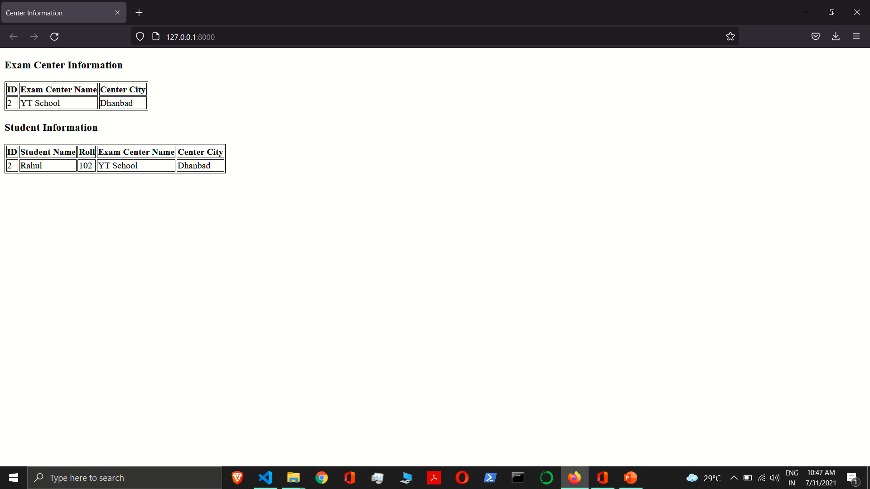

Slide 70
Proxy Model
Sometimes, however, you only want to change the Python behavior of a model – perhaps to change the default manager, or add a new method.
This is what proxy model inheritance is for: creating a proxy for the original model. You can create, delete and update instances of the proxy model and all the data will be saved as if you were using the original (non-proxied) model. The difference is that you can change things like the default model ordering or the default manager in the proxy, without having to alter the original.
Proxy models are declared like normal models. You tell Django that it’s a proxy model by setting the proxy attribute of the Meta class to True.

Slide 71
Proxy Model
from django.db import models
class ExamCenter(models.Model):
cname = models.CharField(max_length=70)
city = models.CharField(max_length=70)
class MyExamCenter(ExamCenter):
class Meta:
proxy = True
ordering = ['city']
def do_something(self):
pass
class MySome(ExamCenter):
objects = NewManager()
class Meta:
proxy = True

Slide 72
Proxy Model
A proxy model must inherit from exactly one non-abstract model class.
You can’t inherit from multiple non-abstract models as the proxy model doesn’t provide any connection between the rows in the different database tables.
A proxy model can inherit from any number of abstract model classes, providing they do not define any model fields.
A proxy model may also inherit from any number of proxy models that share a common non-abstract parent class.
If you don’t specify any model managers on a proxy model, it inherits the managers from its model parents.
If you define a manager on the proxy model, it will become the default, although any managers defined on the parent classes will still be available.

Slide 73
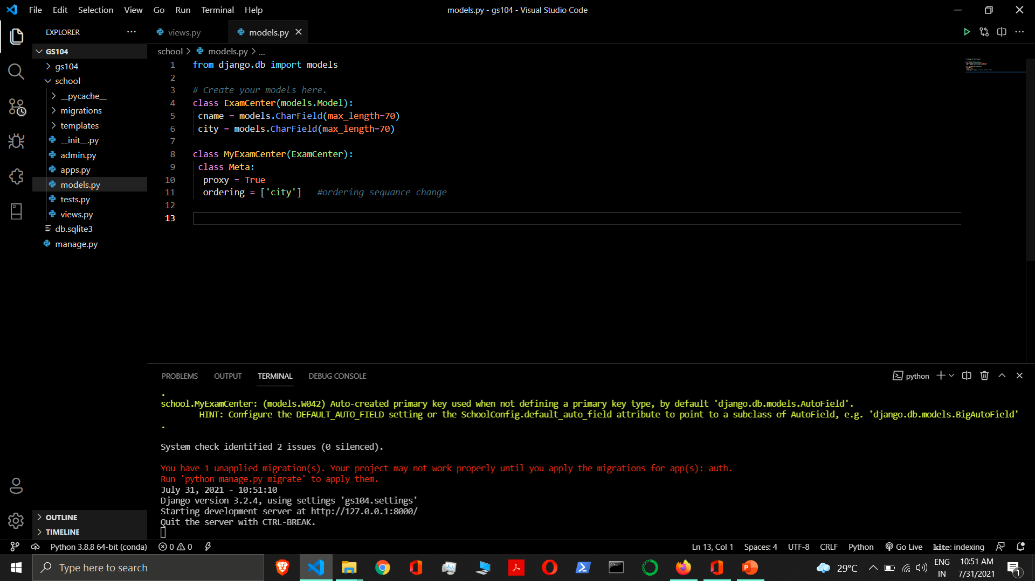

Slide 74
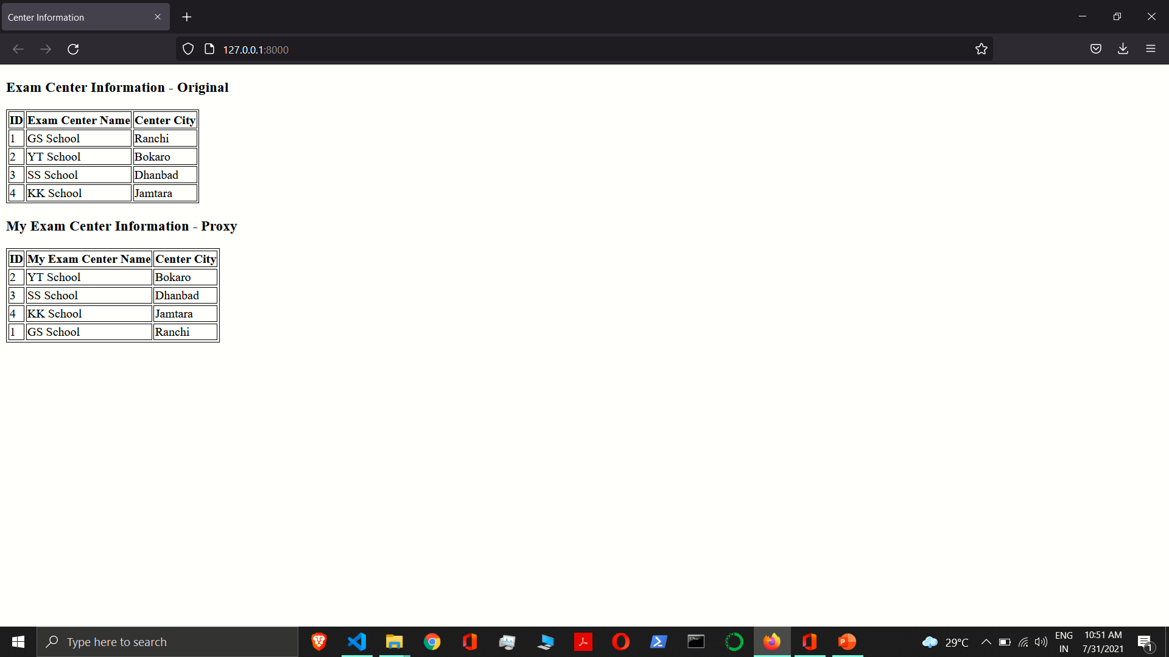

Slide 75
Model Manager
A Manager is the interface through which database query operations are provided to Django models. At least one Manager exists for every model in a Django application.
Model manager is used to interact with database.
By default, Django adds a Manager with the name objects to every Django model class.
django.db.models.manager.Manager

Slide 76
Change Manager Name
By default, Django adds a Manager with the name objects to every Django model class. However, if you want to use objects as a field name, or if you want to use a name other than objects for the Manager, you can rename it on a per-model basis.
To rename the Manager for a given class, define a class attribute of type models.Manager() on that model.
from django.db import models
class Student(models.Model):
name = models.CharField(max_length=70)
roll = models.IntegerField()
students = models.Manager()
student_data = Student.students.all()

Slide 77
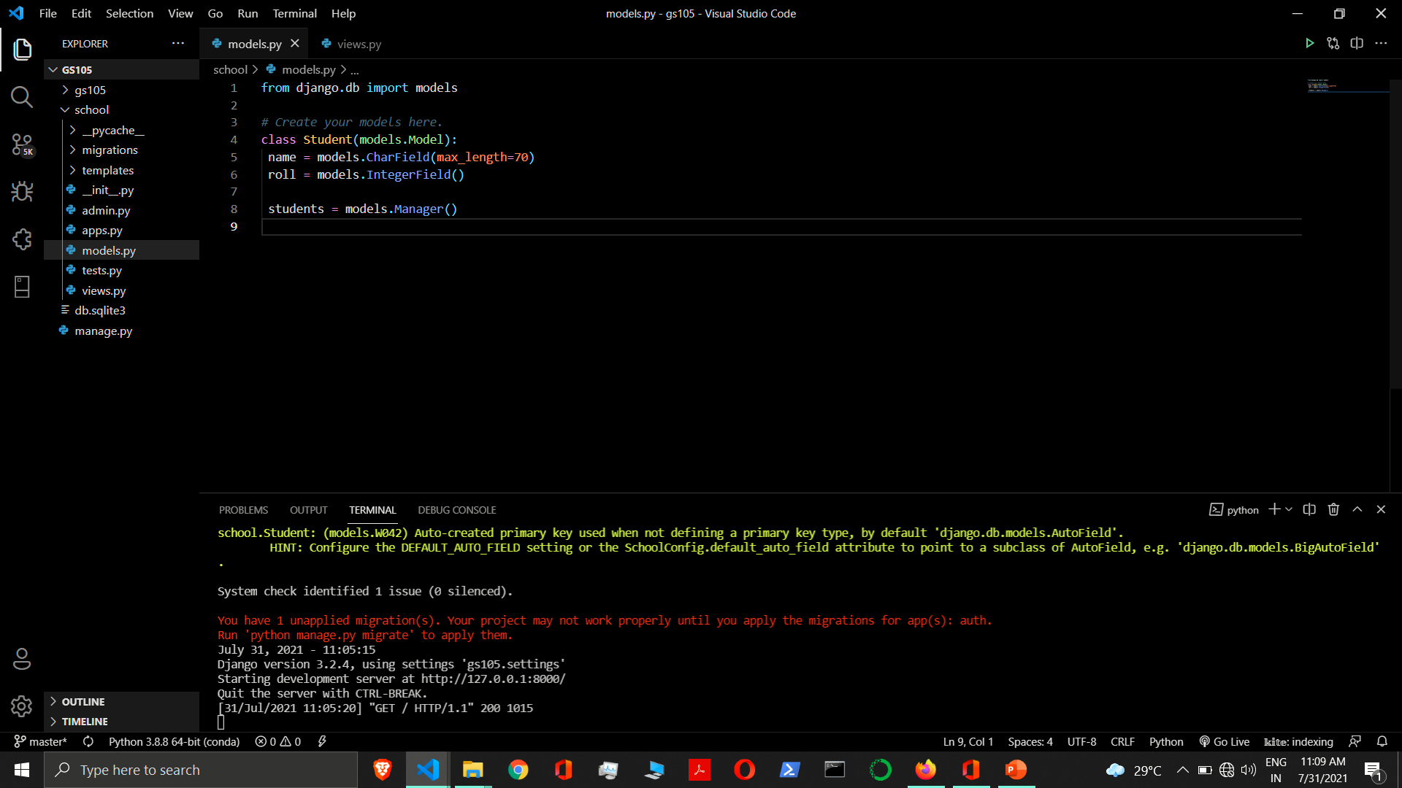

Slide 78
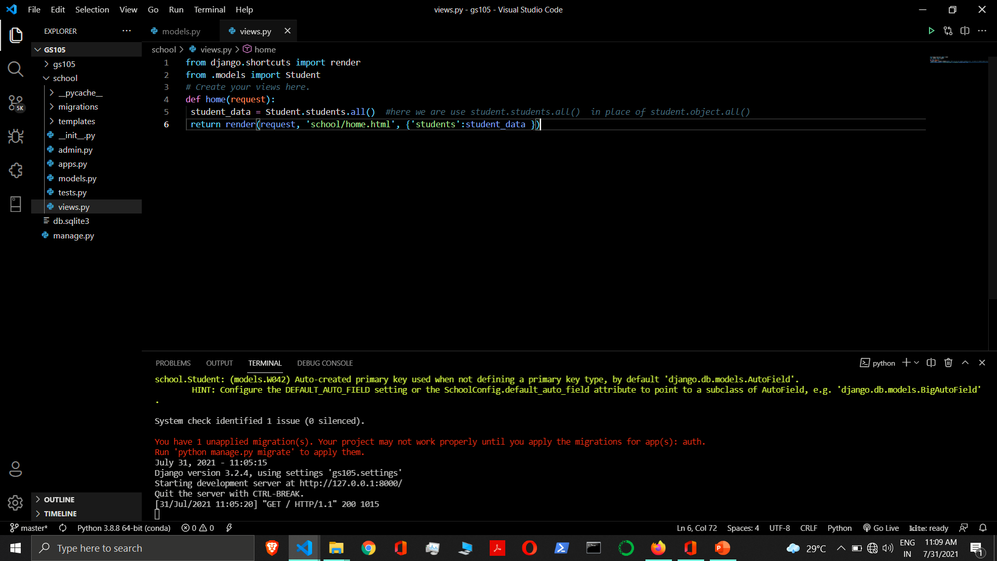

Slide 79
Custom Model Manager
You can use a custom Manager in a particular model by extending the base Manager class and instantiating your custom Manager in your model.
A custom Manager method can return anything you want. It doesn’t have to return a QuerySet.
to modify the initial QuerySet the Manager returns
to add extra Manager methods

Slide 80
Modify the initial QuerySet
A Manager’s base QuerySet returns all objects in the system. You can override a Manager’s base QuerySet by overriding the Manager.get_queryset() method. get_queryset() should return a QuerySet with the properties you require.
Write Model Manager
class CustomManager(models.Manager):
def get_queryset(self): # overriding Built-in method called when we call all()
return super().get_queryset().order_by(‘name’)
Associate Manager with Model
Class Student(models.Model):
objects = models.Manager() # Default Manager
students = CustomManager() # Custom Manager
views.py
Student_data = Student.objects.all() # Work as per default Manager
Student_data = Student.students.all() # Work as per Custom manager
You can associate more than one manager in one Model

Slide 81
Add extra Manager methods
Adding extra Manager methods is the preferred way to add “table-level” functionality to your models.
Write Model Manager
class CustomManager(models.Manager):
def get_stu_roll_range(self, r1, r2):
return super().get_queryset().filter(roll__range=(r1, r2))
Associate Manager with Model
Class Student(models.Model):
objects = models.Manager()
students = CustomManager()
views.py
Student_data = Student.objects.all()
Student_data = Student.students.get_stu_roll_range(101, 103)

Slide 82
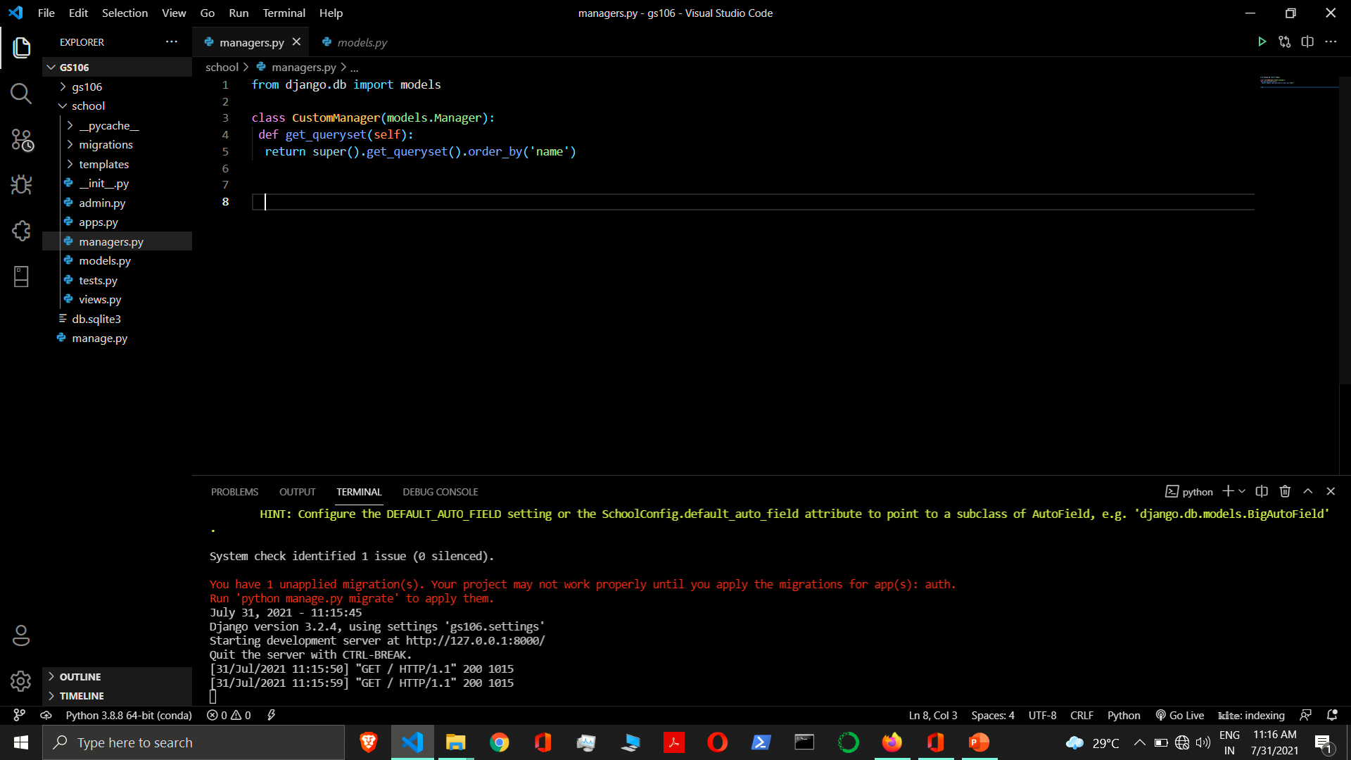

Slide 83
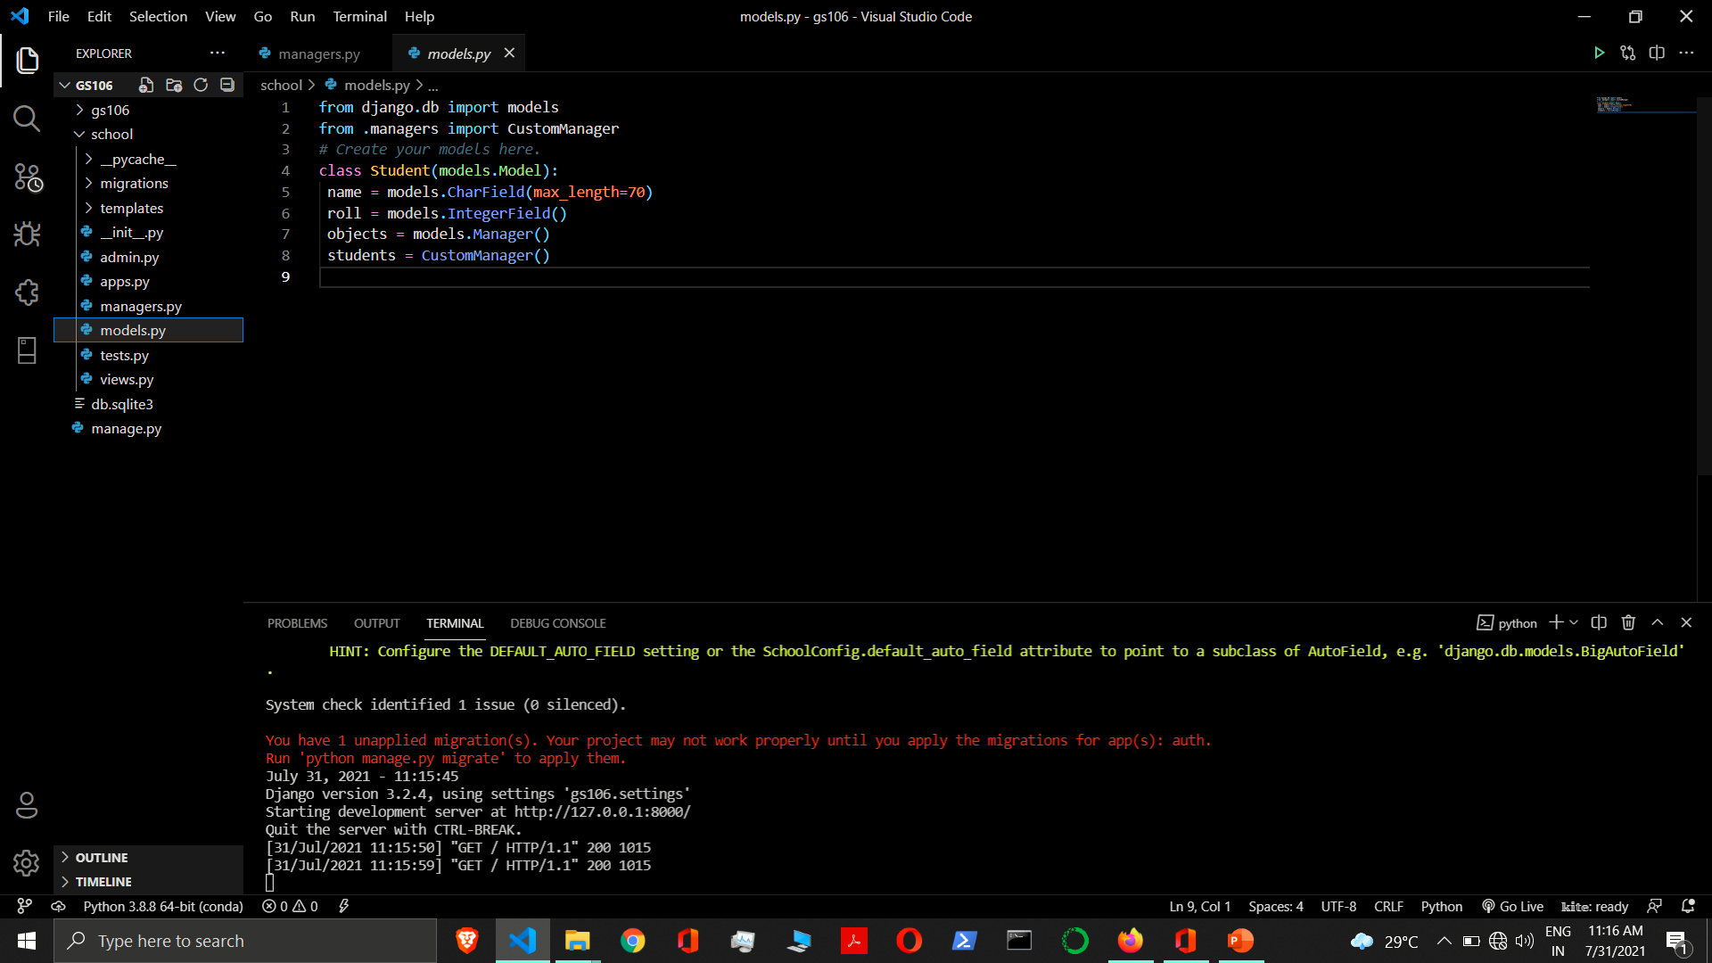

Slide 84
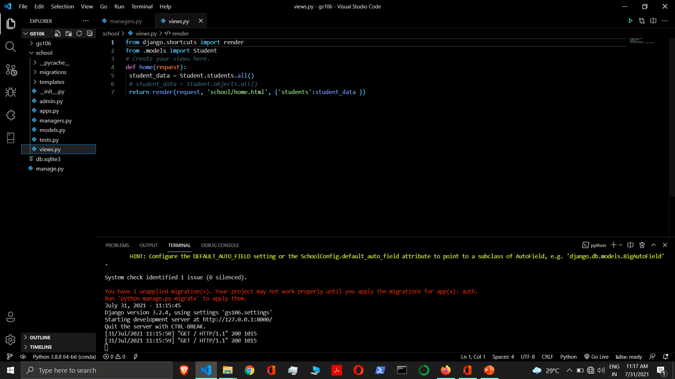

Slide 85
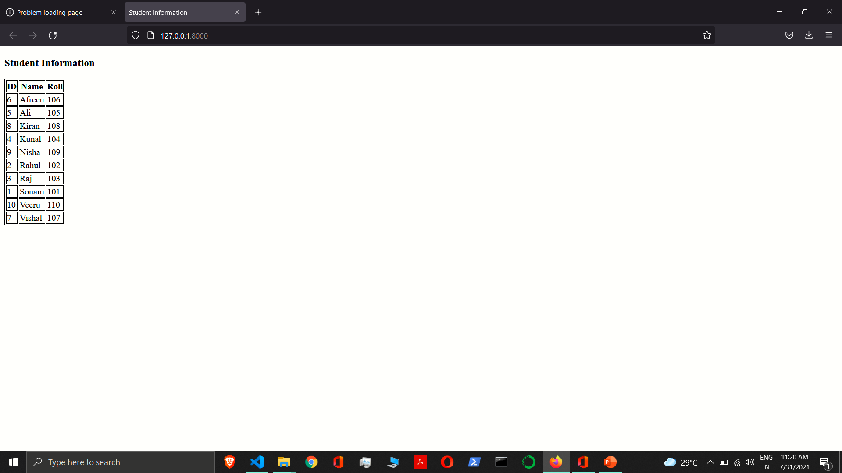

Slide 86
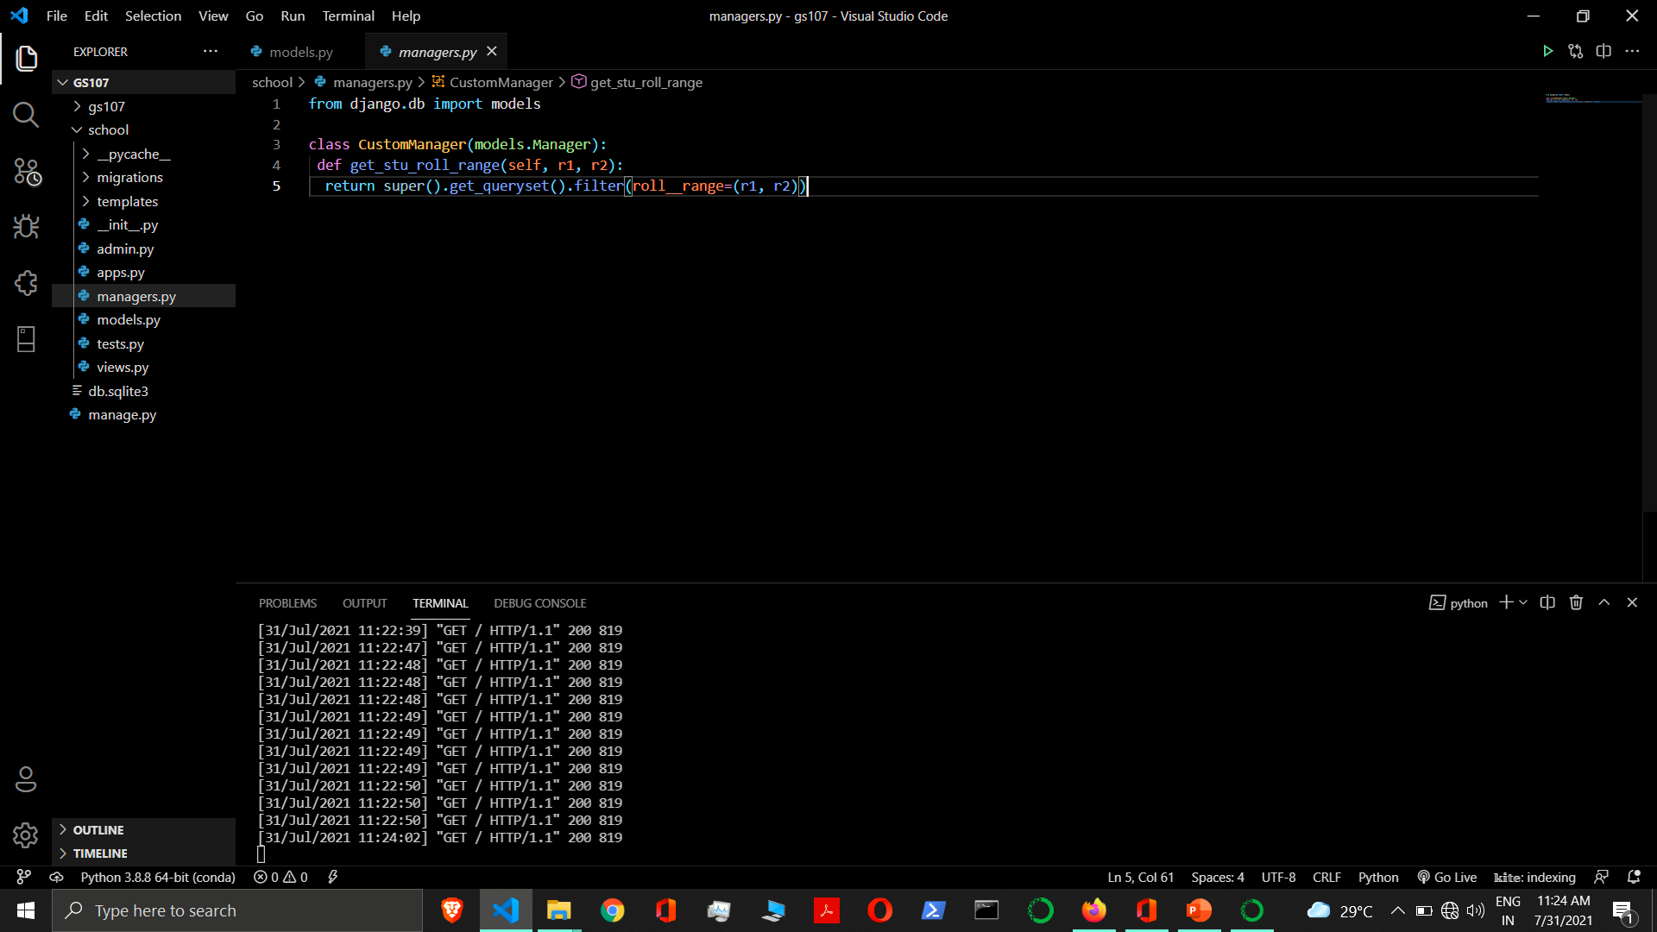

Slide 87
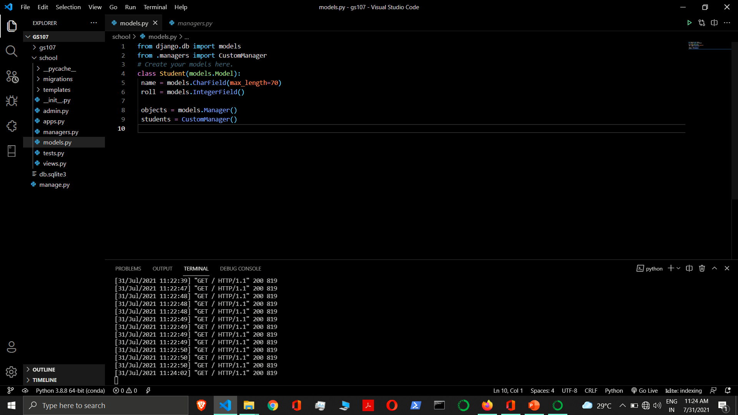

Slide 88
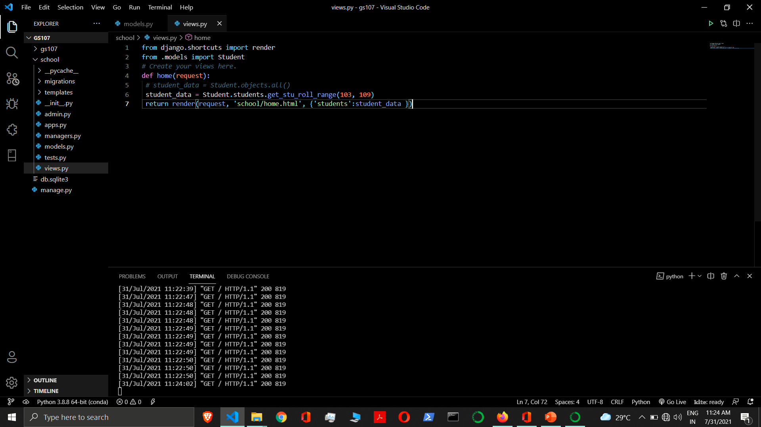

Slide 89
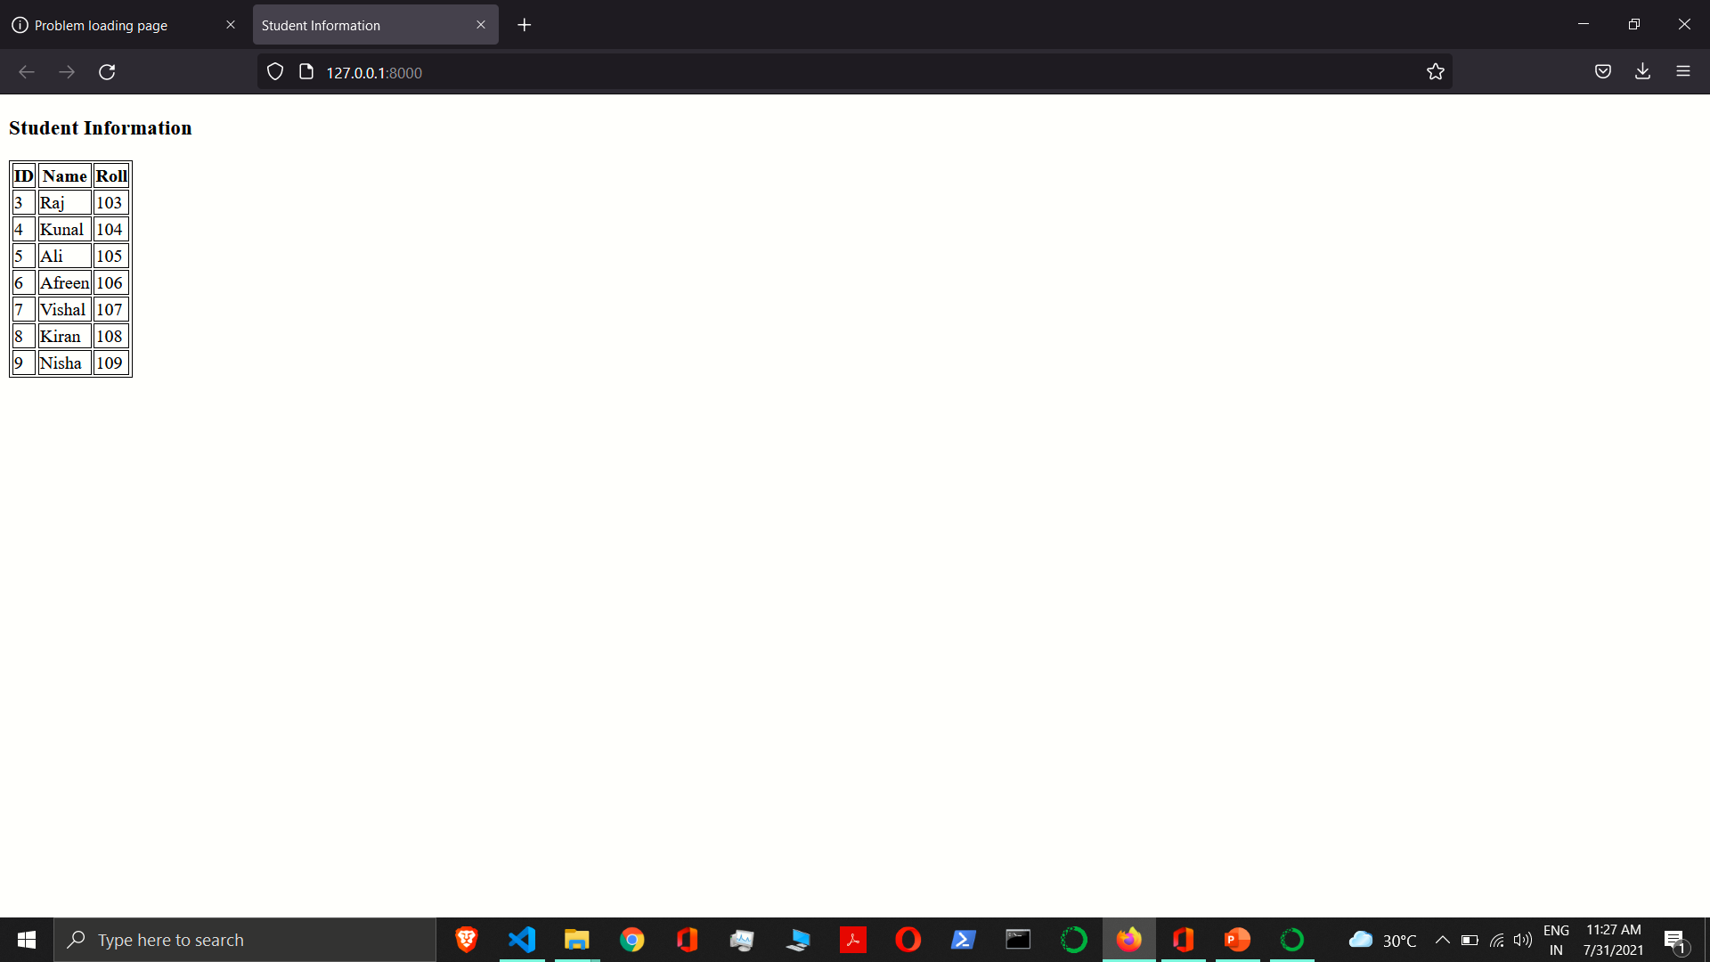

Slide 90
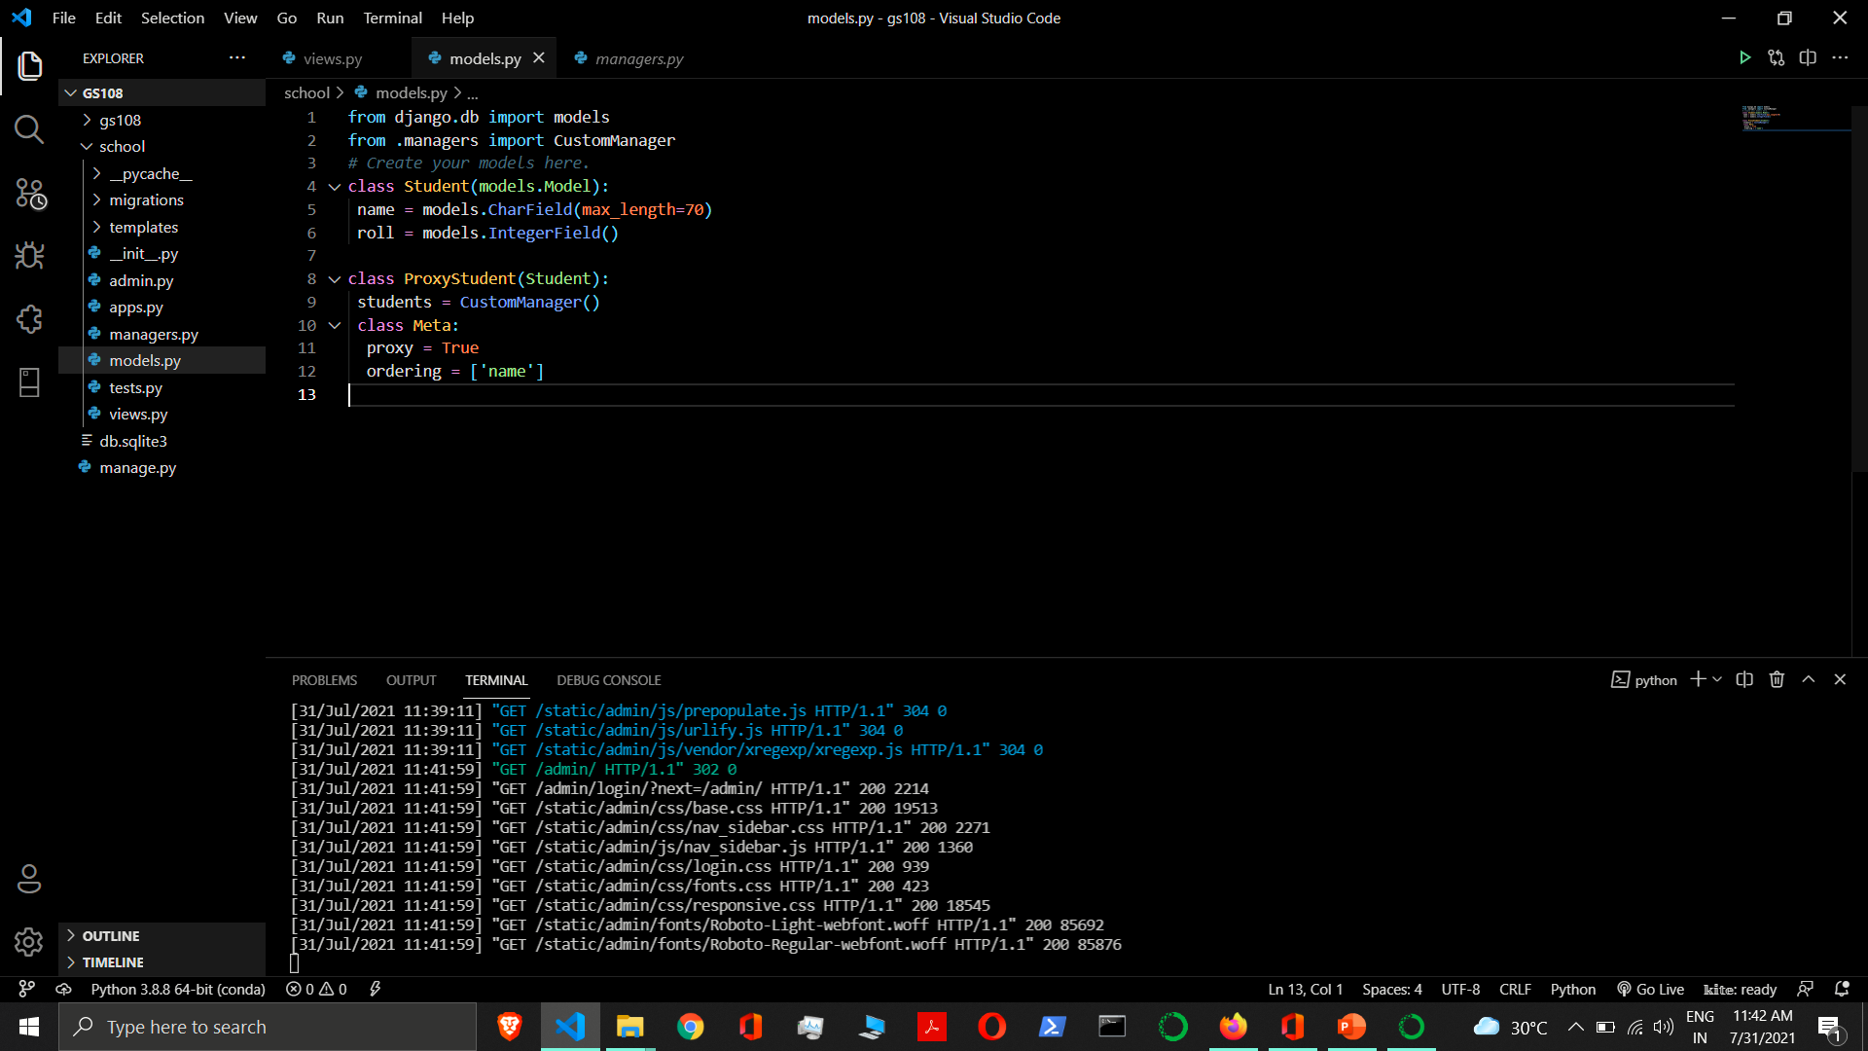

Slide 91
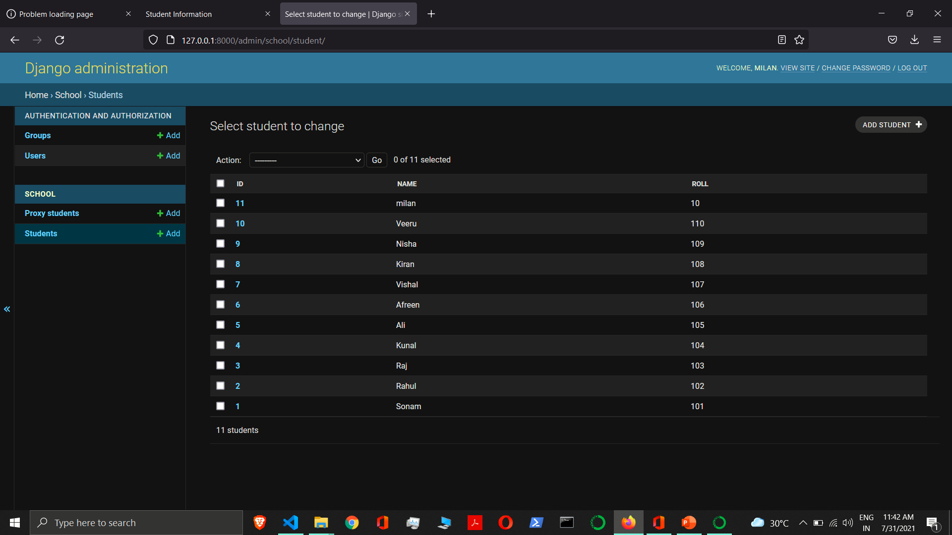

Slide 92
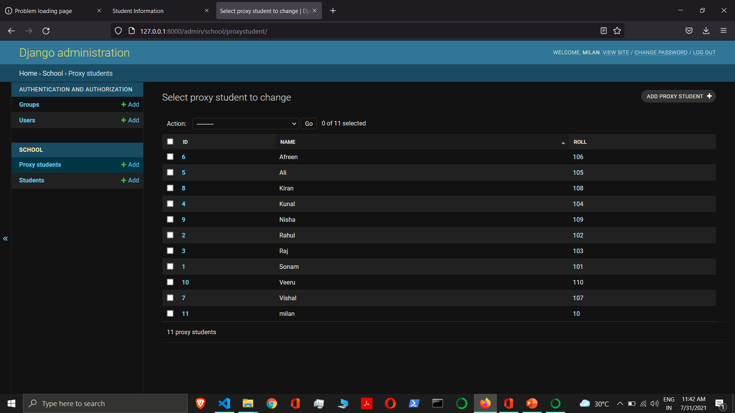

Slide 93
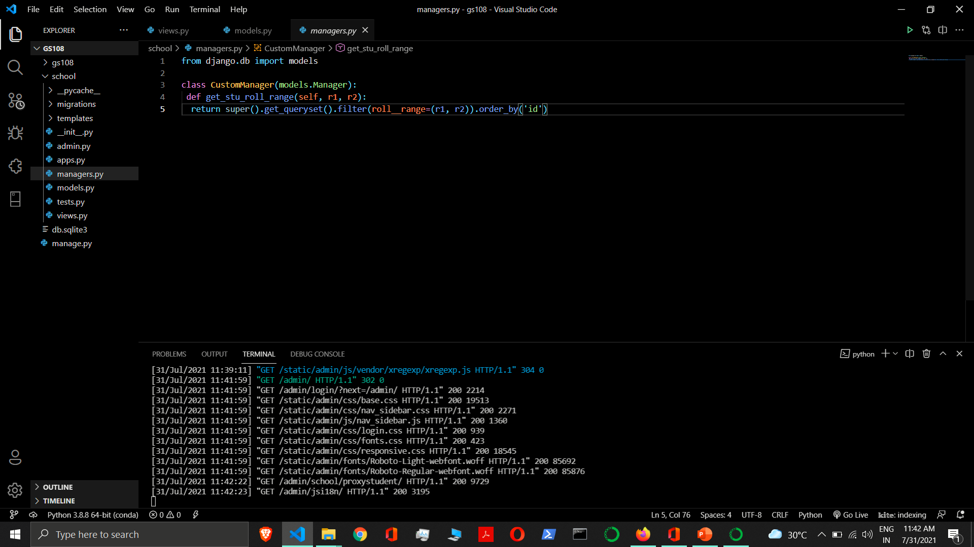

Slide 94
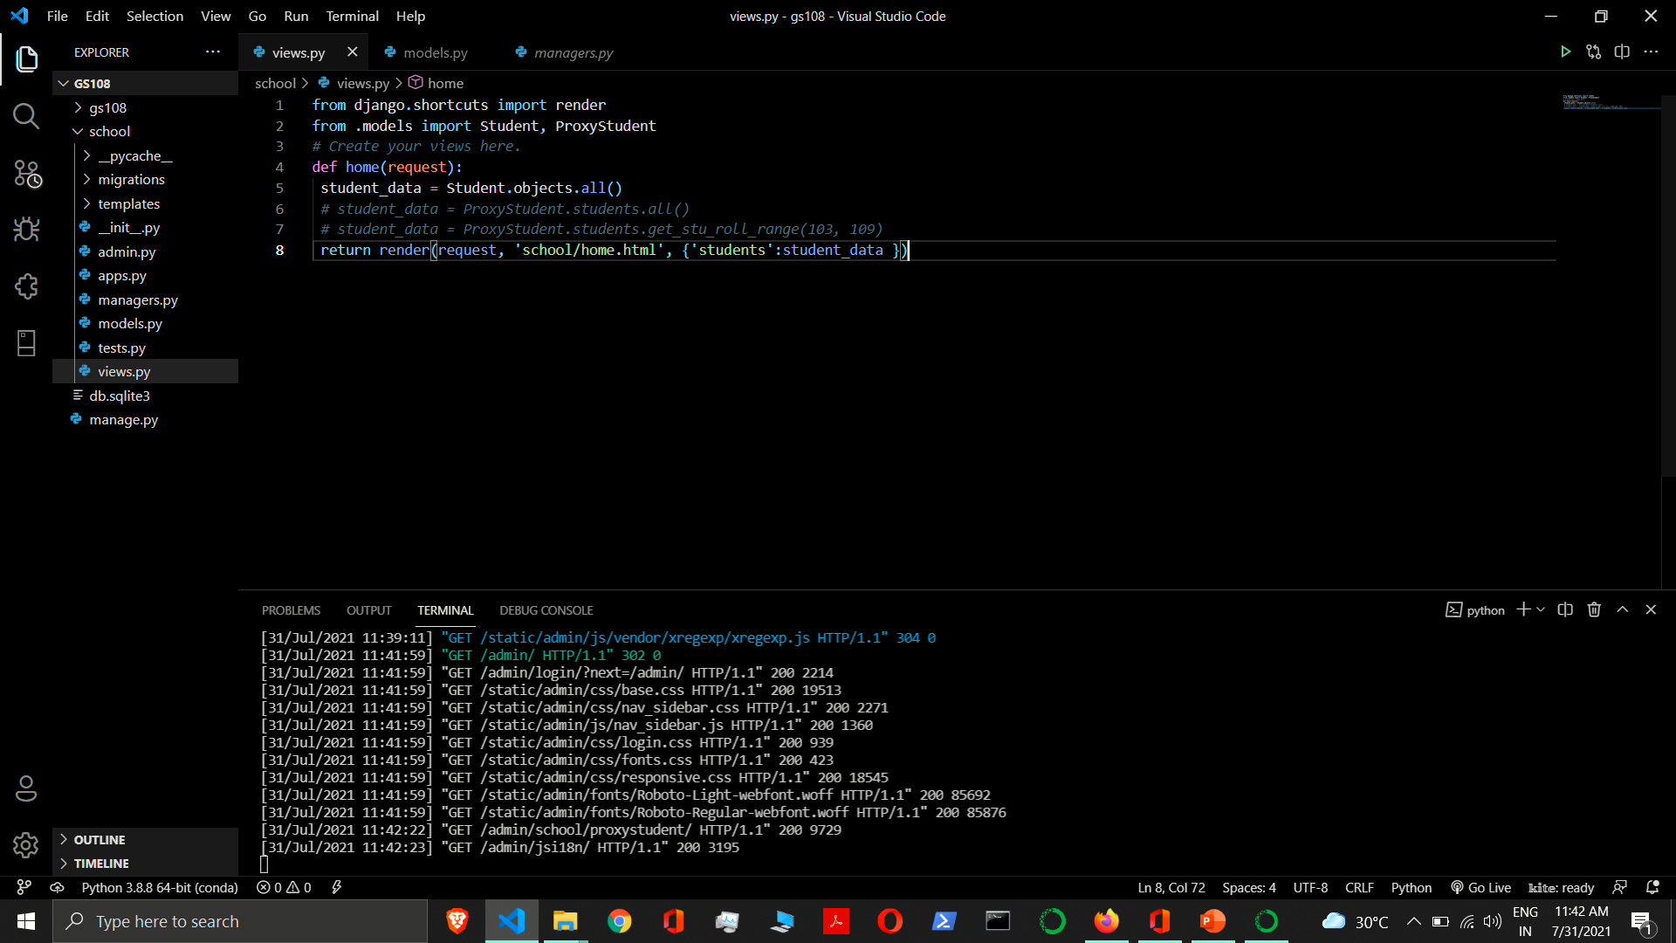

Slide 95
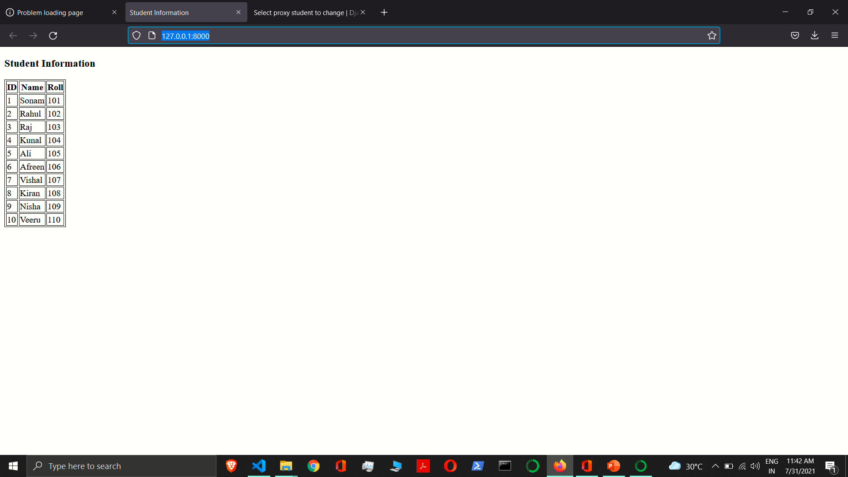

Slide 96
Model Relationship
Django offers ways to define the three most common types of database relationships
One to One Relationship
Many to One Relationship
Many to Many Relationships

Slide 97



One to One Relationship
When one row of table A can be linked to one row of table B.
Husband
Wife

Slide 98
One to One
User
ID | Username | Password
1 | Rahul | rahul12
2 | Sonam | sonam12
3 | Kunal | kunal12
Page
ID | Page Name | Page Cat | Page Publish Date
1 | Geekyshows | Programming | 12-12-2000
2 | World News | News | 11-09-2003
3 | DjangoLove | Programming | 07-01-2001

Slide 99
One to One Relationship
One to One Relationship - To define a one-to-one relationship, use OneToOneField. You use it just like any other Field type by including it as a class attribute of your model.
OneToOneField requires a positional argument, the class to which the model is related.
Syntax:- OneToOneField(to, on_delete, parent_link=False, **options)
Where,
to - The class to which the model is related.
on_delete - When an object referenced by a ForeignKey is deleted, Django will emulate the behavior of the SQL constraint specified by the on_delete argument. on_delete doesn’t create an SQL constraint in the database.
parent_link - When True and used in a model which inherits from another concrete model, indicates that this field should be used as the link back to the parent class, rather than the extra OneToOneField which would normally be implicitly created by subclassing.
limit_choices_to - Sets a limit to the available choices for this field when this field is rendered using a ModelForm or the admin (by default, all objects in the queryset are available to choose). Either a dictionary, a Q object, or a callable returning a dictionary or Q object can be used.

Slide 100
One to One Relationship
related_name - The name to use for the relation from the related object back to this one. It’s also the default value for related_query_name (the name to use for the reverse filter name from the target model).
If you’d prefer Django not to create a backwards relation, set related_name to '+' or end it with '+'.
related_query_name - The name to use for the reverse filter name from the target model. It defaults to the value of related_name or default_related_name if set, otherwise it defaults to the name of the model.
to_field - The field on the related object that the relation is to. By default, Django uses the primary key of the related object. If you reference a different field, that field must have unique=True.
swappable - Controls the migration framework’s reaction if this ForeignKey is pointing at a swappable model. If it is True - the default - then if the ForeignKey is pointing at a model which matches the current value of settings.AUTH_USER_MODEL (or another swappable model setting) the relationship will be stored in the migration using a reference to the setting, not to the model directly.

Slide 101
One to One Relationship
db_constraint - Controls whether or not a constraint should be created in the database for this foreign key. The default is True, and that’s almost certainly what you want; setting this to False can be very bad for data integrity. That said, here are some scenarios where you might want to do this:
You have legacy data that is not valid.
You’re sharding your database.
If this is set to False, accessing a related object that doesn’t exist will raise its DoesNotExist exception.

Slide 102
on_delete
on_delete - When an object referenced by a ForeignKey is deleted, Django will emulate the behavior of the SQL constraint specified by the on_delete argument. on_delete doesn’t create an SQL constraint in the database.
The possible values for on_delete are found in django.db.models:
CASCADE - Cascade deletes. Django emulates the behavior of the SQL constraint ON DELETE CASCADE and also deletes the object containing the ForeignKey.
PROTECT - Prevent deletion of the referenced object by raising ProtectedError, a subclass of django.db.IntegrityError.
SET_NULL - Set the ForeignKey null; this is only possible if null is True.
SET_DEFAULT - Set the ForeignKey to its default value; a default for the ForeignKey must be set.
SET() - Set the ForeignKey to the value passed to SET(), or if a callable is passed in, the result of calling it.
DO_NOTHING - Take no action. If your database backend enforces referential integrity, this will cause an IntegrityError unless you manually add an SQL ON DELETE constraint to the database field.

Slide 103
One to One Relationship
class User(models.Model):
user_name = models.CharField(max_length=70)
password = models.CharField(max_length=70)
class Page(models.Model):
user = models.OneToOneField(User, on_delete=models.CASCADE)
page_name = models.CharField(max_length=70)
page_cat = models.CharField(max_length=70)
page_publish_date = models.DateField()

Slide 104
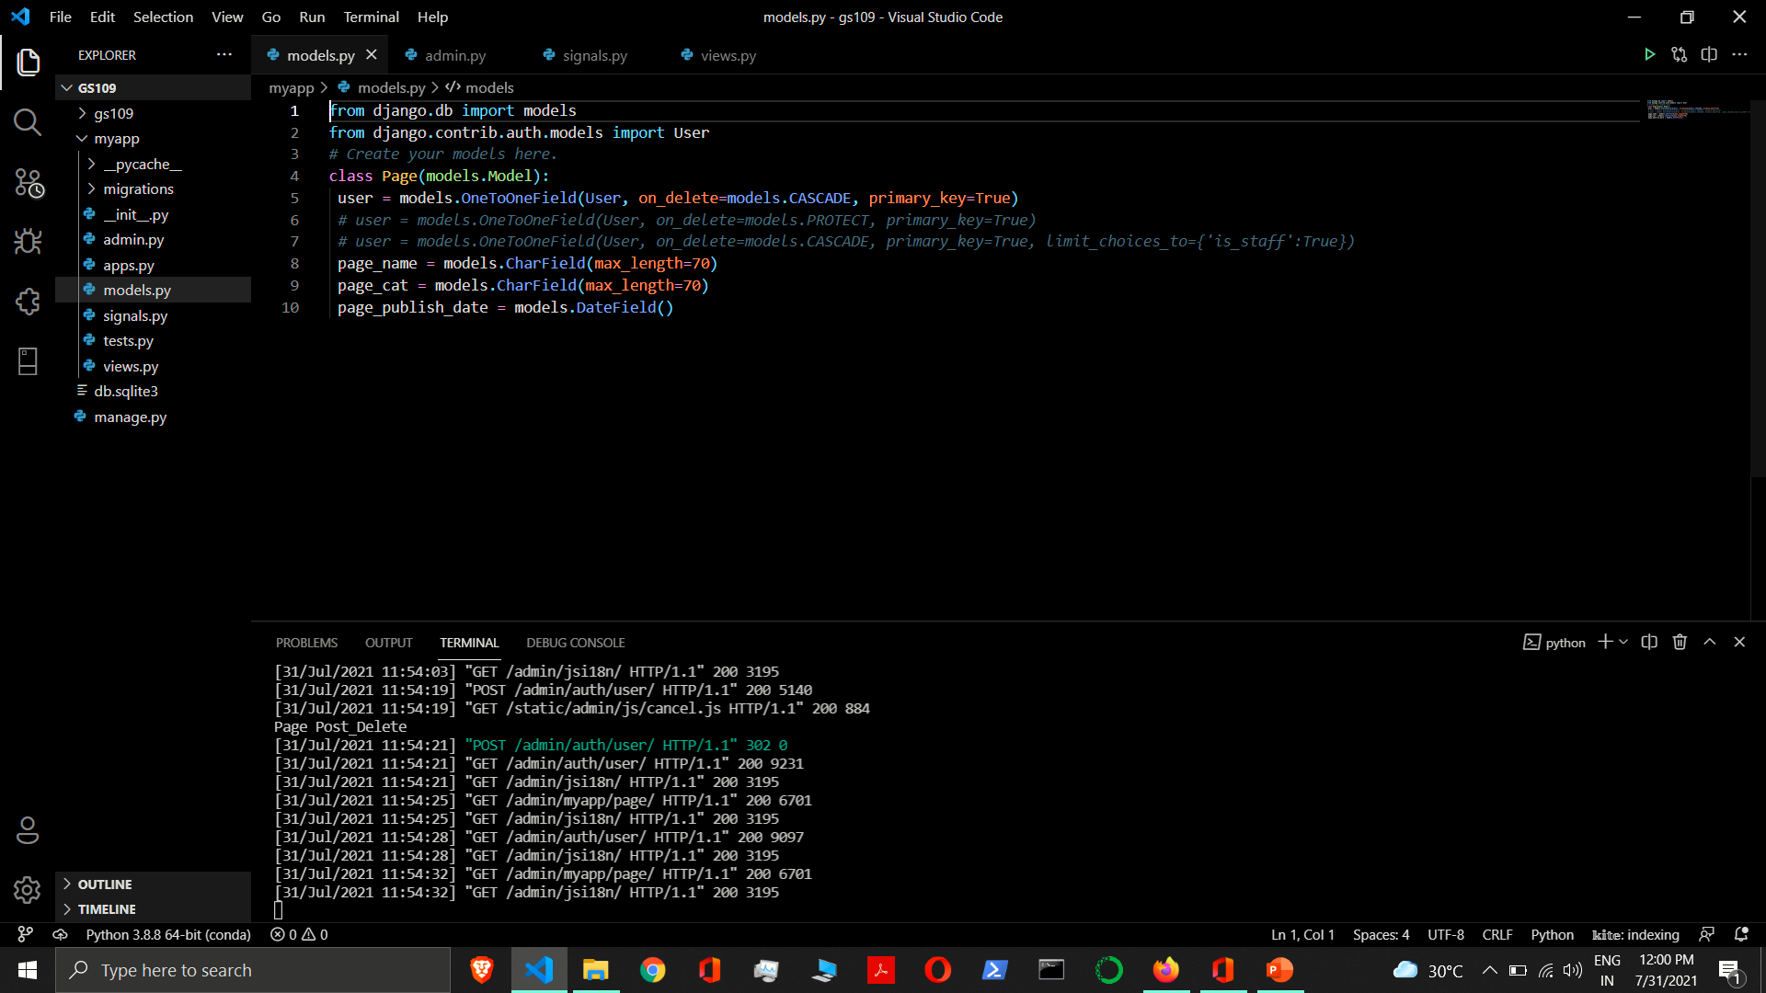

Slide 105
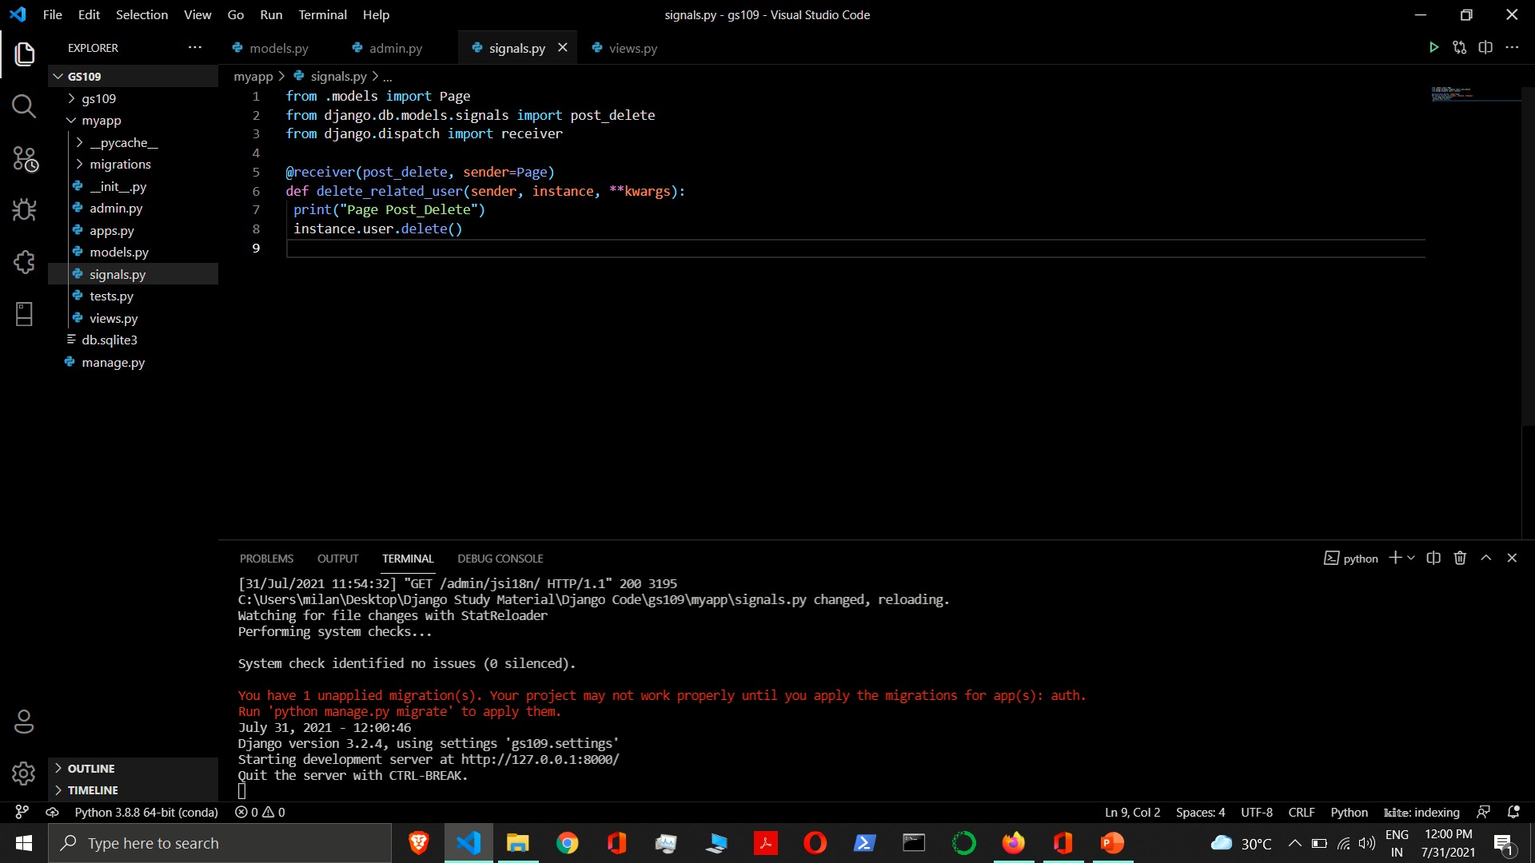

Slide 106
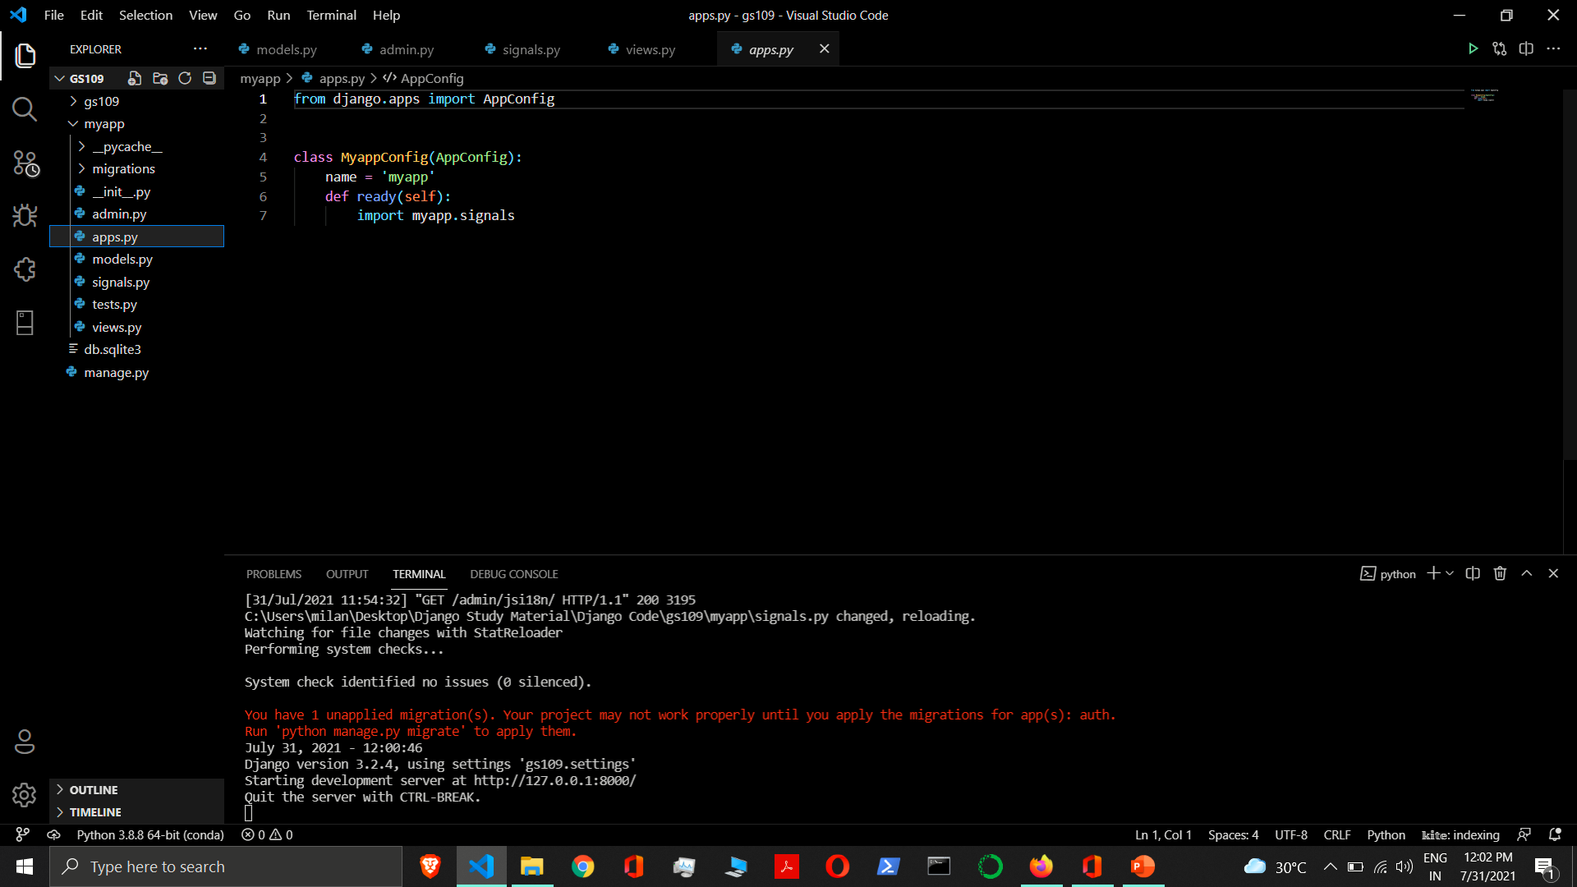

Slide 107
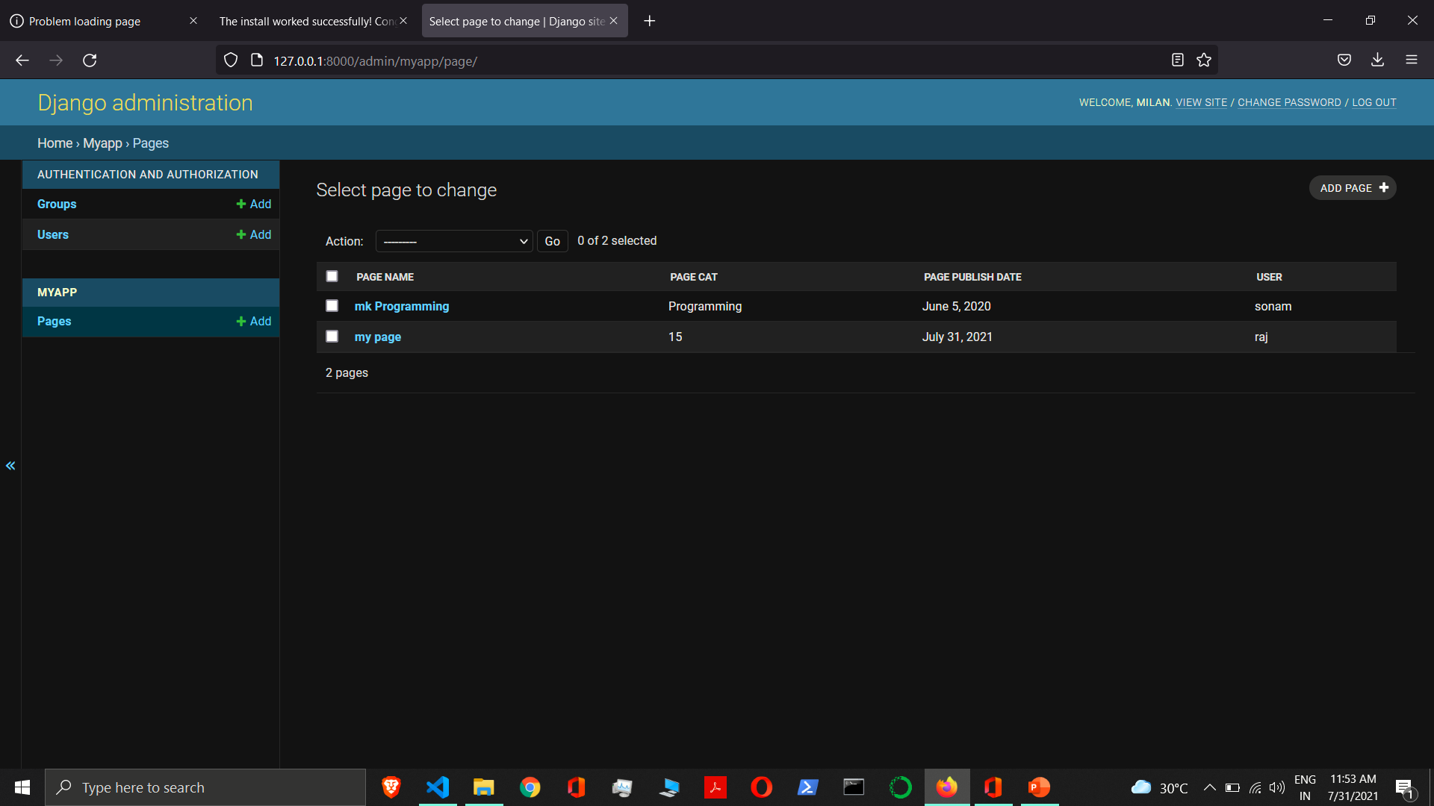

Slide 108
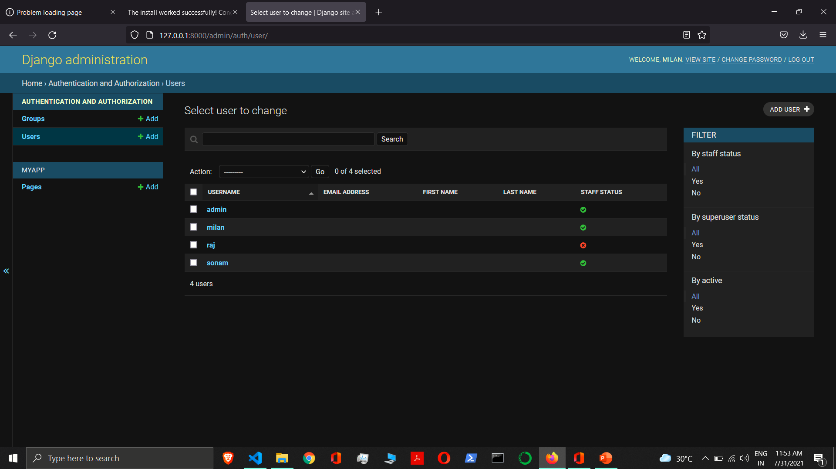

Slide 109
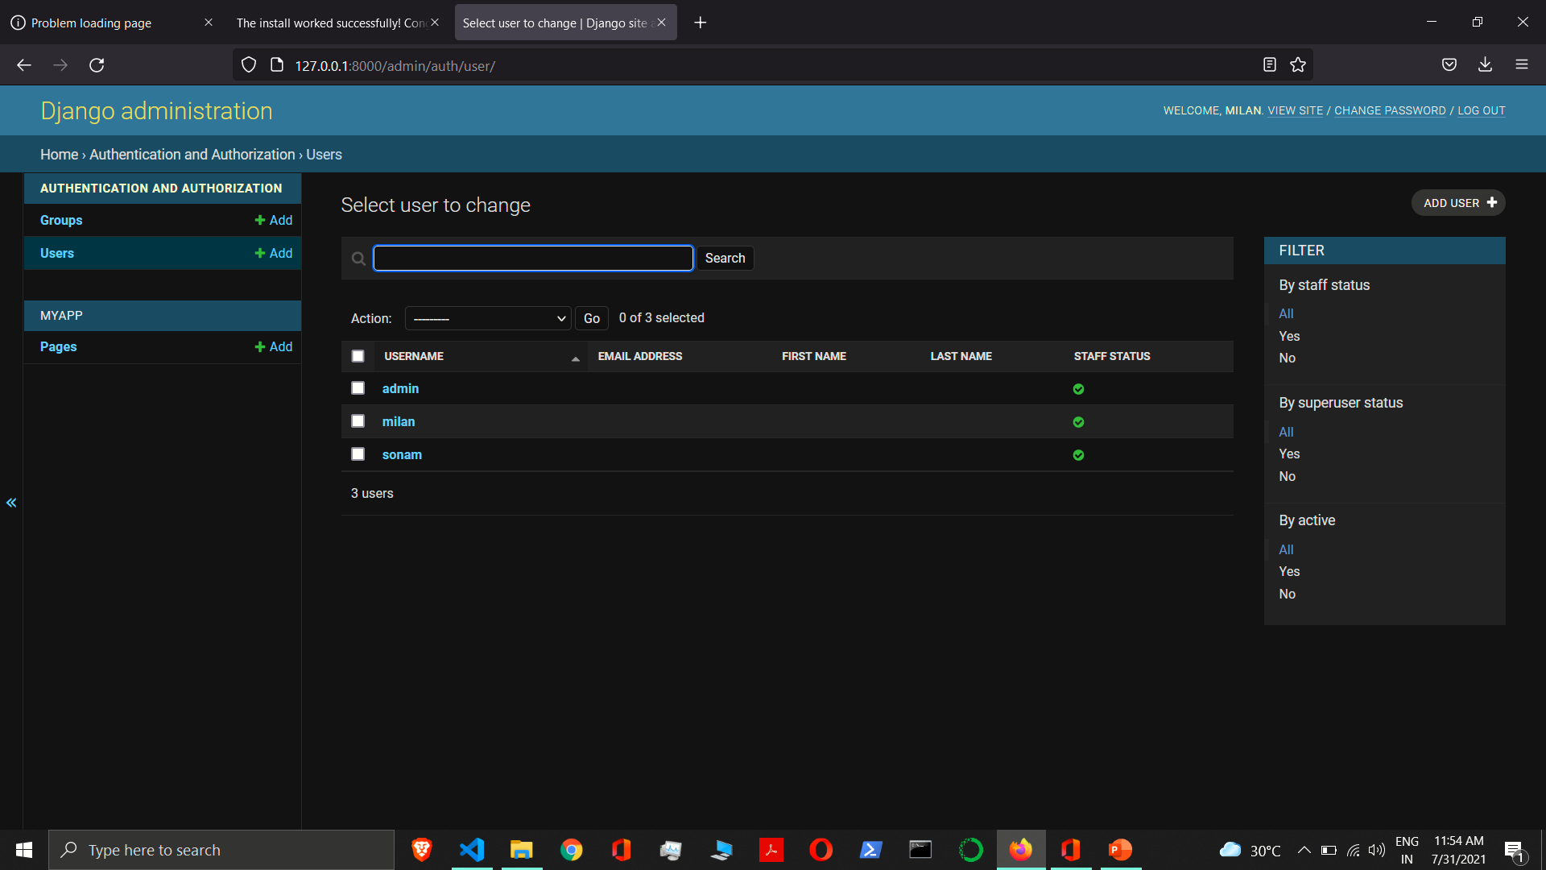

Slide 110
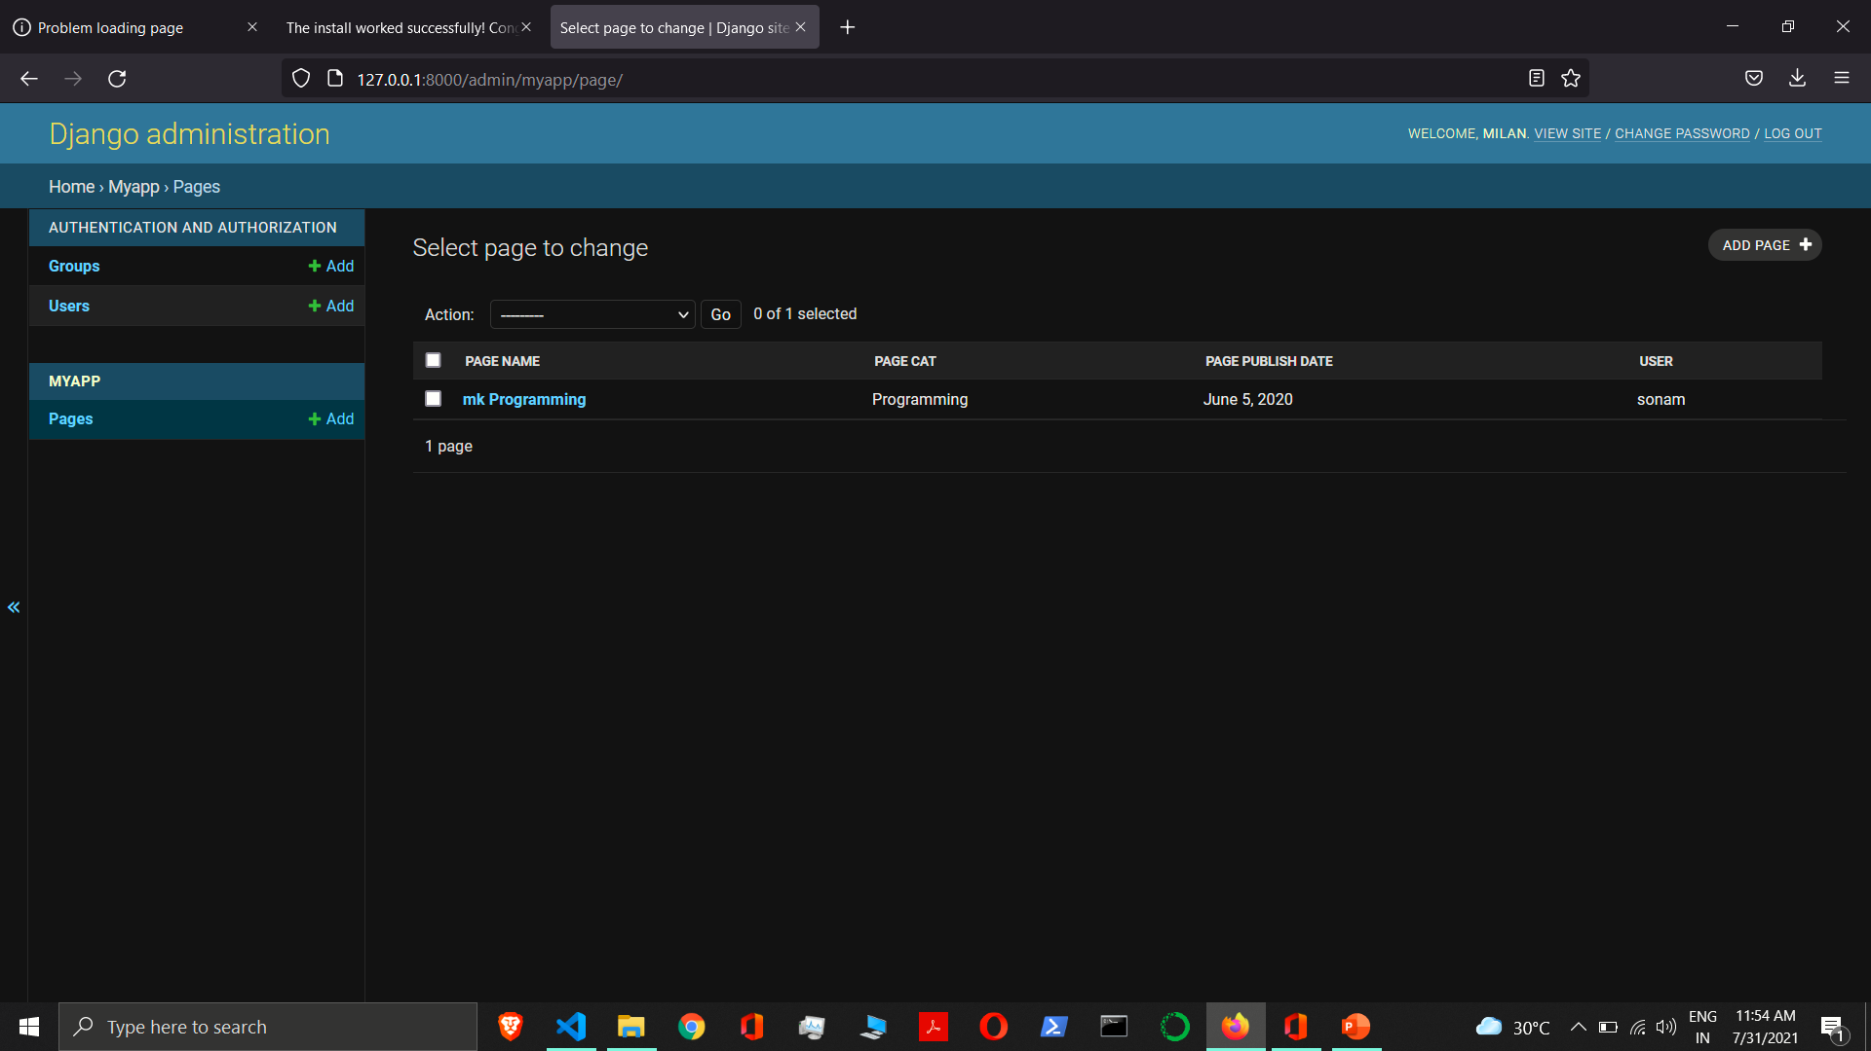

Slide 111




Many to One Relationship
When one or more row of table B can be linked to one row of table A.

Slide 112
Many to One Relationship
Post
ID | Post Title | Post Cat | Post Publish Date
1 | Title 1 | django | 12-12-2000
2 | Title 2 | django | 11-09-2003
3 | Title 3 | python | 07-01-2001
User_id
1
1
2
User
ID | Username | Password
1 | Rahul | rahul12
2 | Sonam | sonam12
3 | Kunal | kunal12

Slide 113
Many to One Relationship
Many to One Relationship - To define a many-to-one relationship, use ForeignKey. You use it just like any other Field type: by including it as a class attribute of your model.
A many-to-one relationship requires two positional arguments: the class to which the model is related and the on_delete option.
Syntax:- ForeignKey(to, on_delete, **options)
to - The class to which the model is related.
on_delete - When an object referenced by a ForeignKey is deleted, Django will emulate the behavior of the SQL constraint specified by the on_delete argument. on_delete doesn’t create an SQL constraint in the database.
limit_choices_to - Sets a limit to the available choices for this field when this field is rendered using a ModelForm or the admin (by default, all objects in the queryset are available to choose). Either a dictionary, a Q object, or a callable returning a dictionary or Q object can be used.

Slide 114
Many to One Relationship
related_name - The name to use for the relation from the related object back to this one. It’s also the default value for related_query_name (the name to use for the reverse filter name from the target model).
If you’d prefer Django not to create a backwards relation, set related_name to '+' or end it with '+'.
related_query_name - The name to use for the reverse filter name from the target model. It defaults to the value of related_name or default_related_name if set, otherwise it defaults to the name of the model.
to_field - The field on the related object that the relation is to. By default, Django uses the primary key of the related object. If you reference a different field, that field must have unique=True.
swappable - Controls the migration framework’s reaction if this ForeignKey is pointing at a swappable model. If it is True - the default - then if the ForeignKey is pointing at a model which matches the current value of settings.AUTH_USER_MODEL (or another swappable model setting) the relationship will be stored in the migration using a reference to the setting, not to the model directly.

Slide 115
Many to One Relationship
db_constraint - Controls whether or not a constraint should be created in the database for this foreign key. The default is True, and that’s almost certainly what you want; setting this to False can be very bad for data integrity. That said, here are some scenarios where you might want to do this:
You have legacy data that is not valid.
You’re sharding your database.
If this is set to False, accessing a related object that doesn’t exist will raise its DoesNotExist exception.

Slide 116
on_delete
on_delete - When an object referenced by a ForeignKey is deleted, Django will emulate the behavior of the SQL constraint specified by the on_delete argument. on_delete doesn’t create an SQL constraint in the database.
The possible values for on_delete are found in django.db.models:
CASCADE - Cascade deletes. Django emulates the behavior of the SQL constraint ON DELETE CASCADE and also deletes the object containing the ForeignKey.
PROTECT - Prevent deletion of the referenced object by raising ProtectedError, a subclass of django.db.IntegrityError.
SET_NULL - Set the ForeignKey null; this is only possible if null is True.
SET_DEFAULT - Set the ForeignKey to its default value; a default for the ForeignKey must be set.
SET() - Set the ForeignKey to the value passed to SET(), or if a callable is passed in, the result of calling it.
DO_NOTHING - Take no action. If your database backend enforces referential integrity, this will cause an IntegrityError unless you manually add an SQL ON DELETE constraint to the database field.

Slide 117
Many to One Relationship
class User(models.Model):
user_name = models.CharField(max_length=70)
password = models.CharField(max_length=70)
class Post(models.Model):
user = models.ForeignKey(User, on_delete=models.CASCADE)
post_title = models.CharField(max_length=70)
post_cat = models.CharField(max_length=70)
post_publish_date = models.DateField()

Slide 118
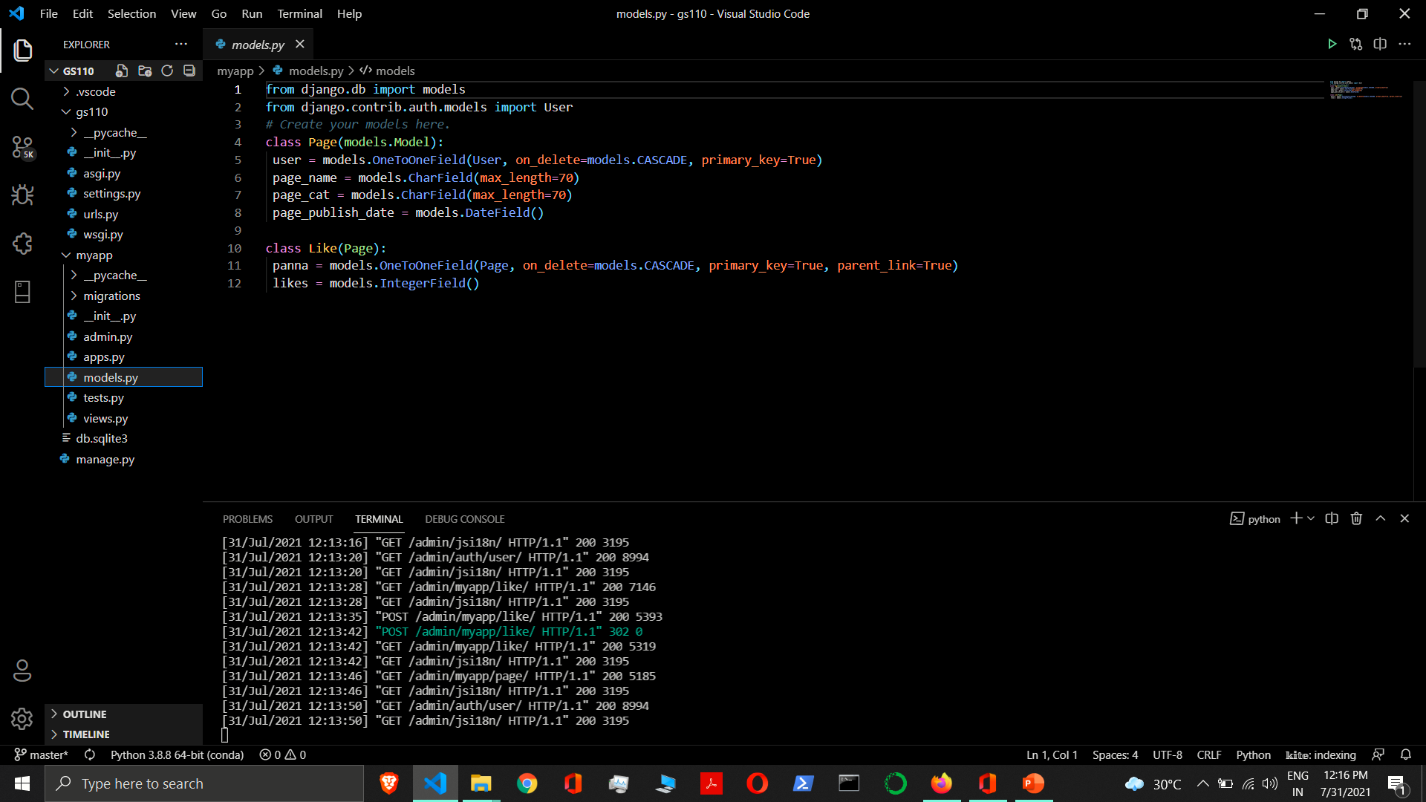

Slide 119


Slide 120


Slide 121


Slide 122


Slide 123


Slide 124


Slide 126


Many to Many Relationship
When one row of table A can be linked to one or more rows of table B, and vice-versa.

Slide 127
Many to Many Relationship
User
ID | Username | Password
1 | Rahul | rahul12
2 | Sonam | sonam12
3 | Kunal | kunal12
song_user
ID | Song_id | User_id
1 | 1 | 1
2 | 1 | 2
3 | 2 | 3
4 | 2 | 1
Song
ID | Song Name | Song Duration
1 | Tum hi ho | 5
2 | Kuch Kuch | 7
3 | Dil to hai dil | 8

Slide 128
Many to Many Relationship
Many to Many Relationships - To define a many-to-many relationship, use ManyToManyField. You use it just like any other Field type: by including it as a class attribute of your model.
ManyToManyField requires a positional argument: the class to which the model is related.
Syntax:- ManyToManyField(to, **options)
Where,
to - The class to which the model is related.
related_name - The name to use for the relation from the related object back to this one. It’s also the default value for related_query_name (the name to use for the reverse filter name from the target model).
If you’d prefer Django not to create a backwards relation, set related_name to '+' or end it with '+'.
related_query_name - The name to use for the reverse filter name from the target model. It defaults to the value of related_name or default_related_name if set, otherwise it defaults to the name of the model.

Slide 129
Many to Many Relationship
limit_choices_to - Sets a limit to the available choices for this field when this field is rendered using a ModelForm or the admin (by default, all objects in the queryset are available to choose). Either a dictionary, a Q object, or a callable returning a dictionary or Q object can be used.
symmetrical - If you do not want symmetry in many-to-many relationships with self, set symmetrical to False. This will force Django to add the descriptor for the reverse relationship, allowing ManyToManyField relationships to be non-symmetrical. Only used in the definition of ManyToManyFields on self.
through - Django will automatically generate a table to manage many-to-many relationships. However, if you want to manually specify the intermediary table, you can use the through option to specify the Django model that represents the intermediate table that you want to use.
through_fields - Only used when a custom intermediary model is specified. Django will normally determine which fields of the intermediary model to use in order to establish a many-to-many relationship automatically. through_fields accepts a 2-tuple ('field1', 'field2'), where field1 is the name of the foreign key to the model the ManyToManyField is defined on , and field2 the name of the foreign key to the target model.

Slide 130
Many to Many Relationship
db_table - The name of the table to create for storing the many-to-many data. If this is not provided, Django will assume a default name based upon the names of: the table for the model defining the relationship and the name of the field itself.
db_constraint - Controls whether or not constraints should be created in the database for the foreign keys in the intermediary table. The default is True, and that’s almost certainly what you want; setting this to False can be very bad for data integrity. That said, here are some scenarios where you might want to do this:
You have legacy data that is not valid.
You’re sharding your database.
It is an error to pass both db_constraint and through.
swappable - Controls the migration framework’s reaction if this ManyToManyField is pointing at a swappable model. If it is True - the default - then if the ManyToManyField is pointing at a model which matches the current value of settings.AUTH_USER_MODEL (or another swappable model setting) the relationship will be stored in the migration using a reference to the setting, not to the model directly.

Slide 131
Many to Many Relationship
Example:-
class User(models.Model):
user_name = models.CharField(max_length=70)
password = models.CharField(max_length=70)
class Song(models.Model):
user = models.ManyToManyField(User)
song_name = models.CharField(max_length=70)
song_duration = models.IntegerField()

Slide 132


Slide 133


Slide 134


Slide 135


Slide 136


Slide 137


Slide 138
Type of Views
Function Based View
Class Based View

Slide 139
Class Based View
Class-based views provide an alternative way to implement views as Python objects instead of functions.
They do not replace function-based views.
Base Class-Based Views / Base View
Generic Class-Based Views / Generic View
Advantages:-
Organization of code related to specific HTTP methods (GET, POST, etc.) can be addressed by separate methods instead of conditional branching.
Object oriented techniques such as mixins (multiple inheritance) can be used to factor code into reusable components.

Slide 140
Base Class-Based View
Base class-based views can be thought of as parent views, which can be used by themselves or inherited from. They may not provide all the capabilities required for projects, in which case there are Mixins which extend what base views can do.
View
TemplateView
RedirectView

Slide 141
View
django.views.generic.base.View
The master class-based base view. All other class-based views inherit from this base class. It isn’t strictly a generic view and thus can also be imported from django.views.
C:\Users\GS\AppData\Local\Programs\Python\Python38-32\Lib\site-packages\django\views\generic
Attribute:-
http_method_names = ['get', 'post', 'put', 'patch', 'delete', 'head', 'options', 'trace’]
The list of HTTP method names that this view will accept.

Slide 142
View
Methods:-
setup(self, request, *args, **kwargs) - It initializes view instance attributes: self.request, self.args, and self.kwargs prior to dispatch()
dispatch(self, request, *args, **kwargs) - The view part of the view – the method that accepts a request argument plus arguments, and returns a HTTP response.
The default implementation will inspect the HTTP method and attempt to delegate to a method that matches the HTTP method; a GET will be delegated to get(), a POST to post(), and so on.
By default, a HEAD request will be delegated to get(). If you need to handle HEAD requests in a different way than GET, you can override the head() method.
http_method_not_allowed(self, request, *args, **kwargs) - If the view was called with a HTTP method it doesn’t support, this method is called instead.
The default implementation returns HttpResponseNotAllowed with a list of allowed methods in plain text.

Slide 143
View
Methods:-
options(self, request, *args, **kwargs) – It handles responding to requests for the OPTIONS HTTP verb. Returns a response with the Allow header containing a list of the view’s allowed HTTP method names.
as_view(cls, **initkwargs) - It returns a callable view that takes a request and returns a response.
_allowed_methods(self)

Slide 144
View
views.py
Function Based View:-
from django.http import HttpResponse
def myview(request):
return HttpResponse('<h1>Function Based View</h1>’)
Class Based View:-
from django.views import View
class MyView(View):
def get(self, request):
return HttpResponse('<h1>Class Based View</h1>')

Slide 145
View
urls.py
Function Based View:-
from django.urls import path
from school import views
urlpatterns = [ path('func/', views.myview, name='func’), ]
Class Based View:-
from django.urls import path
from school import views
urlpatterns = [
path('cl/', views.MyView.as_view(), name='cl'),
]

Slide 146
View
Django’s URL resolver expects to send the request and associated arguments to a callable function, not a class, class-based views have an as_view() class method which returns a function that can be called when a request arrives for a URL matching the associated pattern.
The function creates an instance of the class, calls setup() to initialize its attributes,
and then calls its dispatch() method.
dispatch looks at the request to determine whether it is a GET, POST, etc, and relays the request to a matching method if one is defined,
or raises HttpResponseNotAllowed if not

Slide 147
TemplateView
django.views.generic.base.TemplateView
It renders a given template.
This view inherits methods and attributes from the following views:
django.views.generic.base.TemplateResponseMixin
django.views.generic.base.ContextMixin
django.views.generic.base.View
class TemplateView(TemplateResponseMixin, ContextMixin, View):

Slide 148
TemplateResponseMixin
It provides a mechanism to construct a TemplateResponse, given suitable context. The template to use is configurable and can be further customized by subclasses.
Attributes:-
template_name - The full name of a template to use as defined by a string. Not defining a template_name will raise a django.core.exceptions.ImproperlyConfigured exception.
template_engine - The NAME of a template engine to use for loading the template. template_engine is passed as the using keyword argument to response_class. Default is None, which tells Django to search for the template in all configured engines.
response_class - The response class to be returned by render_to_response method. Default is TemplateResponse. The template and context of TemplateResponse instances can be altered later (e.g. in template response middleware).
If you need custom template loading or custom context object instantiation, create a TemplateResponse subclass and assign it to response_class.

Slide 149
TemplateResponseMixin
Attributes:-
content_type - The content type to use for the response. content_type is passed as a keyword argument to response_class. Default is None – meaning that Django uses 'text/html’.
Methods:-
render_to_response(context, **response_kwargs)- It returns a self.response_class instance.
If any keyword arguments are provided, they will be passed to the constructor of the response class.
Calls get_template_names() to obtain the list of template names that will be searched looking for an existent template.
get_template_names() - It returns a list of template names to search for when rendering the template. The first template that is found will be used.
If template_name is specified, the default implementation will return a list containing template_name (if it is specified).

Slide 150
ContextMixin
A default context mixin that passes the keyword arguments received by get_context_data() as the template context.
Attribute:-
extra_context - A dictionary to include in the context. This is a convenient way of specifying some context in as_view().
Method:-
get_context_data(**kwargs)- It returns a dictionary representing the template context. The keyword arguments provided will make up the returned context.

Slide 151
TemplateView
views.py
from django.views.generic.base import TemplateView
class HomeView(TemplateView):
template_name = 'school/home.html’
urls.py
from school import views
urlpatterns = [
path('home/', views.HomeView.as_view(), name='home’),
]

Slide 152
TemplateView With Context
views.py
from django.views.generic.base import TemplateView
class HomeView(TemplateView):
template_name = 'school/home.html'
def get_context_data(self, **kwargs):
context = super().get_context_data(**kwargs)
context['name'] = 'Sonam'
context['roll'] = 101
return context
urls.py
urlpatterns = [ path('home/', views.HomeView.as_view(), name='home'), ]

Slide 153
TemplateView With Extra Context
views.py
from django.views.generic.base import TemplateView
class HomeView(TemplateView):
template_name = 'school/home.html'
def get_context_data(self, **kwargs):
context = super().get_context_data(**kwargs)
context['name'] = 'Sonam'
context['roll'] = 101
return context
urls.py
urlpatterns = [ path('home/', views.HomeView.as_view(extra_context={'course':'python’}), name='home'), ]

Slide 154
RedirectView
django.views.generic.base.RedirectView
It redirects to a given URL.
The given URL may contain dictionary-style string formatting, which will be interpolated against the parameters captured in the URL. Because keyword interpolation is always done (even if no arguments are passed in), any "%" characters in the URL must be written as "%%" so that Python will convert them to a single percent sign on output.
If the given URL is None, Django will return an HttpResponseGone (410).
This view inherits methods and attributes from the following view:
django.views.generic.base.View

Slide 155
RedirectView
Attributes:-
url - The URL to redirect to, as a string. Or None to raise a 410 (Gone) HTTP error.
pattern_name - The name of the URL pattern to redirect to. Reversing will be done using the same args and kwargs as are passed in for this view.
permanent - Whether the redirect should be permanent. The only difference here is the HTTP status code returned. If True, then the redirect will use status code 301. If False, then the redirect will use status code 302. By default, permanent is False.
query_string - Whether to pass along the GET query string to the new location. If True, then the query string is appended to the URL. If False, then the query string is discarded. By default, query_string is False.

Slide 156
RedirectView
Methods:-
get_redirect_url(*args, **kwargs) - It constructs the target URL for redirection.
The args and kwargs arguments are positional and/or keyword arguments captured from the URL pattern, respectively.
The default implementation uses url as a starting string and performs expansion of % named parameters in that string using the named groups captured in the URL.
If url is not set, get_redirect_url() tries to reverse the pattern_name using what was captured in the URL (both named and unnamed groups are used).
If requested by query_string, it will also append the query string to the generated URL. Subclasses may implement any behavior they wish, as long as the method returns a redirect-ready URL string.

Slide 157
RedirectView
views.py
from django.shortcuts import render
from django.views.generic.base import RedirectView, TemplateView
class GeekyShowsRedirectView(RedirectView):
url='https://geekyshows.com'
class GeekRedirectView(RedirectView):
pattern_name = 'mindex'
permanent = False
query_string = False
def get_redirect_url(self, *args, **kwargs):
print(kwargs)
kwargs['pk'] = 16
return super().get_redirect_url(*args, **kwargs)

Slide 158
RedirectView
urls.py
from django.urls import path
from django.views.generic.base import RedirectView, TemplateView
from school import views
urlpatterns = [
path('admin/', admin.site.urls),
path('', views.TemplateView.as_view(template_name='school/home.html'), name='blankindex'),
path('home/', views.RedirectView.as_view(url='/'), name='home'),
path('index/', views.RedirectView.as_view(pattern_name='home'), name='index'),
path('geekyshows/', views.RedirectView.as_view(url='https://geekyshows.com'), name='go-to-geekyshows'),
path('geekyshows/', views.GeekyShowsRedirectView.as_view(), name='go-to-geekyshows'),
path('home/<int:pk>/', views.GeekRedirectView.as_view(), name='geek'),
path('<int:pk>/', views.TemplateView.as_view(template_name='school/home.html'), name='mindex'),
# path('home/<slug:post>/', views.GeekRedirectView.as_view(), name='geek'),
# path('<slug:post>/', views.TemplateView.as_view(template_name='school/home.html'), name='index'),
]

Slide 159
Type of Views
Function Based View
Class Based View

Slide 160
Class Based View
Class-based views provide an alternative way to implement views as Python objects instead of functions.
They do not replace function-based views.
Base Class-Based Views / Base View
Generic Class-Based Views / Generic View
Advantages:-
Organization of code related to specific HTTP methods (GET, POST, etc.) can be addressed by separate methods instead of conditional branching.
Object oriented techniques such as mixins (multiple inheritance) can be used to factor code into reusable components.

Slide 161
Base Class-Based View
Base class-based views can be thought of as parent views, which can be used by themselves or inherited from. They may not provide all the capabilities required for projects, in which case there are Mixins which extend what base views can do.
View
TemplateView
RedirectView

Slide 162
Generic Class Based View
Django’s generic views are built off of those base views, and were developed as a shortcut for common usage patterns such as displaying the details of an object.
They take certain common idioms and patterns found in view development and abstract them so that you can quickly write common views of data without having to repeat yourself.
Most generic views require the queryset key, which is a QuerySet instance.
Display View – ListView, DetailView
Editing View – FormView, CreateView, UpdateView, DeleteView
Date Views – ArchiveIndexView, YearArchiveView, MonthArchiveView, WeekArchiveView, DayArchiveView, TodayArchiveView, DateDetailView

Slide 163
Generic Display View
The two following generic class-based views are designed to display data.
ListView
DetailView

Slide 164
ListView
django.views.generic.list.ListView
A page representing a list of objects.
While this view is executing, self.object_list will contain the list of objects (usually, but not necessarily a queryset) that the view is operating upon.
This view inherits methods and attributes from the following views:
django.views.generic.list.MultipleObjectTemplateResponseMixin
django.views.generic.base.TemplateResponseMixin
django.views.generic.list.BaseListView
django.views.generic.list.MultipleObjectMixin
django.views.generic.base.View

Slide 165
MultipleObjectTemplateResponseMixin
A mixin class that performs template-based response rendering for views that operate upon a list of object instances. Requires that the view it is mixed with provides self.object_list, the list of object instances that the view is operating on. self.object_list may be, but is not required to be, a QuerySet.
This inherits methods and attributes from the following views:
django.views.generic.base.TemplateResponseMixin
Attribute:-
template_name_suffix - The suffix to append to the auto-generated candidate template name. Default suffix is _list.
Method:-
get_template_names() - It returns a list of candidate template names.

Slide 166
BaseListView
A base view for displaying a list of objects. It is not intended to be used directly, but rather as a parent class of the django.views.generic.list.ListView or other views representing lists of objects.
This view inherits methods and attributes from the following views:
django.views.generic.list.MultipleObjectMixin
django.views.generic.base.View
Methods:-
get(request, *args, **kwargs) - It adds object_list to the context. If allow_empty is True then display an empty list. If allow_empty is False then raise a 404 error.

Slide 167
MultipleObjectMixin
django.views.generic.list.MultipleObjectMixin
A mixin that can be used to display a list of objects.
If paginate_by is specified, Django will paginate the results returned by this. You can specify the page number in the URL in one of two ways:
Use the page parameter in the URLconf.
Pass the page number via the page query-string parameter.
These values and lists are 1-based, not 0-based, so the first page would be represented as page 1.
As a special case, you are also permitted to use last as a value for page.
This allows you to access the final page of results without first having to determine how many pages there are.
Note that page must be either a valid page number or the value last; any other value for page will result in a 404 error.

Slide 168
MultipleObjectMixin
Attribute:-
allow_empty - A boolean specifying whether to display the page if no objects are available. If this is False and no objects are available, the view will raise a 404 instead of displaying an empty page. By default, this is True.
model - The model that this view will display data for. Specifying model = Student is effectively the same as specifying queryset = Student.objects.all(), where objects stands for Student’s default manager.
queryset - A QuerySet that represents the objects. If provided, the value of queryset supersedes the value provided for model.
ordering - A string or list of strings specifying the ordering to apply to the queryset. Valid values are the same as those for order_by().

Slide 169
MultipleObjectMixin
Attributes:-
paginate_by - An integer specifying how many objects should be displayed per page. If this is given, the view will paginate objects with paginate_by objects per page. The view will expect either a page query string parameter (via request.GET) or a page variable specified in the URLconf.
paginate_orphans - An integer specifying the number of “overflow” objects the last page can contain. This extends the paginate_by limit on the last page by up to paginate_orphans, in order to keep the last page from having a very small number of objects.
page_kwarg - A string specifying the name to use for the page parameter. The view will expect this parameter to be available either as a query string parameter (via request.GET) or as a kwarg variable specified in the URLconf. Defaults to page.

Slide 170
MultipleObjectMixin
Attributes:-
paginator_class - The paginator class to be used for pagination. By default, django.core.paginator.Paginator is used. If the custom paginator class doesn’t have the same constructor interface as django.core.paginator.Paginator, you will also need to provide an implementation for get_paginator().
context_object_name - Designates the name of the variable to use in the context.

Slide 171
MultipleObjectMixin
Methods:-
get_queryset() - Get the list of items for this view. This must be an iterable and may be a queryset (in which queryset-specific behavior will be enabled).
get_ordering() - Returns a string (or iterable of strings) that defines the ordering that will be applied to the queryset.
Returns ordering by default.
paginate_queryset(queryset, page_size) - Returns a 4-tuple containing (paginator, page, object_list, is_paginated).
Constructed by paginating queryset into pages of size page_size. If the request contains a page argument, either as a captured URL argument or as a GET argument, object_list will correspond to the objects from that page.

Slide 172
MultipleObjectMixin
Methods:-
get_paginate_by(queryset) - Returns the number of items to paginate by, or None for no pagination. By default this returns the value of paginate_by.
get_paginator(queryset, per_page, orphans=0, allow_empty_first_page=True) - Returns an instance of the paginator to use for this view. By default, instantiates an instance of paginator_class.
get_paginate_orphans() - An integer specifying the number of “overflow” objects the last page can contain. By default this returns the value of paginate_orphans.
get_allow_empty() - Return a boolean specifying whether to display the page if no objects are available. If this method returns False and no objects are available, the view will raise a 404 instead of displaying an empty page. By default, this is True.

Slide 173
MultipleObjectMixin
Methods:-
get_context_object_name(object_list) - Return the context variable name that will be used to contain the list of data that this view is manipulating. If object_list is a queryset of Django objects and context_object_name is not set, the context name will be the model_name of the model that the queryset is composed from, with postfix '_list' appended. For example, the model Article would have a context object named article_list.
get_context_data(**kwargs) - Returns context data for displaying the list of objects.
Context
object_list: The list of objects that this view is displaying. If context_object_name is specified, that variable will also be set in the context, with the same value as object_list.
is_paginated: A boolean representing whether the results are paginated. Specifically, this is set to False if no page size has been specified, or if the available objects do not span multiple pages.
paginator: An instance of django.core.paginator.Paginator. If the page is not paginated, this context variable will be None.
page_obj: An instance of django.core.paginator.Page. If the page is not paginated, this context variable will be None.

Slide 174
ListView with Default Template and Context
views.py
from django.views.generic.list import ListView
from .models import Student
class StudentListView(ListView):
model = Student
urls.py
urlpatterns = [ path('student/', views.StudentListView.as_view(), name='student’), ]
Default Template
Syntax:- AppName/ModelClassName_list.html
Example:- school/student_list.html
Default Context
Syntax:- ModelClassName_list
Example:- student_list
We can also use object_list

Slide 175
ListView with Custom Template and Context
views.py
from django.views.generic.list import ListView
from .models import Student
class StudentListView(ListView):
model = Student
template_name = ‘school/student.html’
context_object_name = ‘students’
urls.py
urlpatterns = [
path('student/', views.StudentListView.as_view(), name='student’),
]
Note - school/students.html, school/student_list.html These both will work
Custom Template Name
Custom Context Name

Slide 176
DetailView
django.views.generic.detail.DetailView
While this view is executing, self.object will contain the object that the view is operating upon.
This view inherits methods and attributes from the following views:
django.views.generic.detail.SingleObjectTemplateResponseMixin
django.views.generic.base.TemplateResponseMixin
django.views.generic.detail.BaseDetailView
django.views.generic.detail.SingleObjectMixin
django.views.generic.base.View

Slide 177
SingleObjectTemplateResponseMixin
django.views.generic.detail.SingleObjectTemplateResponseMixin
A mixin class that performs template-based response rendering for views that operate upon a single object instance. Requires that the view it is mixed with provides self.object, the object instance that the view is operating on. self.object will usually be, but is not required to be, an instance of a Django model. It may be None if the view is in the process of constructing a new instance.
This view inherits methods and attributes from the following views:
django.views.generic.base.TemplateResponseMixin

Slide 178
SingleObjectTemplateResponseMixin
Attribute:-
template_name_field - The field on the current object instance that can be used to determine the name of a candidate template. If either template_name_field itself or the value of the template_name_field on the current object instance is None, the object will not be used for a candidate template name.
template_name_suffix - The suffix to append to the auto-generated candidate template name. Default suffix is _detail.
Method:-
get_template_names()- Returns a list of candidate template names. Returns the following list:
the value of template_name on the view (if provided)
the contents of the template_name_field field on the object instance that the view is operating upon (if available)
<app_label>/<model_name><template_name_suffix>.html

Slide 179
SingleObjectMixin
django.views.generic.detail.SingleObjectMixin
Provides a mechanism for looking up an object associated with the current HTTP request.
Attribute:-
model - The model that this view will display data for. Specifying model = Student is effectively the same as specifying queryset = Student.objects.all(), where objects stands for Student’s default manager.
queryset - A QuerySet that represents the objects. If provided, the value of queryset supersedes the value provided for model.
slug_field - The name of the field on the model that contains the slug. By default, slug_field is 'slug'.
slug_url_kwarg - The name of the URLConf keyword argument that contains the slug. By default, slug_url_kwarg is 'slug'.

Slide 180
SingleObjectMixin
Attribute:-
pk_url_kwarg - The name of the URLConf keyword argument that contains the primary key. By default, pk_url_kwarg is 'pk'.
context_object_name - Designates the name of the variable to use in the context.
query_pk_and_slug - If True, causes get_object() to perform its lookup using both the primary key and the slug. Defaults to False.

Slide 181
SingleObjectMixin
Methods:-
get_object(queryset=None) - Returns the single object that this view will display. If queryset is provided, that queryset will be used as the source of objects; otherwise, get_queryset() will be used. get_object() looks for a pk_url_kwarg argument in the arguments to the view; if this argument is found, this method performs a primary-key based lookup using that value. If this argument is not found, it looks for a slug_url_kwarg argument, and performs a slug lookup using the slug_field.
When query_pk_and_slug is True, get_object() will perform its lookup using both the primary key and the slug.
get_queryset() - Returns the queryset that will be used to retrieve the object that this view will display. By default, get_queryset() returns the value of the queryset attribute if it is set, otherwise it constructs a QuerySet by calling the all() method on the model attribute’s default manager.
get_slug_field() - Returns the name of a slug field to be used to look up by slug. By default this returns the value of slug_field.

Slide 182
SingleObjectMixin
Methods:-
get_context_object_name(obj) - Return the context variable name that will be used to contain the data that this view is manipulating. If context_object_name is not set, the context name will be constructed from the model_name of the model that the queryset is composed from. For example, the model Article would have context object named 'article'.
get_context_data(**kwargs) - Returns context data for displaying the object.
The base implementation of this method requires that the self.object attribute be set by the view (even if None). Be sure to do this if you are using this mixin without one of the built-in views that does so.
It returns a dictionary with these contents:
object: The object that this view is displaying (self.object).
context_object_name: self.object will also be stored under the name returned by get_context_object_name(), which defaults to the lowercased version of the model name.

Slide 183
DetailView with Default Template & Context
views.py
from django.views.generic.detail import DetailView
from .models import Student
class StudentDetailView(DetailView):
model = Student
urls.py
urlpatterns = [ path('student/<int:pk>', views.StudentDetailView.as_view(), name='student’), ]
Default Template
Syntax:- AppName/ModelClassName_detail.html
Example:- school/student_detail.html
Default Context
Syntax:- ModelClassName
Example:= student

Slide 184
DetailView with Custom Template & Context
views.py
from django.views.generic.detail import DetailView
from .models import Student
class StudentDetailView(DetailView):
model = Student
template_name = ‘school/student.html’
context_object_name = ‘student’
urls.py
urlpatterns = [
path('student/<int:pk>', views.StudentDetailView.as_view(), name='student’),
]
Custom Template Name
Custom Context Name

Slide 185
Generic Editing View
The following views are described on this page and provide a foundation for editing content:
FormView
CreateView
UpdateView
DeleteView

Slide 186
FormView
django.views.generic.edit.FormView
A view that displays a form. On error, redisplays the form with validation errors; on success, redirects to a new URL.
This view inherits methods and attributes from the following views:
django.views.generic.base.TemplateResponseMixin
django.views.generic.edit.BaseFormView
django.views.generic.edit.FormMixin
django.views.generic.edit.ProcessFormView
django.views.generic.base.View

Slide 187
FormMixin
django.views.generic.edit.FormMixin
A mixin class that provides facilities for creating and displaying forms.
This view inherits methods and attributes from the following views:
django.views.generic.base.ContextMixin
Attributes:-
initial - A dictionary containing initial data for the form.
form_class - The form class to instantiate.
success_url - The URL to redirect to when the form is successfully processed.
prefix - The prefix for the generated form.

Slide 188
FormMixin
Methods:-
get_initial() - Retrieve initial data for the form. By default, returns a copy of initial.
get_form_class() - Retrieve the form class to instantiate. By default form_class.
get_form(form_class=None) - Instantiate an instance of form_class using get_form_kwargs(). If form_class isn’t provided get_form_class() will be used.
get_form_kwargs() - Build the keyword arguments required to instantiate the form.
The initial argument is set to get_initial(). If the request is a POST or PUT, the request data (request.POST and request.FILES) will also be provided.

Slide 189
FormMixin
Methods:-
get_prefix() - Determine the prefix for the generated form. Returns prefix by default.
get_success_url() - Determine the URL to redirect to when the form is successfully validated. Returns success_url by default.
form_valid(form) - Redirects to get_success_url().
form_invalid(form) - Renders a response, providing the invalid form as context.
get_context_data(**kwargs) - Calls get_form() and adds the result to the context data with the name ‘form’.

Slide 190
ProcessFormView
django.views.generic.edit.ProcessFormView
A mixin that provides basic HTTP GET and POST workflow.
Extends
django.views.generic.base.View
Methods:-
get(request, *args, **kwargs) - Renders a response using a context created with get_context_data().
post(request, *args, **kwargs) - Constructs a form, checks the form for validity, and handles it accordingly.
put(*args, **kwargs) - The PUT action is also handled and passes all parameters through to post().

Slide 191
FormView
forms.py
from django import forms
class ContactForm(forms.Form):
name = forms.CharField()
email = forms.EmailField()
msg = forms.CharField(widget=forms.Textarea)
views.py
from django.views.generic.edit import FormView
class ContactFormView(FormView):
template_name = 'school/contact.html'
form_class = ContactForm
success_url = '/thankyou/'
def form_valid(self, form):
print(form)
print(form.cleaned_data['name’])
return HttpResponse('Msg Sent’)
class ThanksTemplateView(TemplateView):
template_name = 'school/thankyou.html'
urls.py
from school import views
urlpatterns = [
path('contact/', views.ContactFormView.as_view(), name='contact'),
path('thankyou/', views.ThanksTemplateView.as_view(), name='thankyou'),
]

Slide 192
CreateView
django.views.generic.edit.CreateView
A view that displays a form for creating an object, redisplaying the form with validation errors (if there are any) and saving the object.
This view inherits methods and attributes from the following views:
django.views.generic.detail.SingleObjectTemplateResponseMixin
django.views.generic.base.TemplateResponseMixin
django.views.generic.edit.BaseCreateView
django.views.generic.edit.ModelFormMixin
django.views.generic.edit.FormMixin
django.views.generic.detail.SingleObjectMixin
django.views.generic.edit.ProcessFormView
django.views.generic.base.View

Slide 193
CreateView
Attributes:-
template_name_suffix - The CreateView page displayed to a GET request uses a template_name_suffix of ‘_form’.
object - When using CreateView you have access to self.object, which is the object being created. If the object hasn’t been created yet, the value will be None.

Slide 194
ModelFormMixin
A form mixin that works on ModelForms, rather than a standalone form.
Since this is a subclass of SingleObjectMixin, instances of this mixin have access to the model and queryset attributes, describing the type of object that the ModelForm is manipulating.
If you specify both the fields and form_class attributes, an ImproperlyConfigured exception will be raised.
Mixins
django.views.generic.edit.FormMixin
django.views.generic.detail.SingleObjectMixin

Slide 195
ModelFormMixin
Attributes
model - A model class. Can be explicitly provided, otherwise will be determined by examining self.object or queryset.
fields - A list of names of fields. This is interpreted the same way as the Meta.fields attribute of ModelForm.
This is a required attribute if you are generating the form class automatically (e.g. using model). Omitting this attribute will result in an ImproperlyConfigured exception.
success_url - The URL to redirect to when the form is successfully processed.
success_url may contain dictionary string formatting, which will be interpolated against the object’s field attributes. For example, you could use success_url="/polls/{slug}/" to redirect to a URL composed out of the slug field on a model.

Slide 196
ModelFormMixin
Methods:-
get_form_class() - Retrieve the form class to instantiate. If form_class is provided, that class will be used. Otherwise, a ModelForm will be instantiated using the model associated with the queryset, or with the model, depending on which attribute is provided.
get_form_kwargs() - Add the current instance (self.object) to the standard get_form_kwargs().
get_success_url() - Determine the URL to redirect to when the form is successfully validated. Returns django.views.generic.edit.ModelFormMixin.success_url if it is provided; otherwise, attempts to use the get_absolute_url() of the object.
form_valid(form) - Saves the form instance, sets the current object for the view, and redirects to get_success_url().

Slide 197
ModelFormMixin
Methods:-
form_invalid(form) - Renders a response, providing the invalid form as context.

Slide 198
Creating Model for CreateView
models.py
from django.db import models
from django.urls import reverse
class Student(models.Model):
name = models.CharField(max_length=70)
roll = models.IntegerField()
def get_absolute_url(self):
return reverse("thankyou")
# return reverse("studentdetail", kwargs={"pk": self.pk})
urls.py
urlpatterns = [ path('student/', views.StudentCreateView.as_view(), name='studentform’),
# path('model_detail/<int:pk>/', views.StudentDetailView.as_view(), name='studentdetail'),
]

Slide 199
CreateView with Default Template
views.py
from django.views.generic.edit import CreateView
from .models import Student
class StudentCreateView(CreateView):
model = Student
fields = (‘name’, ‘roll’) # fields = ‘__all__’
urls.py
urlpatterns = [ path('student/', views.StudentCreateView.as_view(), name='studentform’),
# path('model_detail/<int:pk>/', views.StudentDetailView.as_view(), name='studentdetail'),
]
Default Template should be: student_form.html

Slide 200
CreateView with Custom Template
views.py
from django.views.generic.edit import CreateView
from .models import Student
class StudentCreateView(CreateView):
model = Student
fields = (‘name’, ‘roll’)
template_name = 'school/student.html’
urls.py
urlpatterns = [ path('student/', views.StudentCreateView.as_view(), name='studentform’),
# path('model_detail/<int:pk>/', views.StudentDetailView.as_view(), name='studentdetail'),
]

Slide 201
UpdateView
django.views.generic.edit.UpdateView
A view that displays a form for editing an existing object, redisplaying the form with validation errors (if there are any) and saving changes to the object. This uses a form automatically generated from the object’s model class (unless a form class is manually specified).
This view inherits methods and attributes from the following views:
django.views.generic.detail.SingleObjectTemplateResponseMixin
django.views.generic.base.TemplateResponseMixin
django.views.generic.edit.BaseUpdateView
django.views.generic.edit.ModelFormMixin
django.views.generic.edit.FormMixin
django.views.generic.detail.SingleObjectMixin
django.views.generic.edit.ProcessFormView
django.views.generic.base.View

Slide 202
UpdateView
Attributes:-
template_name_suffix - The UpdateView page displayed to a GET request uses a template_name_suffix of '_form’.
object - When using UpdateView you have access to self.object, which is the object being updated.

Slide 203
UpdateView with Default Template
views.py
from django.views.generic.edit import UpdateView
from .models import Student
class StudentUpdateView(UpdateView):
model = Student
fields = (‘name’, ‘roll’)
urls.py
urlpatterns = [
path('updatestudent/<int:pk>', views.StudentUpdateView.as_view(), name='update_student’),
]
Default Template should be: student_form.html This is same as create template file.

Slide 204
UpdateView with Custom Template
views.py
from django.views.generic import UpdateView
from .models import Student
class StudentUpdateView(UpdateView):
model = Student
fields = ['name', 'roll']
template_name = 'school/student.html’
urls.py
urlpatterns = [
path('updatestudent/<int:pk>', views.StudentUpdateView.as_view(), name='update_student’),
]
Note The Create View Template File must be same

Slide 205
DeleteView
django.views.generic.edit.DeleteView
A view that displays a confirmation page and deletes an existing object. The given object will only be deleted if the request method is POST. If this view is fetched via GET, it will display a confirmation page that should contain a form that POSTs to the same URL.
This view inherits methods and attributes from the following views:
django.views.generic.detail.SingleObjectTemplateResponseMixin
django.views.generic.base.TemplateResponseMixin
django.views.generic.edit.BaseDeleteView
django.views.generic.edit.DeletionMixin
django.views.generic.detail.BaseDetailView
django.views.generic.detail.SingleObjectMixin
django.views.generic.base.View

Slide 206
DeleteView
Attribute:-
template_name_suffix - The DeleteView page displayed to a GET request uses a template_name_suffix of '_confirm_delete’.

Slide 207
DeletionMixin
django.views.generic.edit.DeletionMixin
Enables handling of the DELETE http action.
Attributes:-
success_url - The url to redirect to when the nominated object has been successfully deleted.
success_url may contain dictionary string formatting, which will be interpolated against the object’s field attributes. For example, you could use success_url="/parent/{parent_id}/" to redirect to a URL composed out of the parent_id field on a model.
Methods:-
delete(request, *args, **kwargs) - Retrieves the target object and calls its delete() method, then redirects to the success URL.
get_success_url() - Returns the url to redirect to when the nominated object has been successfully deleted. Returns success_url by default.

Slide 208
DeleteView with Default Template
views.py
from django.views.generic.edit import DeleteView
From Django.urls import reverse_lazy
from .models import Student
class StudentDeleteView(DeleteView):
model = Student
success_url = reverse_lazy(‘add_student’) # After Delete Redirect to detail page
urls.py
urlpatterns = [
path('deletestudent/<int:pk>', views.StudentDeleteView.as_view(), name='delete_student’),
]
Default Template should be: student_confirm_delete.html

Slide 209
DeleteView with Default Template
Student_confirm_delete.py
<body>
<h1>Are you Sure ?</h1>
<form action="" method="post">
{% csrf_token %}
<input type="submit" value="Delete">
<a href="{% url 'add_student' %}">Cancel</a>
</form>
</body>

Slide 210
DeleteView with Custom Template
views.py
from django.views.generic.edit import DeleteView
from django.urls import reverse_lazy
from .models import Student
class StudentDeleteView(DeleteView):
model = Student
success_url = reverse_lazy(‘add_student’) # After Delete Redirect to detail page
template_name = ‘school/studentdeleteconfirmation.html’
urls.py
urlpatterns = [
path('deletestudent/<int:pk>', views.StudentDeleteView.as_view(), name='delete_student’),
]

Slide 211
CBV and FBV
CBV
It is not powerful.
Its Wrapper for FBV to hide complexity
This is used in most generic view
Flow of execution is unexpected the flow is defined internally
For Get Request define get() and for POST define post ()
Its easy to use and have reusability.

Slide 212
Model Related Class Based View
ListView – To List all Record. This will look for default template file named ModelClassName_list.html and default context object named ModelClassName_list. We can also specific our own template and context file using template_name = student.html as well context by context_object_name = list_of_student
DetailView – To get details of a particular Record. This will look for default template file named ModelClassName_detail.html and default context object named ModelClassName or object. We can also specific our own template and context file using template_name = student.html as well context by context_object_name = list_of_student
CreateView – To Create Record
This will look for default template file named ModelClassName_form.html. We can also specific our own template and context file using template_name = studentform.html. We also need to define get_absolute_url so it will redirected after insertion.

Slide 213
Model Related Class Based View
UpdateView – To Update Record. This is very similar to create infact it will use CreateView default template file. This will look for default template file named ModelClassName_detail.html . We can also specific our own template and context file using template_name = studentform.html. We also need to define get_absolute_url so it will redirected after insertion.
DeleteView – To Delete Record
This will look for default template file named ModelClassName_confirm_delete.html and default context object named ModelClassName or object. We can also specific our own template file using template_name = studentdeleteconfirmation.html

Slide 214
Base class base view

Slide 215


Slide 216


Slide 217


Slide 218


Slide 219


Slide 220
templateview

Slide 221


Slide 222


Slide 223


Slide 224
redirectview

Slide 225


Slide 226


Slide 227


Slide 228
listview

Slide 229


Slide 230


Slide 231


Slide 232


Slide 233


Slide 234


Slide 235


Slide 236


Slide 237


Slide 238
detailview

Slide 239


Slide 240


Slide 241


Slide 242


Slide 243


Slide 244


Slide 245


Slide 246


Slide 247
formview

Slide 248


Slide 249


Slide 250


Slide 251


Slide 252


Slide 253
createview

Slide 254


Slide 255


Slide 256


Slide 257


Slide 258


Slide 259

Authentication Views
Django provides several views that you can use for handling login, logout, and password management.
These make use of the stock auth forms but you can pass in your own forms as well.
Django provides no default template for the authentication views.
You should create your own templates for the views you want to use.
urls.py
path('accounts/', include('django.contrib.auth.urls’)),
These all url will be available:-
accounts/login/ [name='login']
accounts/logout/ [name='logout']
accounts/password_change/ [name='password_change']
accounts/password_change/done/ [name='password_change_done']
accounts/password_reset/ [name='password_reset']
accounts/password_reset/done/ [name='password_reset_done']
accounts/reset/<uidb64>/<token>/ [name='password_reset_confirm']
accounts/reset/done/ [name='password_reset_complete']

Slide 260
Authentication Views

Slide 261
login_required Decorator
login_required(redirect_field_name='next', login_url=None)
If the user is logged in, execute the view normally. The view code is free to assume the user is logged in.
If the user isn’t logged in, redirect to settings.LOGIN_URL, passing the current absolute path in the query string. Example: /accounts/login/?next=/accounts/profile/
django.contrib.auth.decorators.login_required
Where,
redirect_field_name - If you would prefer to use a different name for this parameter, login_required() takes an optional redirect_field_name parameter. If you provide a value to redirect_field_name, you will most likely need to customize your login template as well, since the template context variable which stores the redirect path will use the value of redirect_field_name as its key rather than "next" (the default).
login_url - If you don’t specify the login_url parameter, you’ll need to ensure that the settings.LOGIN_URL and your login view are properly associated.
The settings.LOGIN_URL also accepts view function names and named URL patterns. This allows you to freely remap your login view within your URLconf without having to update the setting.

Slide 262
login_required Decorator
Example:-
from django.contrib.auth.decorators import login_required
@login_required
def profile(request):
return render(request, 'registration/profile.html')

Slide 263
staff_member_required decorator
staff_member_required(redirect_field_name='next', login_url='admin:login’)
This decorator is used on the admin views that require authorization. A view decorated with this function will having the following behavior:
If the user is logged in, is a staff member (User.is_staff=True), and is active (User.is_active=True), execute the view normally.
Otherwise, the request will be redirected to the URL specified by the login_url parameter, with the originally requested path in a query string variable specified by redirect_field_name. For example: /admin/login/?next=/profile/
Example:-
from django.contrib.admin.views.decorators import staff_member_required
@staff_member_required
def profile(request):
return render(request, 'registration/profile.html')

Slide 264
permission_required Decorator
permission_required(perm, login_url=None, raise_exception=False)
It’s a relatively common task to check whether a user has a particular permission. For that reason, Django provides a shortcut for that case: the permission_required() decorator.
Just like the has_perm() method, permission names take the form “<app label>.<permission codename>”
Example:-
from django.contrib.auth.decorators import permission_required
@permission_required(‘blog.can_add’)
def profile(request):
return render(request, 'registration/profile.html')

Slide 265
Decorating Class-Based View
Decorating in urls.py or URLconf
The simplest way of decorating class-based views is to decorate the result of the as_view() method. The easiest place to do this is in the URLconf where you deploy your view:
from django.urls import path
from django.views.generic import TemplateView
from registration.views import ProfileTemplateView
from django.contrib.auth.decorators import login_required
urlpatterns = [
path(‘dashboard/', login_required(TemplateView.as_view(template_name=‘blog/dash.html')), name=‘dash’),
path('profile/', login_required(ProfileTemplateView.as_view(template_name='registration/profile.html')), name='profile’),
path(‘blogpost/', permission_required(‘blog.can_add’)(BlogPostView.as_view())),
]

Slide 266
method_decorator
The method_decorator decorator transforms a function decorator into a method decorator so that it can be used on an instance method.
A method on a class isn’t quite the same as a standalone function, so you can’t just apply a function decorator to the method you need to transform it into a method decorator first.
@method_decorator(*args, **kwargs)

Slide 267
Decorating Class-Based View
Decorating in the Class
To decorate every instance of a class-based view, you need to decorate the class definition itself. To do this you apply the decorator to the dispatch() method of the class.
from django.utils.decorators import method_decorator
from django.views.generic import TemplateView
class ProfileTemplateView(TemplateView):
template_name = ‘registration/profile.html'
@method_decorator(login_required)
def dispatch(self, *args, **kwargs):
return super().dispatch(*args, **kwargs)

Slide 268
Decorating Class-Based View
Decorating in the Class
You can decorate the class instead and pass the name of the method to be decorated as the keyword argument name:
@method_decorator(login_required, name='dispatch')
class ProfileTemplateView(TemplateView):
template_name = ‘registration/profile.html'

Slide 269
Decorating Class-Based View
Decorating in the Class
If you have a set of common decorators used in several places, you can define a list or tuple of decorators and use this instead of invoking method_decorator() multiple times.
@method_decorator(never_cache, name='dispatch')
@method_decorator(login_required, name='dispatch')
class ProfileTemplateView(TemplateView):
template_name = ‘registration/profile.html'
decorators = [never_cache, login_required]
@method_decorator(decorators, name='dispatch')
class ProfileTemplateView(TemplateView):
template_name = ‘registration/profile.html'
The decorators will process a request in the order they are passed to the decorator. In the example, never_cache() will process the request before login_required().

Slide 270
Authentication Views
This is a list with all the views django.contrib.auth provides.
LoginView
LogoutView
PasswordChangeView
PasswordChangeDoneView
PasswordResetView
PasswordResetDoneView
PasswordResetConfirmView
PasswordResetCompleteView

Slide 271
LoginView
django.contrib.auth.views.LoginView
template_name = 'registration/login.html’
path('login/', views.LoginView.as_view(), name='login’)
It’s your responsibility to provide the html for the login template , called registration/login.html by default.
If called via GET, it displays a login form that POSTs to the same URL.
If called via POST with user submitted credentials, it tries to log the user in.
If login is successful, the view redirects to the URL specified in next.
If next isn’t provided, it redirects to settings.LOGIN_REDIRECT_URL (which defaults to /accounts/profile/).
If login isn’t successful, it redisplays the login form.

Slide 272
LoginView
Default Template:-
registration/login.html
This template gets passed four template context variables:
form: A Form object representing the AuthenticationForm.
next: The URL to redirect to after successful login. This may contain a query string, too.
site: The current Site, according to the SITE_ID setting. If you don’t have the site framework installed, this will be set to an instance of RequestSite, which derives the site name and domain from the current HttpRequest.
site_name: An alias for site.name. If you don’t have the site framework installed, this will be set to the value of request.META['SERVER_NAME’].
Custom Template:-
path('login/', views.LoginView.as_view(template_name='myapp/login.html'), name='login’)

Slide 273
LoginView
Attributes:-
template_name: The name of a template to display for the view used to log the user in. Defaults to registration/login.html.
redirect_field_name: The name of a GET field containing the URL to redirect to after login. Defaults to next.
authentication_form: A callable (typically a form class) to use for authentication. Defaults to AuthenticationForm.
extra_context: A dictionary of context data that will be added to the default context data passed to the template.
redirect_authenticated_user: A boolean that controls whether or not authenticated users accessing the login page will be redirected as if they had just successfully logged in. Defaults to False.
success_url_allowed_hosts: A set of hosts, in addition to request.get_host(), that are safe for redirecting after login. Defaults to an empty set.

Slide 274

LogoutView
django.contrib.auth.views.LogoutView
template_name =‘registration/logged_out.html’
path('logout/', views.LogoutView.as_view(), name='logout’)
logged_out.html template is already available and used by admin logout template file.
You can create your own custom logout template by defining template_name attribute.

Slide 275
LogoutView
Default Template:-
registration/logged_out.html
This template gets passed three template context variables:
title: The string “Logged out”, localized.
site: The current Site, according to the SITE_ID setting. If you don’t have the site framework installed, this will be set to an instance of RequestSite, which derives the site name and domain from the current HttpRequest.
site_name: An alias for site.name. If you don’t have the site framework installed, this will be set to the value of request.META['SERVER_NAME’].
Custom Template:-
path('logout/', views.LogoutView.as_view(template_name=‘myapp/logout.html’), name='logout’)

Slide 276
LogoutView
Attributes:-
next_page: The URL to redirect to after logout. Defaults to settings.LOGOUT_REDIRECT_URL.
template_name: The full name of a template to display after logging the user out. Defaults to registration/logged_out.html.
redirect_field_name: The name of a GET field containing the URL to redirect to after log out. Defaults to next. Overrides the next_page URL if the given GET parameter is passed.
extra_context: A dictionary of context data that will be added to the default context data passed to the template.
success_url_allowed_hosts: A set of hosts, in addition to request.get_host(), that are safe for redirecting after logout. Defaults to an empty set.

Slide 277

PasswordChangeView
django.contrib.auth.views.PasswordChangeView
template_name =‘registration/password_change_form.html’
path('password_change/', views.PasswordChangeView.as_view(), name='password_change’),
registration/password_change_form.html template is already available and used by admin change password template file.
You can create your own custom change password template by defining template_name attribute.

Slide 278
PasswordChangeView
Default Template:-
registration/password_change_form.html
This template gets passed following template context variables:
form: The password change form
Custom Template:-
path('password_change/', views.PasswordChangeView.as_view(template_name=‘myapp/changepass.html’), name='password_change'),

Slide 279
PasswordChangeView
Attributes:-
template_name: The full name of a template to use for displaying the password change form. Defaults to registration/password_change_form.html if not supplied.
success_url: The URL to redirect to after a successful password change. Defaults to 'password_change_done'.
form_class: A custom “change password” form which must accept a user keyword argument. The form is responsible for actually changing the user’s password. Defaults to PasswordChangeForm.
extra_context: A dictionary of context data that will be added to the default context data passed to the template.

Slide 280

PasswordChangeDoneView
django.contrib.auth.views.PasswordChangeDoneView
template_name =‘registration/password_change_done.html’
path('password_change/done/', views.PasswordChangeDoneView.as_view(), name='password_change_done’),
registration/password_change_done.html template is already available and used by admin password change done template file.
You can create your own custom password change done template by defining template_name attribute.

Slide 281
PasswordChangeDoneView
Default Template:-
registration/password_change_done.html
Custom Template:-
path('password_change/done/', views.PasswordChangeDoneView.as_view(template_name=‘myapp/changepassdone.html’), name='password_change_done’),

Slide 282
PasswordChangeDoneView
Attributes:-
template_name: The full name of a template to use. Defaults to registration/password_change_done.html if not supplied.
extra_context: A dictionary of context data that will be added to the default context data passed to the template.

Slide 283

PasswordResetView
django.contrib.auth.views.PasswordResetView
template_name =‘registration/password_reset_form.html’
path('password_reset/', views.PasswordResetView.as_view(), name='password_reset’),
registration/password_reset_form.html template is already available and used by admin password reset template file.
You can create your own custom password reset template by defining template_name attribute.

Slide 284
PasswordResetView
Default Template:-
registration/password_reset_form.html
This template gets passed following template context variables:
form: The form for resetting the user’s password.
Custom Template:-
path('password_reset/', views.PasswordResetView.as_view(template_name=‘myapp/resetpass.html’), name='password_reset’),

Slide 285
PasswordResetView
This Email template gets passed following email template context variables:
email: An alias for user.email
user: The current User, according to the email form field. Only active users are able to reset their passwords (User.is_active is True).
site_name: An alias for site.name. If you don’t have the site framework installed, this will be set to the value of request.META['SERVER_NAME']. For more on sites, see The “sites” framework.
domain: An alias for site.domain. If you don’t have the site framework installed, this will be set to the value of request.get_host().
protocol: http or https
uid: The user’s primary key encoded in base 64.
token: Token to check that the reset link is valid.

Slide 286
PasswordResetView
Attributes:-
template_name: The full name of a template to use for displaying the password reset form. Defaults to registration/password_reset_form.html if not supplied.
form_class: Form that will be used to get the email of the user to reset the password for. Defaults to PasswordResetForm.
email_template_name: The full name of a template to use for generating the email with the reset password link. Defaults to registration/password_reset_email.html if not supplied.
subject_template_name: The full name of a template to use for the subject of the email with the reset password link. Defaults to registration/password_reset_subject.txt if not supplied.
token_generator: Instance of the class to check the one time link. This will default to default_token_generator, it’s an instance of django.contrib.auth.tokens.PasswordResetTokenGenerator.
success_url: The URL to redirect to after a successful password reset request. Defaults to 'password_reset_done'.

Slide 287
PasswordResetView
Attributes:-
from_email: A valid email address. By default Django uses the DEFAULT_FROM_EMAIL.
extra_context: A dictionary of context data that will be added to the default context data passed to the template.
html_email_template_name: The full name of a template to use for generating a text/html multipart email with the password reset link. By default, HTML email is not sent.
extra_email_context: A dictionary of context data that will be available in the email template. It can be used to override default template context values listed below e.g. domain.

Slide 288

PasswordResetDoneView
django.contrib.auth.views.PasswordResetDoneView
The page shown after a user has been emailed a link to reset their password. This view is called by default if the PasswordResetView doesn’t have an explicit success_url URL set.
If the email address provided does not exist in the system, the user is inactive, or has an unusable password, the user will still be redirected to this view but no email will be sent.
template_name =‘registration/password_reset_done.html’
path('password_reset/done/', views.PasswordResetDoneView.as_view(), name='password_reset_done’),
registration/password_reset_done.html template is already available and used by admin password reset done template file.
You can create your own custom password reset done template by defining template_name attribute.

Slide 289
PasswordResetDoneView
Default Template:-
registration/password_reset_done.html
Custom Template:-
path('password_reset/done/', views.PasswordResetDoneView.as_view(template_name=‘myapp/resetpassdone.html’), name='password_reset_done’),

Slide 290
PasswordResetDoneView
Attributes:-
template_name: The full name of a template to use. Defaults to registration/password_reset_done.html if not supplied.
extra_context: A dictionary of context data that will be added to the default context data passed to the template.

Slide 291
PasswordResetConfirmView
django.contrib.auth.views.PasswordResetConfirmView
It presents a form for entering a new password.
Keyword arguments from the URL:
uidb64: The user’s id encoded in base 64.
token: Token to check that the password is valid.
template_name =‘registration/password_reset_confirm.html’
path('reset/<uidb64>/<token>/', views.PasswordResetConfirmView.as_view(), name='password_reset_confirm’),
registration/password_reset_confirm.html template is already available and used by admin password reset confirm template file.
You can create your own custom password reset confirm template by defining template_name attribute.

Slide 292
PasswordResetConfirmView
Default Template:-
registration/password_reset_confirm.html
This template gets passed following template context variables:
form: The form for setting the new user’s password.
validlink: Boolean, True if the link (combination of uidb64 and token) is valid or unused yet.
Custom Template:-
path('reset/<uidb64>/<token>/', views.PasswordResetConfirmView.as_view(template_name=‘myapp/resetpassconfirm.html’), name='password_reset_confirm'),

Slide 293
PasswordResetConfirmView
Attributes:-
template_name: The full name of a template to display the confirm password view. Default value is registration/password_reset_confirm.html.
token_generator: Instance of the class to check the password. This will default to default_token_generator, it’s an instance of django.contrib.auth.tokens.PasswordResetTokenGenerator.
post_reset_login: A boolean indicating if the user should be automatically authenticated after a successful password reset. Defaults to False.
post_reset_login_backend: A dotted path to the authentication backend to use when authenticating a user if post_reset_login is True. Required only if you have multiple AUTHENTICATION_BACKENDS configured. Defaults to None.
form_class: Form that will be used to set the password. Defaults to SetPasswordForm.
success_url: URL to redirect after the password reset done. Defaults to 'password_reset_complete’.
extra_context: A dictionary of context data that will be added to the default context data passed to the template.

Slide 294
PasswordResetConfirmView
Attributes:-
reset_url_token: Token parameter displayed as a component of password reset URLs. Defaults to 'set-password'.

Slide 295
PasswordResetCompleteView
django.contrib.auth.views.PasswordResetCompleteView
It presents a view which informs the user that the password has been successfully changed.
template_name =‘registration/password_reset_complete.html’
path('reset/done/', views.PasswordResetCompleteView.as_view(), name='password_reset_complete’),
registration/password_reset_complete.html template is already available and used as admin password reset complete template file.
You can create your own custom password reset complete template by defining template_name attribute.

Slide 296
PasswordResetCompleteView
Default Template:-
registration/password_reset_complete.html
Custom Template:-
path('reset/done/', views.PasswordResetCompleteView.as_view(template_name=‘myapp/resetpasscomp.html’), name='password_reset_complete'),

Slide 297
PasswordResetCompleteView
Attributes:-
template_name: The full name of a template to display the view. Defaults to registration/password_reset_complete.html.
extra_context: A dictionary of context data that will be added to the default context data passed to the template.

Slide 298
Built-in Forms
AdminPasswordChangeForm - A form used in the admin interface to change a user’s password. It takes the user as the first positional argument.
AuthenticationForm - A form for logging a user in. It takes request as its first positional argument, which is stored on the form instance for use by sub-classes.
PasswordChangeForm - A form for allowing a user to change their password.
PasswordResetForm - A form for generating and emailing a one-time use link to reset a user’s password.
SetPasswordForm - A form that lets a user change their password without entering the old password.
UserChangeForm - A form used in the admin interface to change a user’s information and permissions.
UserCreationForm - A ModelForm for creating a new user.

Slide 299
Auth Settings
Settings for django.contrib.auth.
AUTHENTICATION_BACKENDS
A list of authentication backend classes (as strings) to use when attempting to authenticate a user.
Default: ['django.contrib.auth.backends.ModelBackend']
AUTH_USER_MODEL
The model to use to represent a User.
Default: 'auth.User'
LOGIN_REDIRECT_URL
The URL or named URL pattern where requests are redirected after login when the LoginView doesn’t get a next GET parameter.
Default: '/accounts/profile/'

Slide 300
Auth Settings
LOGIN_URL
The URL or named URL pattern where requests are redirected for login when using the login_required() decorator, LoginRequiredMixin, or AccessMixin.
Default: '/accounts/login/'
LOGOUT_REDIRECT_URL
The URL or named URL pattern where requests are redirected after logout if LogoutView doesn’t have a next_page attribute.
If None, no redirect will be performed and the logout view will be rendered.
Default: None

Slide 301
Auth Settings
PASSWORD_RESET_TIMEOUT
The number of seconds a password reset link is valid for. Depending on when the link is generated, it will be valid for up to a day longer.
Used by the PasswordResetConfirmView.
Default: 259200 (3 days, in seconds)
PASSWORD_HASHERS
Default: [
'django.contrib.auth.hashers.PBKDF2PasswordHasher',
'django.contrib.auth.hashers.PBKDF2SHA1PasswordHasher',
'django.contrib.auth.hashers.Argon2PasswordHasher',
'django.contrib.auth.hashers.BCryptSHA256PasswordHasher',
]

Slide 302
Auth Settings
AUTH_PASSWORD_VALIDATORS
The list of validators that are used to check the strength of user’s passwords.
Default: [ ] (Empty list)

Slide 303
SQLite3
Open settings.py
DATABASE = {
‘default’:{
‘ENGINE’: ‘django.db.backends.sqlite3’,
‘NAME’: os.path.join(BASE_DIR, ‘db.sqlite3’),
}
}

Slide 304
MySQL Configuration
Install mysql in your system.
You have to create your own database and user to config MySQL with Django.
Open settings.py
DATABASE = {
‘default’:{
‘ENGINE’: ‘django.db.backends.mysql’,
‘NAME’: ‘database_name’
‘USER’: ‘user_name’,
‘PASSWORD’: ‘password’,
‘HOST’: ‘localhost’,
‘PORT’: port_number
}
}
DATABASE = {
‘default’:{
‘ENGINE’: ‘django.db.backends.mysql’,
‘NAME’: ‘mydb’
‘USER’: ‘root’,
‘PASSWORD’: ‘’,
‘HOST’: ‘localhost’,
‘PORT’: 5555
}
}
Optional

Slide 305
Oracle SQL Configuration
Install Oracle in your system.
You have to create your own database and user to config Oracle with Django.
Open settings.py
DATABASE = {
‘default’:{
‘ENGINE’: ‘django.db.backends.oracle’,
‘NAME’: ‘database_name’
‘USER’: ‘user_name’,
‘PASSWORD’: ‘password’,
‘HOST’: ‘localhost’,
‘PORT’: port_number
}
}

Slide 306
Postgres Configuration
Install Postgres in your system.
You have to create your own database and user to config Postgres with Django.
Open settings.py
DATABASE = {
‘default’:{
‘ENGINE’: ‘django.db.backends.postgres’,
‘NAME’: ‘database_name’
‘USER’: ‘user_name’,
‘PASSWORD’: ‘password’,
‘HOST’: ‘localhost’,
‘PORT’: port_number
}
}

Slide 307

Pagination
Using pagination we can split data to several pages, with Previous/Next links.
Django provides a few classes that help you manage paginated data:-
Paginator Class
Page Class

Slide 308
Paginator Class
class Paginator(object_list, per_page, orphans=0, allow_empty_first_page=True)
Where,
object_list – It takes tuple, list, QuerySet or other sliceable object with a count() or __len__() method. It is required.
per_page – The maximum number of items to include on a page, not including orphans. It is required.
orphans – Use this when you don’t want to have a last page with very few items. If the last page would normally have a number of items less than or equal to orphans, then those items will be added to the previous page (which becomes the last page) instead of leaving the items on a page by themselves. orphans defaults to zero, which means pages are never combined and the last page may have one item. It is optional.
allow_empty_first_page - Whether or not the first page is allowed to be empty. If False and object_list is empty, then an EmptyPage error will be raised. It is optional.

Slide 309
Pagination Class Attributes
count - The total number of objects, across all pages.
num_pages - The total number of pages.
page_range - A 1-based range iterator of page numbers, e.g. yielding [1, 2, 3, 4].

Slide 310
Pagination Class Methods
get_page(number) – This method returns a Page object with the given 1-based index, while also handling out of range and invalid page numbers. If the page isn’t a number, it returns the first page. If the page number is negative or greater than the number of pages, it returns the last page. Raises an EmptyPage exception only if you specify Paginator(..., allow_empty_first_page=False) and the object_list is empty.
page(number) – This method returns a Page object with the given 1-based index. Raises InvalidPage if the given page number doesn’t exist.

Slide 311
Page Class
class Page(object_list, number, paginator)
A page acts like a sequence of Page.object_list when using len() or iterating it directly.

Slide 312
Page Class Attributes
object_list - The list of objects on this page.
number - The 1-based page number for this page.
paginator - The associated Paginator object.

Slide 313
Page Class Methods
has_next() - It returns True if there’s a next page.
has_previous() - It returns True if there’s a previous page.
has_other_pages() - It returns True if there’s a next or previous page.
next_page_number() - It returns the next page number. Raises InvalidPage if next page doesn’t exist.
previous_page_number() - It returns the previous page number. Raises InvalidPage if previous page doesn’t exist.
start_index() - It returns the 1-based index of the first object on the page, relative to all of the objects in the paginator’s list. For example, when paginating a list of 5 objects with 2 objects per page, the second page’s start_index() would return 3.
end_index() - It returns the 1-based index of the last object on the page, relative to all of the objects in the paginator’s list. For example, when paginating a list of 5 objects with 2 objects per page, the second page’s end_index() would return 4.

Slide 314
Using Pagination
Pagination with Function Based View
Pagination with Class Based View

Slide 315
Filters
When we need to modify variable before displaying we can use filters. Pipe ‘|’ is used to apply filter.
Syntax:- {{variable | filter}}
Example:- {{name|upper}}
Built-in Filters – upper, truncateword:40,
Custom Filters

Slide 316
Custom Filters
Custom filters are Python functions.
Create Filter’s Function
Register Filter
Use Filter in Template

Slide 317
Geeky Steps
Create a Folder inside Application named:- templatetags
Create __init__.py File inside templatetags Folder to ensure the Folder is treated as a Python package.
Create Modules as many as you need, inside templatetags package and write code for custom filter
Note - After adding the templatetags module, you will need to restart your server before you can use the tags or filters in templates.

Slide 318
Custom Filters
Creating Filter’s Function:-
def function_name(value, arg):
return value.replace(arg, ‘’)
Register Filter:-
from django import template
register = template.Library()
register.filter(“filter_name”, filter_function)
Creating Filter’s Function And Registering:-
@register.filter(name=“filter_name”)
def function_name(value, arg):
return value.replace(arg, ‘’)
@register.filter
def function_name(value, arg):
return value.replace(arg, ‘’)
Note- If you leave off the name argument, Django will use the function’s name as the filter name.

Slide 319
Custom Filters
How to use Custom Filter in Templates:-
Load the filter module in Template using load Tag
{% load filter_module_name %}
Use Filter
{{ variable|filter_name }}
{{ variable|filter_name:argument }}

Slide 320
Django Security
Cross Site Scripting (XSS) Protection
Cross Site Request Forgery (CSRF) Protection
SQL Injection Protection
ClickJacking Protection
SSL/HTTPS
Host header validation
Referrer Policy
Session security
User-Uploaded Content

Slide 321
Django Security
Make sure that your Python code is outside of the Web server’s root. This will ensure that your Python code is not accidentally served as plain text (or accidentally executed).
Take care with any user uploaded files.
Django does not throttle requests to authenticate users. To protect against brute-force attacks against the authentication system, you may consider deploying a Django plugin or Web server module to throttle these requests.
Keep your SECRET_KEY a secret.
It is a good idea to limit the accessibility of your caching system and database using a firewall.

Slide 322
What Next ?
Update Yourself by reading Django Doc and other Resources
Build Applications
Apply for Job or Internship
Try to use various packages with Django - www.pypi.org
Learn Django REST Framework
Learn other Web App Framework/Library – Flask, Web2Py, TurboGears Pyramid
Job Opportunities in Django are more as compared to Flask.

Slide 323
Django 3.1
Django 3.1 supports Python 3.6, 3.7, and 3.8.
Asynchronous views and middleware support
JSONField for all supported database backends
DEFAULT_HASHING_ALGORITHM settings
Django 3.1 supports MariaDB 10.2 and higher.
The admin no longer supports the legacy Internet Explorer browser.
The admin now has a sidebar on larger screens for easier navigation.
The settings.py generated by the startproject command now uses pathlib.Path instead of os.path for building filesystem paths.

Slide 324
Features Deprecated in 3.1
PASSWORD_RESET_TIMEOUT_DAYS setting is deprecated in favor of PASSWORD_RESET_TIMEOUT.
The HttpRequest.is_ajax() method is deprecated.
providing_args argument for Signal is deprecated.
The passing of URL kwargs directly to the context by TemplateView is deprecated. Reference them in the template with view.kwargs instead.
The NullBooleanField model field is deprecated in favor of BooleanField(null=True).

Slide 325
Asynchronous Views and Middleware
# views.py
async def my_view(request):
await asyncio.sleep(0.5)
return HttpResponse('Hello, async world!’)
All asynchronous features are supported whether you are running under WSGI or ASGI mode.
If you make External HTTP calls from a view, You can use async View.
The ORM, cache layer, and several other parts of code that involve long-running network calls do not support async yet.

Slide 326
Pathlib
The settings.py generated by the startproject command now uses pathlib.Path instead of os.path for building filesystem paths.
# settings.py
import os
BASE_DIR = os.path.dirname(os.path.dirname(os.path.abspath(__file__)))
DATABASES = {
'default': {
'ENGINE': 'django.db.backends.sqlite3',
'NAME': os.path.join(BASE_DIR, 'db.sqlite3'),
}
}
BASE_DIR = Path(__file__).resolve(strict=True).parent.parent
'NAME': BASE_DIR / 'db.sqlite3',

Slide 327
The admin now has a sidebar
The admin now has a sidebar on larger screens for easier navigation.

Slide 328
PASSWORD_RESET_TIMEOUT
PASSWORD_RESET_TIMEOUT_DAYS = 3
PASSWORD_RESET_TIMEOUT = 5000

Slide 329

Templates inside Project
settings.py
TEMPLATES_DIR = BASE_DIR / ‘templates’
INSTALLED_APPS = [
‘course’,
‘fees’
]
TEMPLATES = [
{
‘DIRS’: [TEMPLATES_DIR],
‘APP_DIRS’: True,
}
]
Old Django Version 3.0
TEMPLATES_DIR = os.path.join(BASE_DIR, ‘templates’)

Slide 330

Static inside Project
settings.py
TEMPLATES_DIR = BASE_DIR / ‘templates’
STATIC_DIR = BASE_DIR / ‘static’
INSTALLED_APPS = [
‘course’
]
TEMPLATES = [
{
‘DIRS’: [TEMPLATES_DIR]
}
]
STATIC_URL = ‘/static/’
STATICFILES_DIRS = [ STATIC_DIR ]
Old Django Version 3.0
STATIC_DIR = os.path.join(BASE_DIR, ‘static’)

